Slide 2
BREAKING DOWN THE
BARRIERS

Slide 4
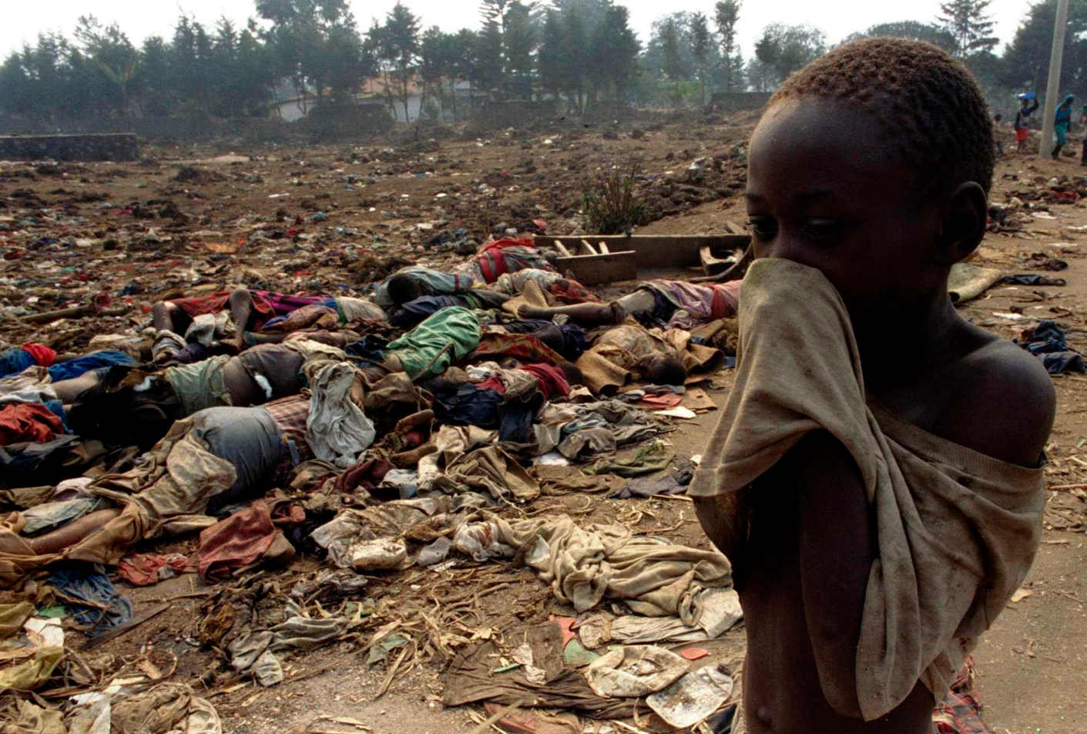
Rwanda 1994
Rwandan genocide
500,000 – 1,000,000 killed in 100 days
Hutu tribes kill Tusti tribes members

Slide 5
Rwanda 1994
Rwandan genocide
500,000 – 1,000,000 killed in 100 days
Hutu tribes kill Tusti tribes members

Slide 6
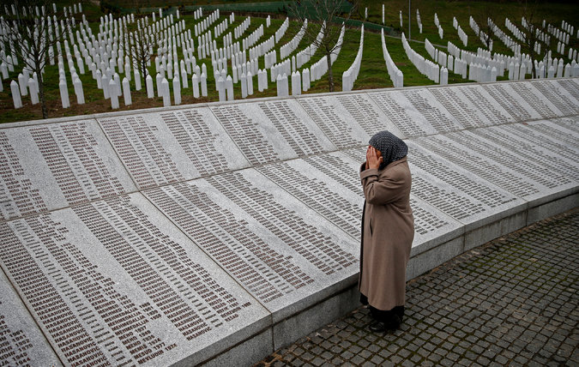
Bosnia 1992-1995
Bosnian genocide
100,000 killed
Serbs kill Bosnian and Croatian civilians

Slide 7
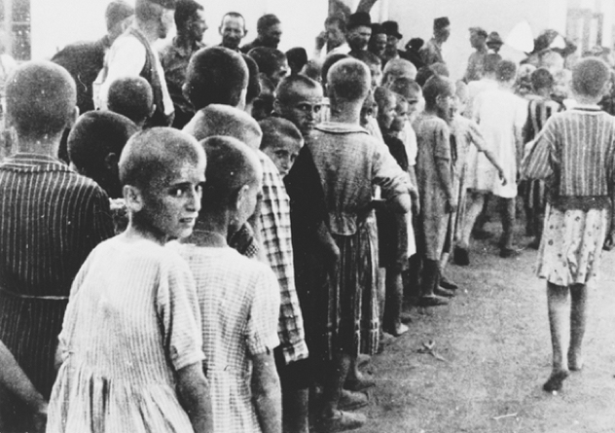
Germany 1941 - 1945
Jewish Holocaust
6,000,000 Jewish killed
Nazi’s killed Jewish population

Slide 8
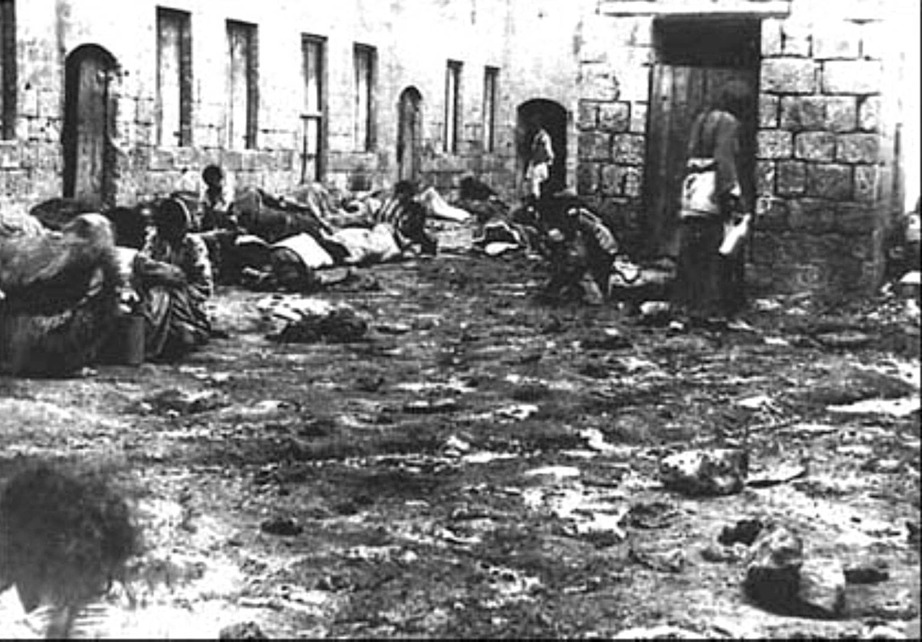
Armenia 1915 - 1917
Armenian Genocide
1,500,000 Armenian Christians killed

Slide 10
Jerusalem

Slide 11
Samaria
Jerusalem

Slide 12
Damascus
Samaria
Jerusalem

Slide 13
Damascus
Samaria
Joppa
Jerusalem

Slide 14
Damascus
Caesarea
Samaria
Joppa
Jerusalem

Slide 15
In Caesarea there lived a Roman army officer named Cornelius, who was a captain of the Italian Regiment. He was a devout, God-fearing man, as was everyone in his household. He gave generously to the poor and prayed regularly to God. One afternoon about three o’clock, he had a vision in which he saw an angel of God coming toward him. “Cornelius!” the angel said.
Cornelius stared at him in terror. “What is it, sir?” he asked the angel.
And the angel replied, “Your prayers and gifts to the poor have been received by God as an offering! Now send some men to Joppa, and summon a man named Simon Peter. He is staying with Simon, a tanner who lives near the seashore.”

Slide 16
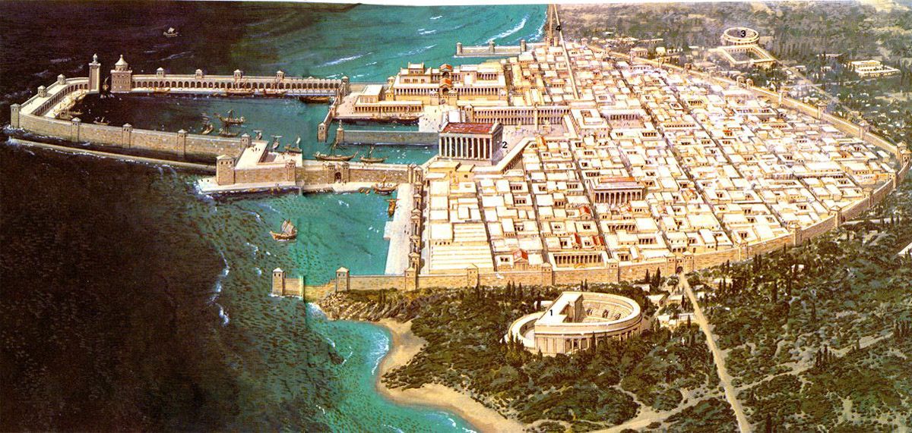

Slide 17
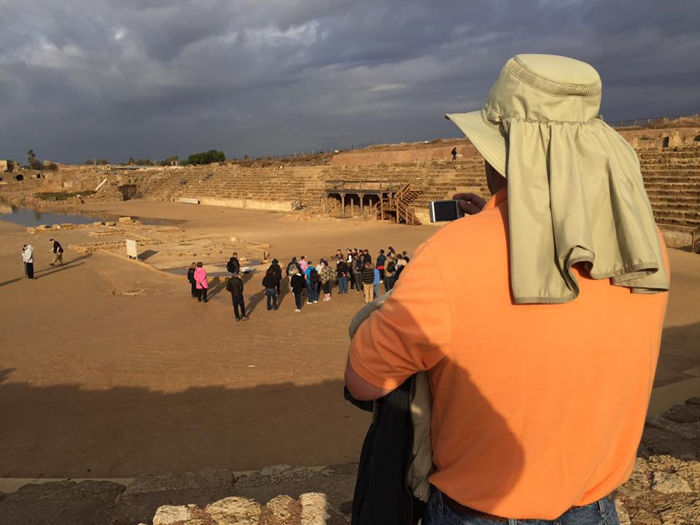

Slide 19
1
UNPACK SOME OF YOUR
BAGGAGE

Slide 20
“No, Lord,” Peter declared.
“I have never eaten anything that our Jewish laws have declared impure and unclean.”
Acts 10:14
new living translation

Slide 22
2
VALUE
ALL LIVES

Slide 23
“Do not call something unclean if God has made it clean.”
Acts 10:15 new living translation

Slide 25
TAKE THE GOSPEL TO
3
EVERYONE

Slide 26
Then Peter replied, “I see very clearly that God shows no favoritism. In every nation he accepts those who fear him and do what is right.”
Acts 10:34-35 new living translation

Slide 27
HEAR THE GOSPEL
BELIEVE IN JESUS
REPENT AND BE BAPTIZED

Slide 29
4
REMEMBER THAT GOD IS
ALWAYS WORKING

Slide 30
Even as Peter was saying these things, the Holy Spirit fell upon all who were listening to the message. The Jewish believers[e] who came with Peter were amazed that the gift of the Holy Spirit had been poured out on the Gentiles, too. For they heard them speaking in other tongues and praising God.
Acts 10:44-46 new living translation

Slide 32
5
MAKE EVERY EFFORT TO BE
UNITED

Slide 33
“a large number of these Gentiles believed…”
Acts 11:21 new living translation

Slide 34
“Always be humble and gentle. Be patient with each other, making allowance for each other’s faults because of your love. Make every effort to keep yourselves united in the Spirit, binding yourselves together with peace.”
Ephesians 4:2-3
Live in harmony with each other. Don’t be too proud to enjoy the company of ordinary people. And don’t think you know it all! Do all that you can to live in peace with everyone.
Romans 12:16, 18
new living translation
new living translation

Slide 35
Among the prophets and teachers of the church
at Antioch of Syria were Barnabas,
Simeon (called “the black man”),
Lucius (from Cyrene),
Manaen (the childhood companion of King Herod Antipas,)
and Saul.
Acts 13:1 new living translation

Slide 37
However, multiculturalism is NOT our primary goal. Our primary goal is the proclamation of the GOSPEL everywhere.

