Slide 2
Book of the TWELVE

Slide 3
MICAH
act justly love mercy walk humbly

Slide 4
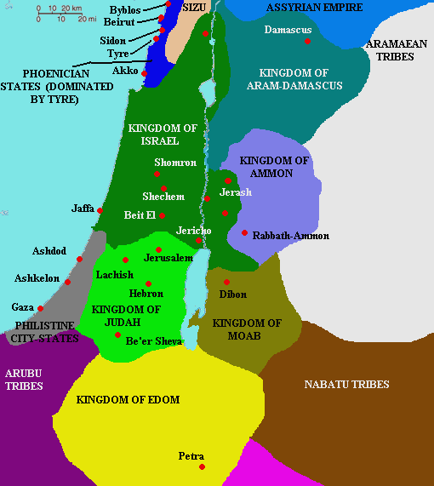

Slide 5
ASSYRIAN EMPIRE
Moresheth

Slide 6
ASSYRIAN EMPIRE
¹⁷ Then some of the wise old men stood and spoke to all the people assembled there. ¹⁸ They said, “Remember when Micah of Moresheth prophesied during the reign of King Hezekiah of Judah. Jeremiah 26:18
Moresheth

Slide 7
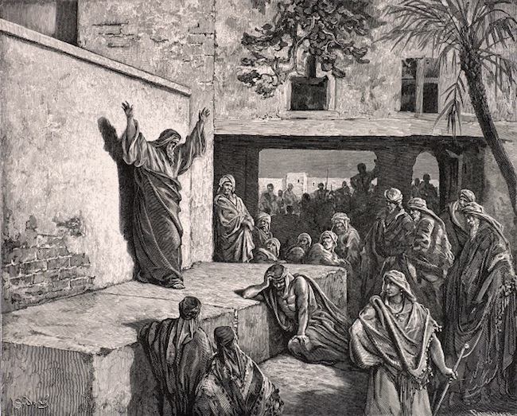

Slide 8
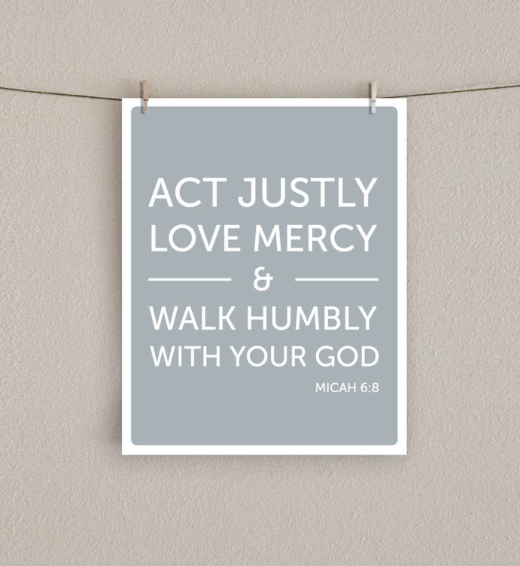

Slide 9
What can we bring to the Lord?
Should we bring him burnt offerings?
Should we bow before God Most High
with offerings of yearling calves?
Should we offer him thousands of rams
and ten thousand rivers of olive oil?
Should we sacrifice our firstborn children to pay for our sins?
Micah 6:6-7

Slide 10
“No, O people, the Lord has told you what is good, and this is what he requires of you:
to do what is right, to love mercy,
and to walk humbly with your God. Micah 6:8

Slide 12
ACT JUSTLY
1
Do what is right
to do what is right, to love mercy,
and to walk humbly with your God. Micah 6:8

Slide 13
Listen to me, you leaders of Israel!
You hate justice and twist all that is right. You are building Jerusalem on a foundation of murder and corruption.
You rulers make decisions based on bribes; you priests teach God’s laws only for a price; you prophets won’t prophesy unless you are paid. Yet all of you claim to depend on the Lord.
Micah 3:9-11

Slide 15
SHOW MERCY
to do what is right, to love mercy,
and to walk humbly with your God. Micah 6:8
2

Slide 16
But you, O Bethlehem Ephrathah,
are only a small village among all the people of Judah. Yet a ruler of Israel,
whose origins are in the distant past,
will come from you on my behalf.
Micah 5:2

Slide 18
WALK HUMBLY
3
to do what is right, to love mercy,
and to walk humbly with your God. Micah 6:8

Slide 20
As for me, I look to the Lord for help.
I wait confidently for God to save me,
and my God will certainly hear me.
Micah 7:7

Slide 21
Though I sit in darkness, the Lord will be my light. I will be patient as the Lord punishes me, for I have sinned against him. But after that, he will take up my case and give me justice for all I have suffered from my enemies. The Lord will bring me into the light, and I will see his righteousness.
Micah 7:8-9

Slide 23
Hang on to Jesus and put God's things first.

