Slide 1
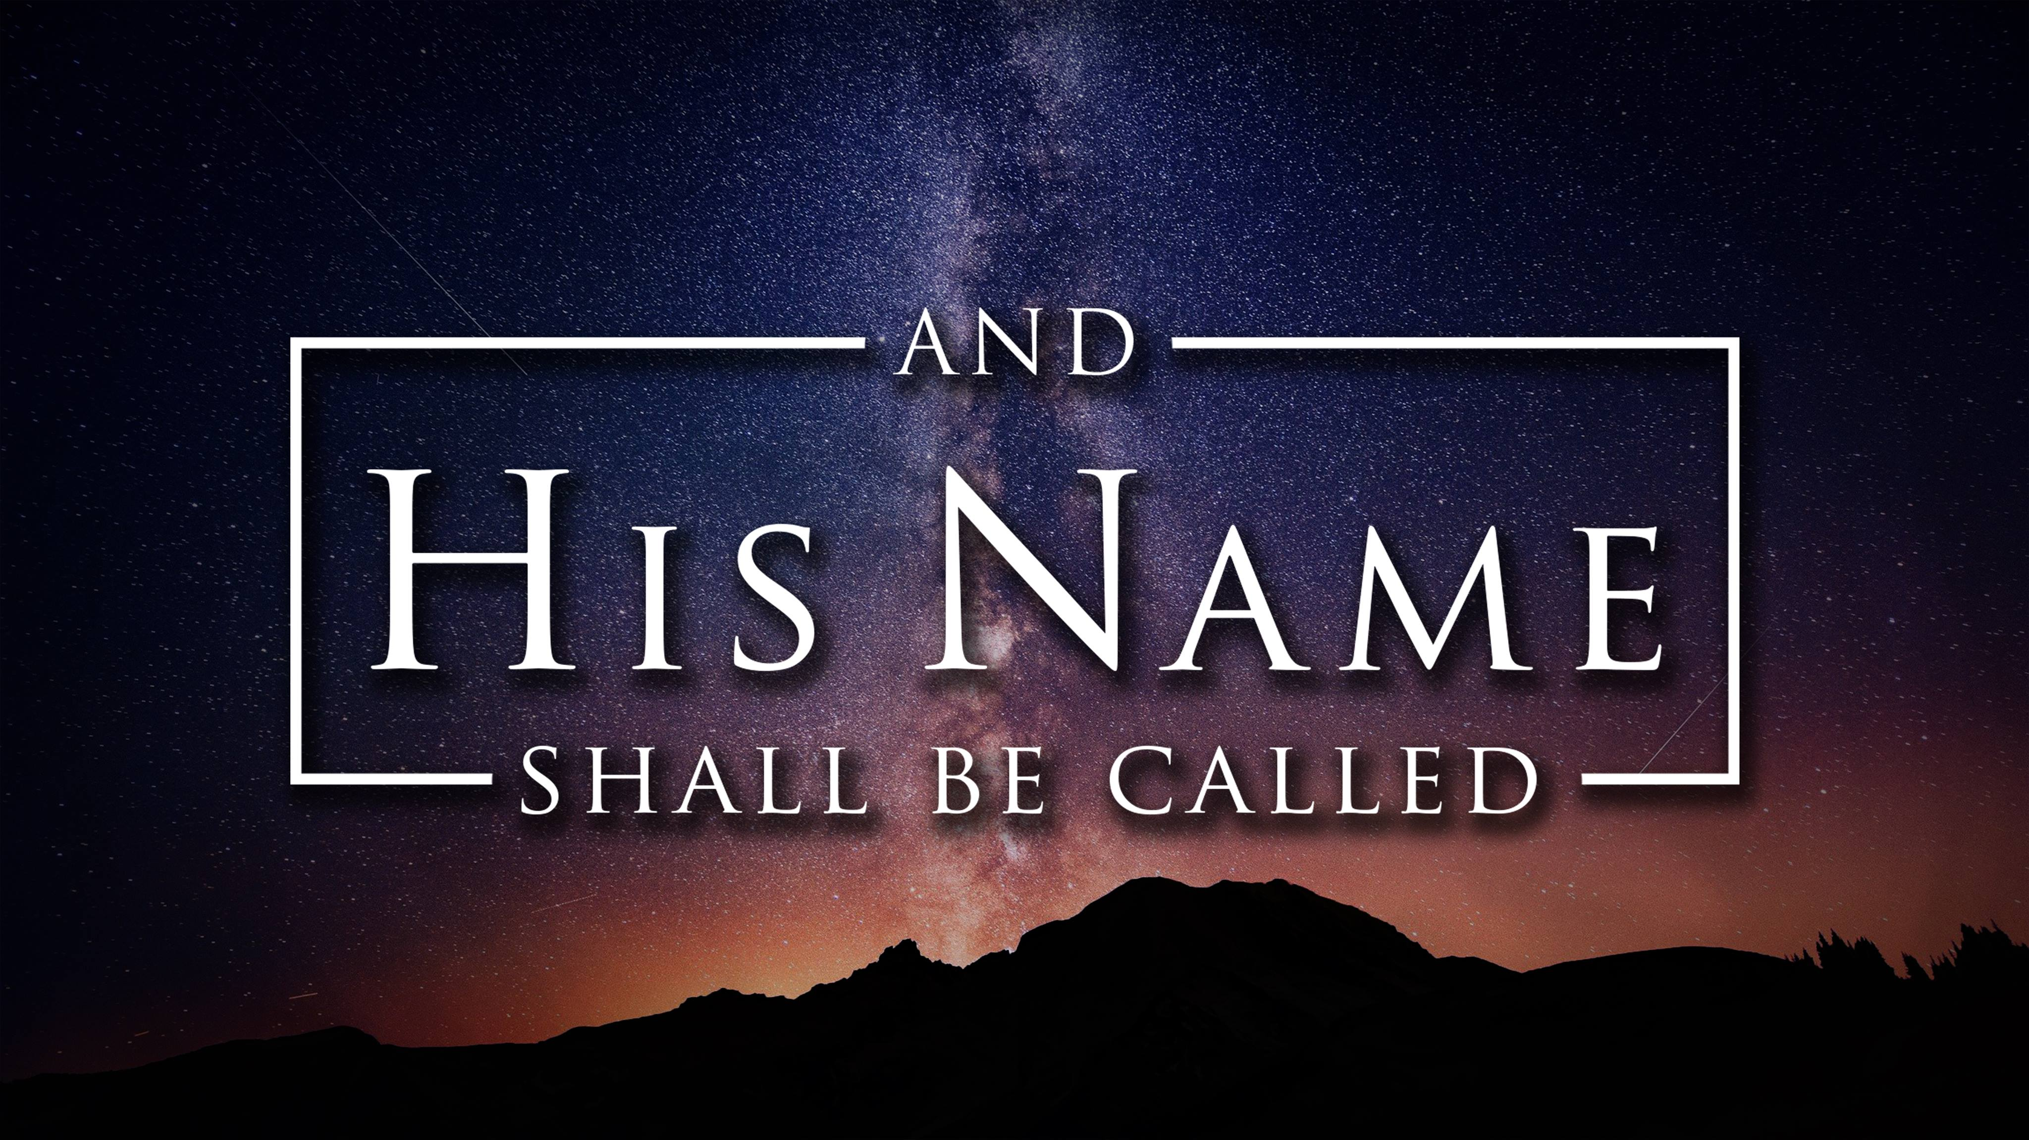

Slide 2
The Savior

Slide 3
That night there were shepherds staying in the fields nearby, guarding their flocks of sheep. Suddenly, an angel of the Lord appeared among them, and the radiance of the Lord’s glory surrounded them. They were terrified, but the angel reassured them.
“Don’t be afraid!” he said. “I bring you good news that will bring great joy to all people. The Savior—yes, the Messiah, the Lord—has been born today in Bethlehem, the city of David! And you will recognize him by this sign: You will find a baby wrapped snugly in strips of cloth, lying in a manger.”
Luke 2:8-12

Slide 4
Suddenly, the angel was joined by a vast host of others—the armies of heaven—praising God and saying,
“Glory to God in highest heaven,
and peace on earth to those with whom God is pleased.”
Luke 2:13-14

Slide 6
1
We need a Savior
“The Savior—yes, the Messiah, the Lord—has been born today in Bethlehem, the city of David.”
Luke 2:11

Slide 7
“No one is righteous not even one .
No one is truly wise; no one is seeking God.
Romans 3:10-11

Slide 8
Since they thought it foolish to acknowledge God, he abandoned them to their foolish thinking and let them do things that should never be done. Their lives became full of every kind of wickedness, sin, greed, hate, envy, murder, quarreling, deception, malicious behavior, and gossip. They are backstabbers, haters of God, insolent, proud, and boastful. They invent new ways of sinning, and they disobey their parents. They refuse to understand, break their promises, are heartless, and have no mercy. They know God’s justice requires that those who do these things deserve to die, yet they do them anyway. Worse yet, they encourage others to do them too.
Romans 1:28-32

Slide 9
"I will take revenge; I will pay them back.
In due time their feet will slip.
Their day of disaster will arrive,
and their destiny will overtake them."
Deuteronomy 32:35

Slide 11
https://www.youtube.com/watch?v=z2-XN_Vq2U4

Slide 13
2
Give Glory to God
Suddenly, the angel was joined by a vast host of others—the armies of heaven—praising God and saying,
“Glory to God in highest heaven…”
Luke 2:13-14

Slide 14
For by him all things were created, in heaven and on earth, visible and invisible, whether thrones or dominions or rulers or authorities—all things were created through him and for him.”
Colossians 1:16

Slide 15
For everything comes from him and exists by his power
and is intended for his glory. All glory to him forever! Amen.
Romans 11:36

Slide 16
When the right time came, God sent him
to buy freedom for us who were slaves to the law,
so that he could adopt us as his very own children.
Galatians 4:4

Slide 17
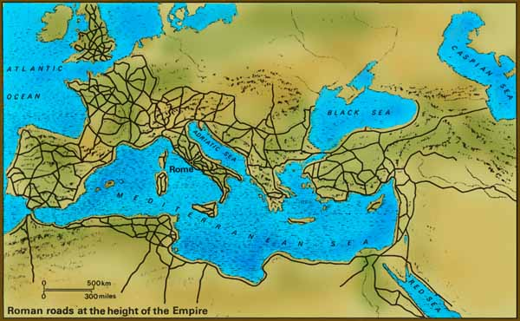
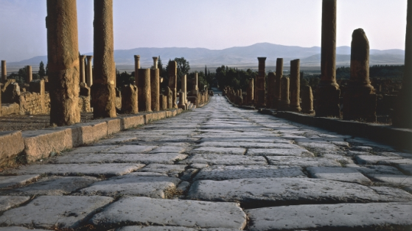
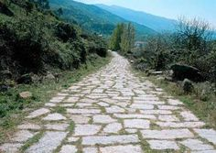

Slide 18
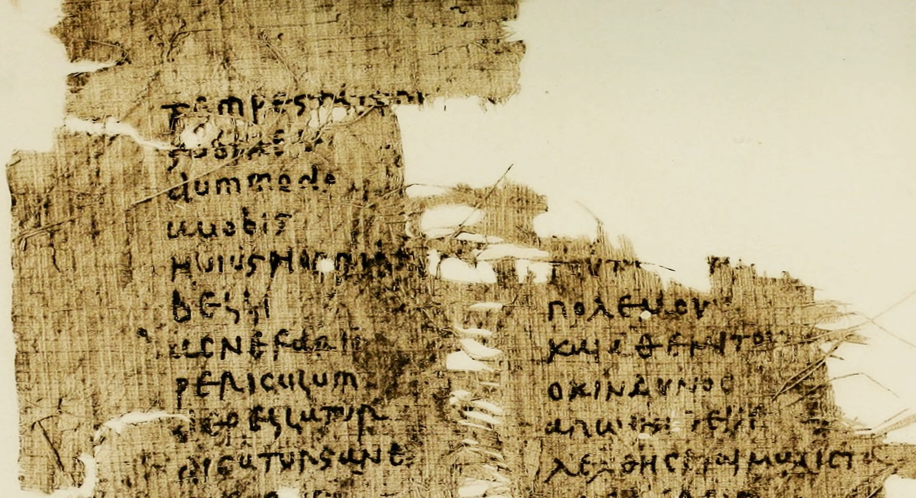

Slide 20
3
Experience the Peace he brings
Glory to God in highest heaven,
and peace on earth to those with whom God is pleased.
Luke 2:14

Slide 21
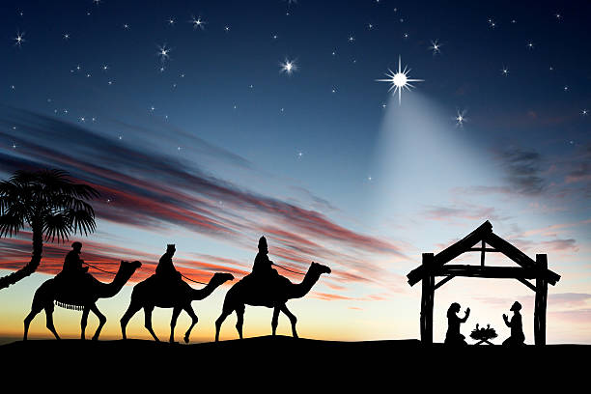


Slide 22
Peace with God
“Therefore, since we have been justified by faith,
we have peace with God through our Lord Jesus Christ.”
Romans 5:1

Slide 23
Peace with God
Peace with Ourselves
“Do not be anxious about anything, but in everything by prayer and supplication with thanksgiving let your requests be made known to God. And the peace of God, which surpasses all understanding, will guard your hearts and your minds in Christ Jesus.”
Philippians 4:6-7

Slide 24
Peace with God
Peace with Ourselves
Peace with Others
“If possible, so far as it depends on you,
live peaceably with all.”
Romans 12:18

Slide 25
“For unto you is born this day in the city of David a Savior,
who is Christ the Lord.”
Luke 2:11

Slide 27
https://www.youtube.com/watch?v=PixWSSeKGtI

