Slide 2
Evil
THE
PROBLEM OF
AND
Suffering
Presented by Dr. Brent Strawsburg

Slide 3
⁴ Or those eighteen who died when the tower in Siloam fell on them—do you think they were more guilty than all the others living in Jerusalem? ⁵ I tell you, no! But unless you repent, you too will all perish.”
LUKE 13:4-5
new international version

Slide 4
LESSON 1

Slide 5
LESSON 1
Don’t Try to Answer
The “Why” Question

Slide 6
DEFENSE 1

Slide 7
DEFENSE 1
Free Will Defense

Slide 8
O Jerusalem, Jerusalem, you who kill the prophets and stone those sent to you, how often I have longed to gather your children together, as a hen gathers her chicks under her wings, but you were not willing.
MATTHEW 23:37
new international version

Slide 9
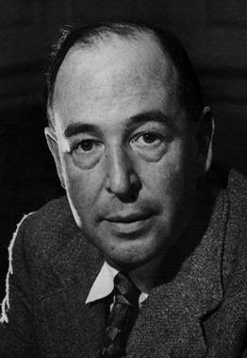
“God created things which had free will. That means creatures which can go wrong or right. Some people think they can imagine a creature which was free but had no possibility of going wrong, but I can't. If a thing is free to be good it's also free to be bad.

Slide 10
And free will is what has made evil possible. Why, then, did God give them free will? Because free will, though it makes evil possible, is also the only thing that makes possible any love or goodness or joy worth having.”
C.S. LEWIS

Slide 11
In a world where God grants people
the dignity of free will--some people
will choose to do evil.

Slide 12
QUESTION 1

Slide 13
QUESTION 1
What About God’s Sovereignty?

Slide 14
²¹ But the hand of him who is going to betray me is with mine on the table. ²² The Son of Man will go as it has been decreed. But woe to that man who betrays him!”
LUKE 22:21-22
new international version

Slide 15
QUESTION 2

Slide 16
QUESTION 2
Isn’t God All-Powerful?

Slide 17
God’s power is constrained in certain logical ways—there are certain things that He can’t do not because He is somehow overwhelmed by the immensity of the task—it’s simply a logical impossibility!

Slide 18
…He can’t make round square

Slide 19
…He can’t make round square
…He can’t make a rock so big that he can’t move it

Slide 20
…He can’t make round square
…He can’t make a rock so big that he can’t move it
…He can’t make two plus two equal five

Slide 21
…He can’t make round square
…He can’t make a rock so big that he can’t move it
…He can’t make two plus two equal five
…He can’t become inconsistent with other qualities that make Him God

Slide 22
…He can’t make round square
…He can’t make a rock so big that he can’t move it
…He can’t make two plus two equal five
…He can’t become inconsistent with other qualities that make Him God
…He can’t prevent people with free will from doing evil!

Slide 23
…He can’t make round square
…He can’t make a rock so big that he can’t move it
…He can’t make two plus two equal five
…He can’t become inconsistent with other qualities that make Him God
…He can’t prevent people with free will from doing evil!
God’s power is constrained
by Who He Is

Slide 24
God is all powerful but if He stopped evil every single time that people wanted Him to intervene—life would be chaotic and unpredictable. Human responsibility would disappear.

Slide 25
DEFENSE 2

Slide 26
DEFENSE 2
Greatest Way Defense

Slide 27
Yet to all who received him, to those who believed in His name, he gave the right to become children of God.
JOHN 1:12
new international version

Slide 28
²⁸ And we know that in all things God works for the good of those who love him, who have been called according to his purpose. ²⁹ For those God foreknew he also predestined to be conformed to the likeness of his Son.
ROMANS 8:28,29
new international version

Slide 29
WHAT ABOUT NATURAL DISASTERS &
OTHER TRADGEDIES?

Slide 30
Certain disasters and tragedies are built into the very fabric of life

Slide 31
EXAMPLE 1
NATURAL PROCESSES
PRODUCE NATURAL EVIL.

Slide 32
EXAMPLE 2
NATURAL EVIL IS INTERTWINED
WITH MORAL EVIL.

Slide 33
EXAMPLE 3
NATURAL EVIL IS GENERATED BY CERTAIN BIOLOGICAL AND GENETIC REALITIES

Slide 34
When Mary reached the place where Jesus was and saw him, she fell at his feet and said, “Lord, if you had been here, my brother would not have died.” When Jesus saw her weeping, and the Jews who had come along with her also weeping, he was deeply moved in spirit and troubled.
JOHN 11:32-33
new international version

Slide 35
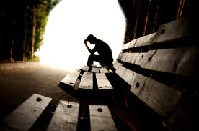
WHY DOESN’T
GOD CARE?

Slide 36
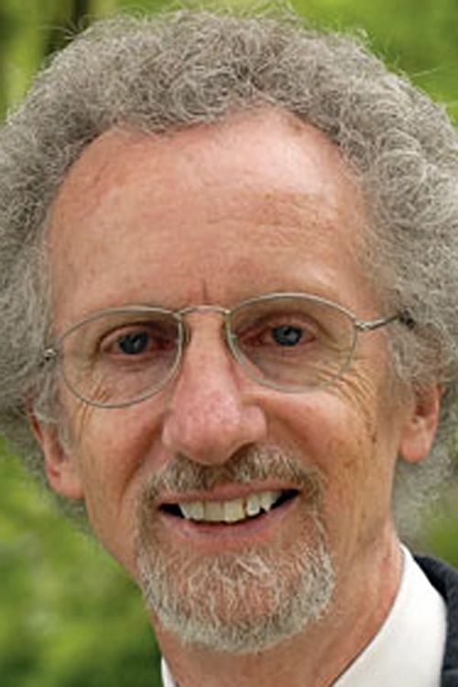
“The image Jesus left with the world, the cross, the most common image in the Christian religion, is proof that God cares about our suffering and pain. He died of it. Today the image is coated with gold and worn around the necks of beautiful girls, a symbol of how far we can stray from the reality of history…

Slide 37
But it stands, unique among all the religions of the world. Many of them have gods. But only one has a God who cared enough to become a man and to die.”
PHILIP YANCEY

Slide 38
Evil
THE
PROBLEM OF
AND
Suffering
Presented by Dr. Brent Strawsburg

