Slide 2
WORDS MATTER

Slide 3
Jerusalem

Slide 4
https://www.youtube.com/watch?v=1rc0dzrC0mA

Slide 5
PRESCRIPTIVE
DESCRIPTIVE?

Slide 7
1
ALWAYS BE READY TO EXPLAIN YOUR FAITH

Slide 8
“Then Peter stepped forward with the eleven other apostles and shouted to the crowd, “Listen carefully, all of you, fellow Jews and residents of Jerusalem! Make no mistake about this. These people are not drunk, as some of you are assuming. Nine o’clock in the morning is much too early for that.”
Acts 2:14-15 new living translation

Slide 9
“But even if you suffer for doing what is right, God will reward you for it. So don’t worry or be afraid of their threats. Instead, you must worship Christ as Lord of your life. And if someone asks about your hope as a believer, always be ready to explain it. But do this in a gentle and respectful way. Keep your conscience clear.”
1 Peter 3:14-16 new living translation

Slide 10
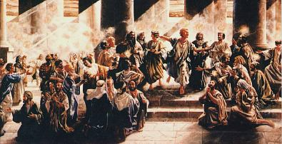
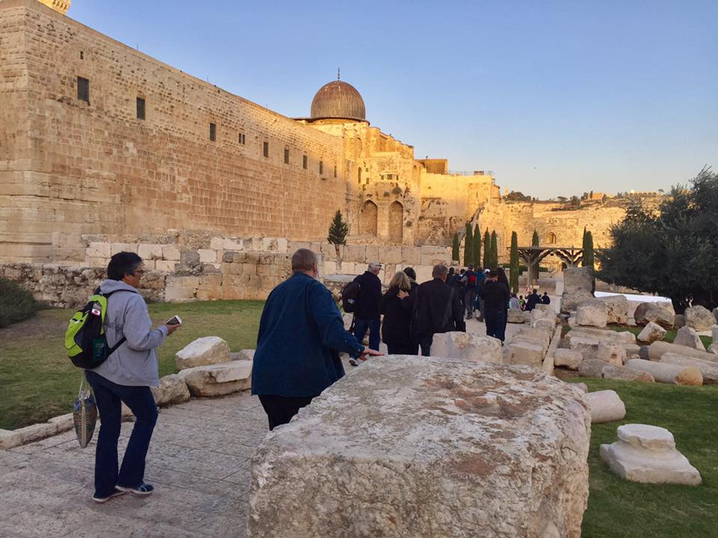

Slide 12
2
EXPLAIN THAT GOD KNOWS

Slide 13
“But God knew what would happen, and his prearranged plan was carried out when Jesus was betrayed. With the help of lawless Gentiles, you nailed him to a cross and killed him. But God released him from the horrors of death and raised him back to life, for death could not keep him in its grip. ”
Acts 2:23-24 new living translation

Slide 14
https://www.youtube.com/watch?v=cKznxJ-dm7I&t=38s

Slide 16
3
EXPLAIN THAT GOD HAS GIVEN US HOPE

Slide 17
“David was looking into the future and speaking of the Messiah’s resurrection. He was saying that God would not leave him among the dead or allow his body to rot in the grave. God raised Jesus from the dead, and we are all witnesses of this.”
Acts 2:31- 32 new living translation

Slide 19
4
MAKE IT CLEAR THAT EVERYONE MUST BELIEVE AND REPENT

Slide 20
“Peter’s words pierced their hearts, and they said to him and to the other apostles, “Brothers, what should we do?”
Peter replied, “Each of you must repent of your sins and turn to God, and be baptized in the name of Jesus Christ for the forgiveness of your sins. Then you will receive the gift of the Holy Spirit. This promise is to you, to your children, and to those far away—all who have been called by the Lord our God.”.”
Acts 2:37-39 new living translation

Slide 21
“The same sun that melts the ice hardens the clay.”
-puritan saying

Slide 22
