Slide 4
The Lord is my shepherd; I shall not want.
He maketh me to lie down in green pastures: he leadeth me beside the still waters.
He restoreth my soul: he leadeth me in the paths of righteousness for his name's sake.
Yea, though I walk through the valley of the shadow of death, I will fear no evil:
for thou art with me;
thy rod and thy staff they comfort me.
Psalm 23:1-4 (KJV)

Slide 5
Thou preparest a table before me
in the presence of mine enemies:
thou anointest my head with oil;
my cup runneth over.
Surely goodness and mercy shall follow me
all the days of my life:
and I will dwell in the house of the Lord for ever.
Psalm 23:5-6 (KJV)

Slide 6
Psalm 23

Slide 7
“You prepare a feast for me in the presence of my enemies. You honor me by anointing my head with oil.” Psalm 23:5

Slide 8
Living in the goodness of God
Living An Anointed Life

Slide 9
Psalm 23

Slide 10
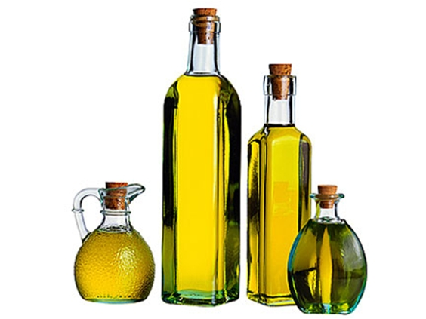

Slide 11
Olive oil comes from the olive fruit. But when you press the fruit real hard, you won’t find oil, only a white sap. Also, the fruit tastes very bitter. To get the oil, the fruit and its seed have to be crushed by a great weight in an olive press. The crushing also removes the bitterness. In the same manner, Jesus was crushed under the burden and weight of our sins, and under the judgment of a holy God. He was crushed to become the anointing oil that heals us today.

Slide 12
Psalm 23

Slide 13
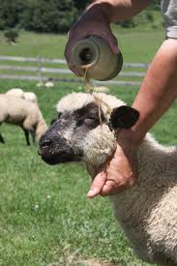
Sheep were anointed
“You anoint my head with oil”
Psalm 23:5

Slide 14
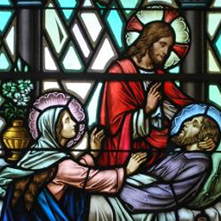
Sick were anointed
"They drove out many demons and anointed many sick people with oil and healed them"
Mark 6:13 (NIV)

Slide 15
Sick were anointed
Are any of you sick? You should call for the elders of the church to come and pray over you, anointing you with oil in the name of the Lord.
James 5:14

Slide 16
Object were anointed
Then Moses took the anointing oil and anointed the Tabernacle and everything in it, making them holy. He sprinkled the oil on the altar seven times, anointing it and all its utensils, as well as the washbasin and its stand, making them holy.
Leviticus 8:10-11

Slide 17
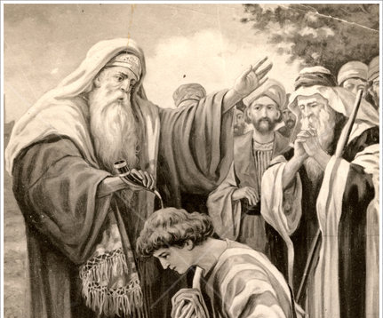
Leaders were anointed
Samuel took the flask of olive oil he had brought and anointed David with the oil. And the Spirit of the Lord came powerfully upon David from that day on.
1 Samuel 16:13

Slide 18
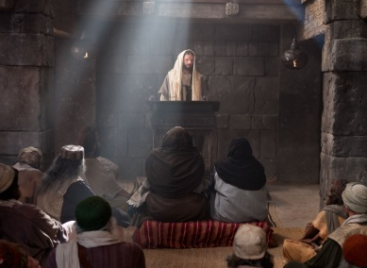
Jesus was anointed
“The Spirit of the Lord is upon me,
for he has anointed me to bring Good News to the poor. He has sent me to proclaim that captives will be released, that the blind will see,
that the oppressed will be set free and that the time of the Lord’s favor has come.
Luke 4:17-19

Slide 19
Believers are anointed
And it is God who establishes us with you in Christ, and has anointed us,
and who has also put his seal on us and given us
his Spirit in our hearts as a guarantee.
2 Corinthians 1:21-22 (ESV)

Slide 20
Psalm 23

Slide 21
GOD ANOINTED US TO DO GOOD THINGS
1
For we are God’s masterpiece. He has created us anew in Christ Jesus, so we can do the good things he planned for us long ago.
Ephesians 2:10

Slide 22
Psalm 23

Slide 23
GOD’S ANOINTING EMPOWERS US
2
“You will receive my power when my Holy Spirit comes on you; and you will be my witnesses...to the ends of the earth."
Acts 1:8

Slide 24
GOD’S ANOINTING EMPOWERS US
2
This is why I remind you to fan into flames the spiritual gift God gave you when I laid my hands on you. For God has not given us a spirit of fear and timidity, but of power, love, and self-discipline.
2 Timothy 1:6-7

Slide 25
GOD’S ANOINTING EMPOWERS US
2
The members of the council were amazed when they saw the boldness of Peter and John, for they could see that they were ordinary men with no special training in the Scriptures. They also recognized them as men who had been with Jesus. Acts 3:13

Slide 26
Psalm 23

Slide 27
GOD’S ANOINTING IS GIVEN TO BLESS OTHERS
3
“God anointed Jesus with the Holy Spirit’s power, and he went around doing good and healing people who were beaten down by devil.”
Acts 10:38

Slide 28
GOD’S ANOINTING IS GIVEN TO BLESS OTHERS
3
God has given each of you a gift from his great variety of spiritual gifts. Use them well to serve one another.
1 Peter 4:10

Slide 29
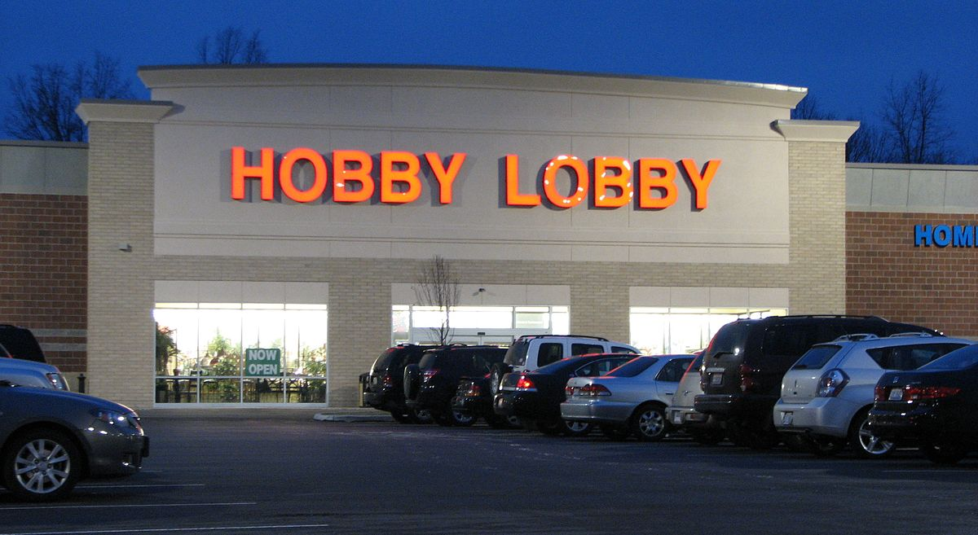
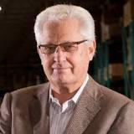
“… everyone wants to receive a miracle, but no one wants to be in a position to receive one. So it is with learning the joy of giving. We want to experience the joy without taking the step of faith to get there.” -Steve Green President, Hobby Lobby

Slide 30
Psalm 23

Slide 31
OUR RESPONSIBILITY

Slide 32
LISTEN TO THE HOLY SPIRIT
1
But when the Father sends the Advocate as my representative—that is, the Holy Spirit—he will teach you everything and will remind you of everything I have told you.
John 14:26

Slide 33
DON’T GRIEVE THE HOLY SPIRIT
2
And do not grieve the Holy Spirit of God, with whom you were sealed for the day of redemption.
Ephesians 4:30 (NIV)

Slide 34
DON’T QUENCH THE HOLY SPIRIT
3
See that no one repays anyone evil for evil, but always seek to do good to one another and to everyone. Rejoice always, pray without ceasing, give thanks in all circumstances; for this is the will of God in Christ Jesus for you. Do not quench the Spirit. 1 Thessalonians 5:15-19 (ESV)

Slide 35
PRAY TO BE FILLED
4
Do not get drunk on wine, which leads to debauchery. Instead, be filled with the Spirit, speaking to one another with psalms, hymns, and songs from the Spirit. Sing and make music from your heart to the Lord, always giving thanks to God the Father for everything, in the name of our Lord Jesus Christ. Ephesians 5:18-20

Slide 37
You’ve been anointed for a specific purpose in furthering God’s Kingdom.

