Slide 2
INFALLIBLE
PROOFS

Slide 3
Jerusalem

Slide 4
During the forty days after he suffered and died, he appeared to the apostles from time to time, and he proved to them in many ways that he was actually alive. And he talked to them about the Kingdom of God.
Acts 1:4 new living translation

Slide 5
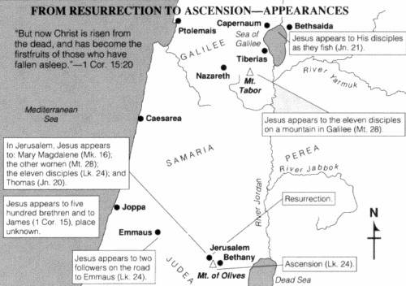

Slide 7
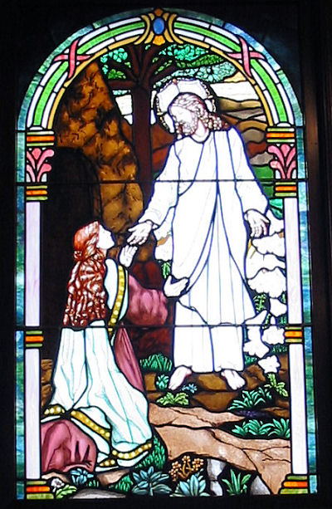
MARY MAGDALENE
1

Slide 8
“Mary!” Jesus said. She turned to him and cried out, “Rabboni!” (which is Hebrew for “Teacher”).
“Don’t cling to me,” Jesus said, “for I haven’t yet ascended to the Father. But go find my brothers and tell them, ‘I am ascending to my Father and your Father, to my God and your God.’”
John 20: 16-17 new living translation

Slide 10
A NEW LIFE
Anyone who belongs to Christ has become a new person. The old life is gone; a new life has begun!
2 Corinthians 5:17
new living translation

Slide 12
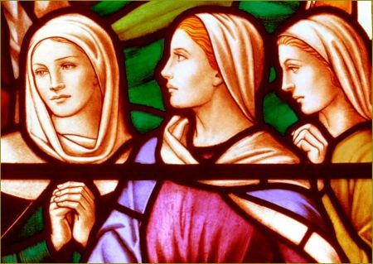
OTHER WOMEN
2

Slide 13
“And as they went, Jesus met them and greeted them. And they ran to him, grasped his feet, and worshiped him. Then Jesus said to them, “Don’t be afraid! Go tell my brothers to leave for Galilee, and they will see me there.”
Matthew 28:9-11
new living translation

Slide 15
HONOR AND RESPECT
In the same way, you husbands must give honor to your wives. Treat your wife with understanding as you live together. She may be weaker than you are, but she is your equal partner in God’s gift of new life. Treat her as you should so your prayers will not be hindered.
1 Peter 3:7
new living translation

Slide 17
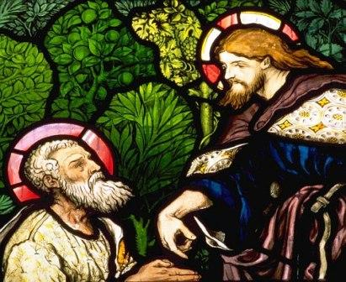
PETER
3

Slide 18
“He appeared to Peter.”
Luke 24:34
new living translation
“He was seen by Peter…”
1 Corinthians 15:3
new living translation

Slide 20
FORGIVENESS
Instead, be kind to each other, tenderhearted, forgiving one another, just as God through Christ has forgiven you.
Ephesians 4:32
new living translation

Slide 22
ROAD TO EMMAUS
4

Slide 23
As they walked along they were talking about everything that had happened. As they talked and discussed these things, Jesus himself suddenly came and began walking with them. But God kept them from recognizing him.
Luke 24:14-16
new living translation

Slide 25
HOPE
“Didn’t our hearts burn within us as he talked with us on the road and explained the Scriptures to us?”
Luke 24:32
new living translation
…and Christ Jesus, who gives us hope.
1 Timothy 1:11
new living translation

Slide 27
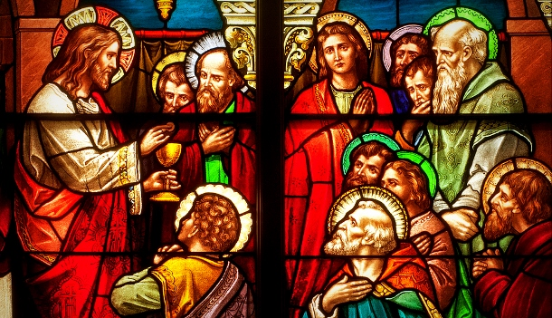
BEHIND LOCKED DOORS
5

Slide 28
And just as they were telling about it, Jesus himself was suddenly standing there among them. “Peace be with you,” he said. But the whole group was startled and frightened, thinking they were seeing a ghost!
Luke 24:36-37
new living translation

Slide 30
BOLDNESS
The members of the council were amazed when they saw the boldness of Peter and John, for they could see that they were ordinary men with no special training in the Scriptures. They also recognized them as men who had been with Jesus.
Acts 4:13
new living translation

Slide 32
DISCIPLES AND THOMAS
6

Slide 33
Eight days later the disciples were together again, and this time Thomas was with them. The doors were locked; but suddenly, as before, Jesus was standing among them. “Peace be with you,” he said. Then he said to Thomas, “Put your finger here, and look at my hands. Put your hand into the wound in my side.
Don’t be faithless any longer. Believe!”
John 20:26-27
new living translation

Slide 34
“My Lord and my God!” Thomas exclaimed.
Then Jesus told him, “You believe because you have seen me. Blessed are those who believe without seeing me.”
John 20:28-29
new living translation

Slide 36
FAITH
And let us run with endurance the race God has set before us. We do this by keeping our eyes on Jesus, the champion who initiates and perfects our faith. Hebrews 12:1-2
Hebrews 12:1-2
new living translation

Slide 38
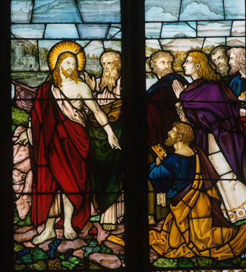
SEA OF GALILEE
7

Slide 39
Then Jesus served them the bread and the fish.
This was the third time Jesus had appeared to his disciples since he had been raised from the dead.
John 21:13-14
new living translation

Slide 41
HELP OTHERS GROW
Like newborn babies, you must crave pure spiritual milk so that you will grow into a full experience of salvation.
1 Peter 2:2
new living translation

Slide 43
MOUNTAIN IN GALILEE
8

Slide 44
Then the eleven disciples left for Galilee, going to the mountain where Jesus had told them to go. When they saw him, they worshiped him—but some of them doubted!
Matthew 28:16-17
new living translation

Slide 45
After that, he was seen by more than 500 of his followers at one time, most of whom are still alive, though some have died.
1 Corinthians 15:6
new living translation

Slide 47
REMEMBER
Do this in remembrance of me.
Luke 22:19 new living translation
For our Lord Jesus Christ has shown me that I must soon leave this earthly life, so I will work hard to make sure you always remember these things after I am gone.
2 Peter 1:14-16 new living translation

Slide 49
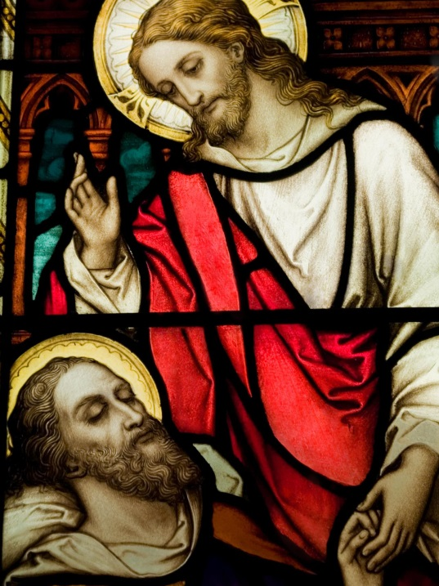
JAMES
9

Slide 50
Then he was seen by James…
1 Corinthians 15:7
new living translation

Slide 52
STEP IT UP
When they had finished, James stood and said, “Brothers, listen to me...”
“And so my judgment is that we should not make it difficult for the Gentiles who are turning to God.”
Acts 15:13 and 19
new living translation

Slide 54
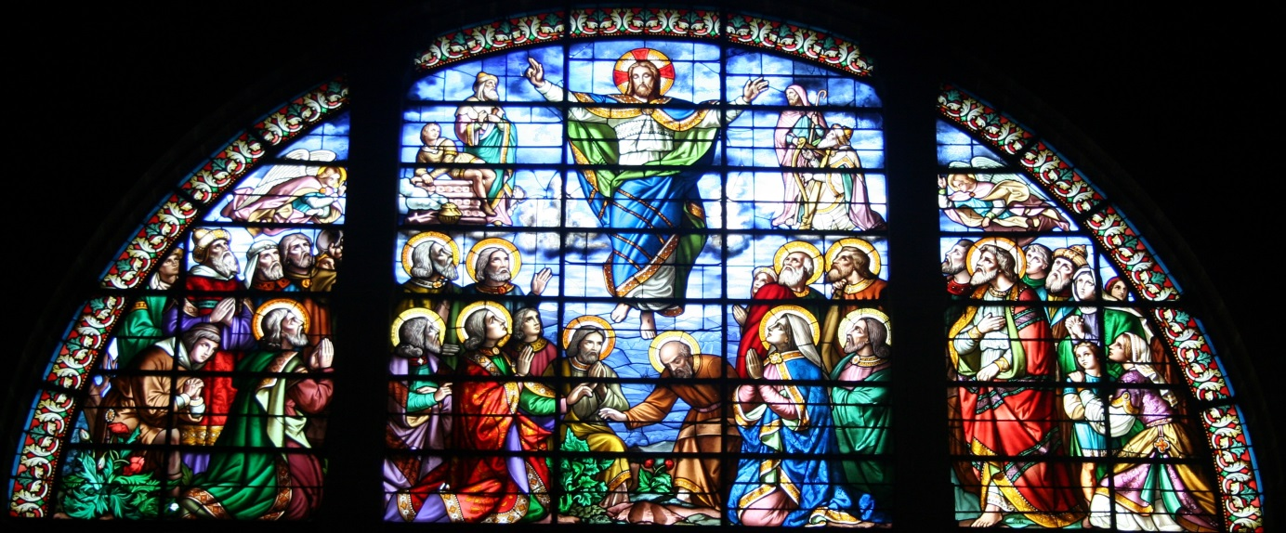
MOUNT OF OLIVES
10

Slide 55
PURPOSE
Go and make disciples of all the nations, baptizing them in the name of the Father and the Son and the Holy Spirit. Teach these new disciples to obey all the commands I have given you. And be sure of this: I am with you always, even to the end of the age.”
Matthew 28:19-20
new living translation

Slide 56
So when the apostles were with Jesus, they kept asking him, “Lord, has the time come for you to free Israel and restore our kingdom?”
He replied, “The Father alone has the authority to set those dates and times, and they are not for you to know. But you will receive power when the Holy Spirit comes upon you. And you will be my witnesses, telling people about me everywhere—in Jerusalem, throughout Judea, in Samaria, and to the ends of the earth.”
Acts 1:6-8
new living translation

Slide 57
After saying this, he was taken up into a cloud while they were watching, and they could no longer see him. As they strained to see him rising into heaven, two white-robed men suddenly stood among them. “Men of Galilee,” they said, “why are you standing here staring into heaven? Jesus has been taken from you into heaven, but someday he will return from heaven in the same way you saw him go!”
Acts 1:9-11
new living translation

Slide 58
On that day his feet will stand on the Mount of Olives, east of Jerusalem. And the Mount of Olives will split apart, making a wide valley running from east to west. Half the mountain will move toward the north and half toward the south.
Zechariah 14:4
new living translation

Slide 60
https://www.youtube.com/watch?v=9h0zTWHQGP4

