Slide 3
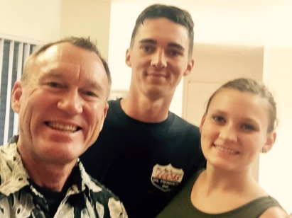
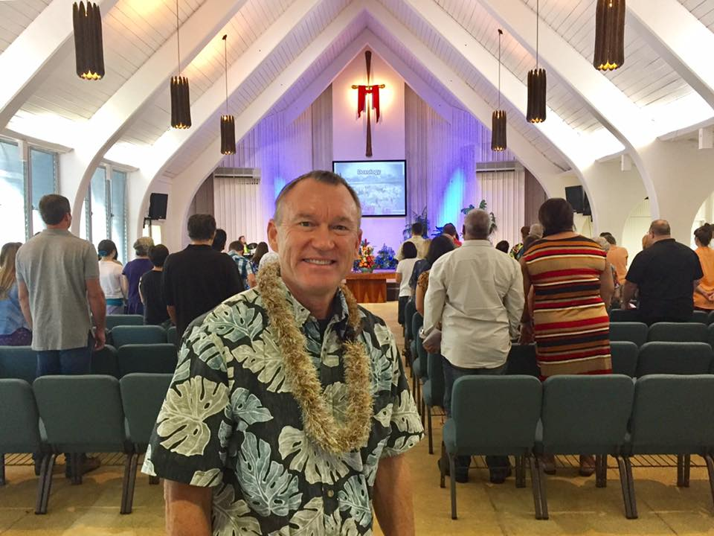
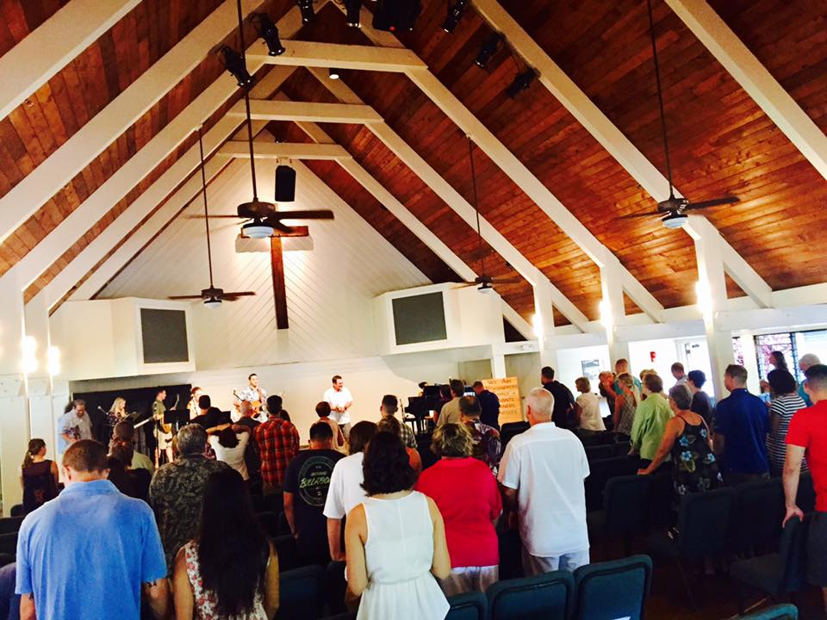
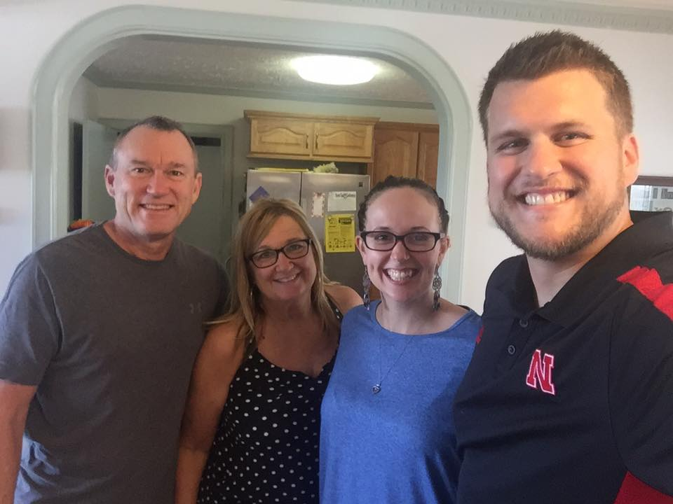
Victory Aiea Church Pastor Dane and Liz
Jasmine and Conner
Daybreak Church
International Church
Pastor Scott and Fiona

Slide 4
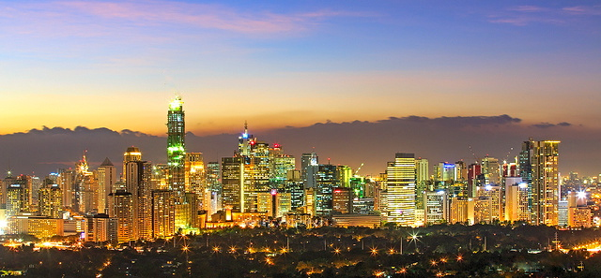
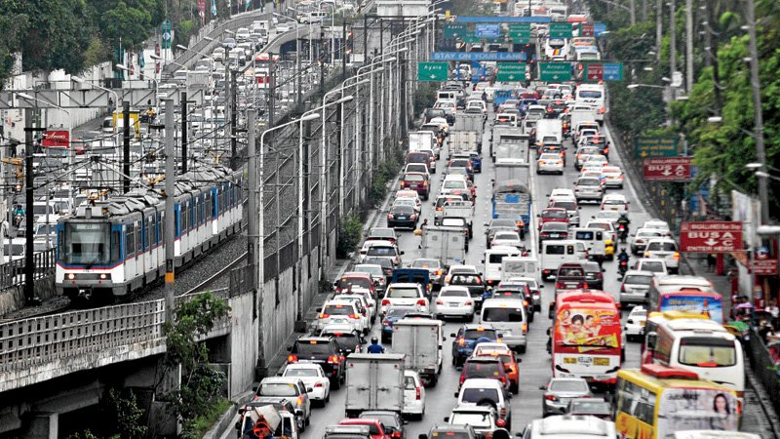

Slide 5
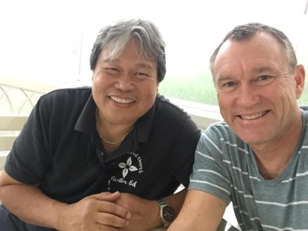
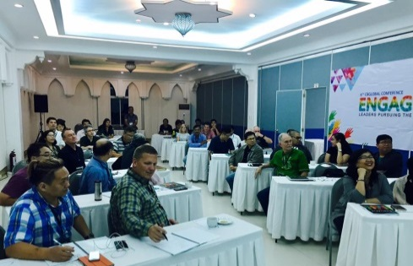
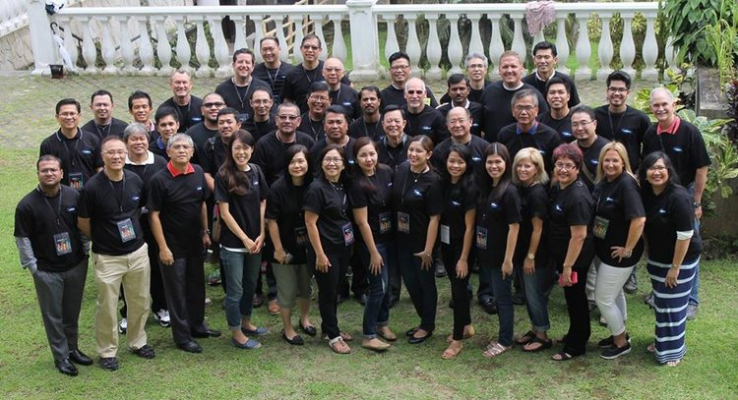
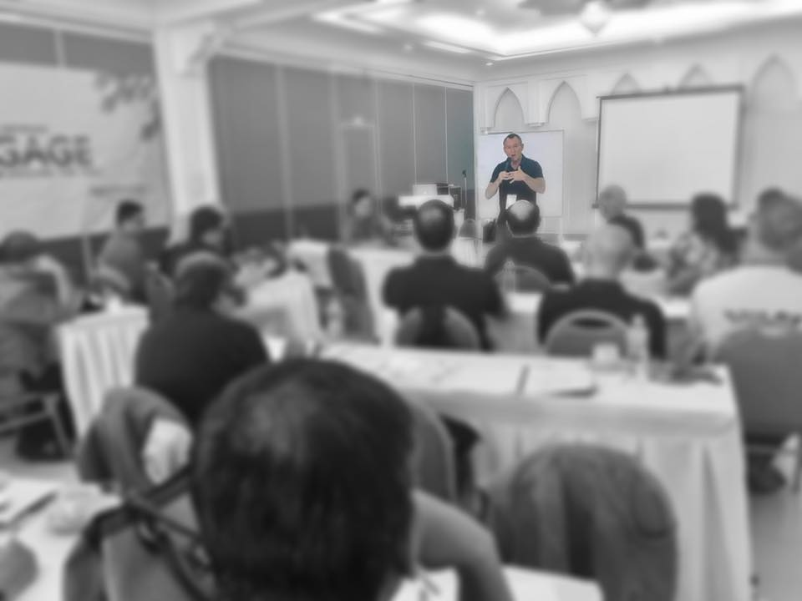
Board of Directors

Slide 6
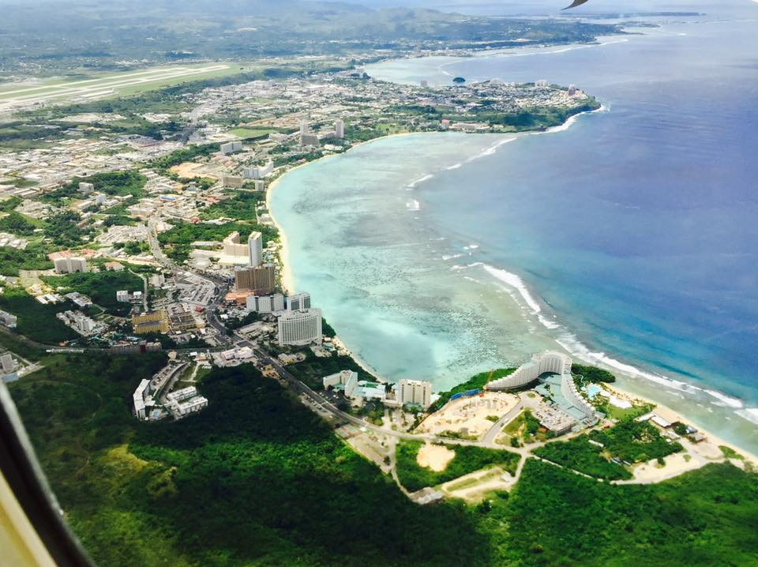

Slide 7
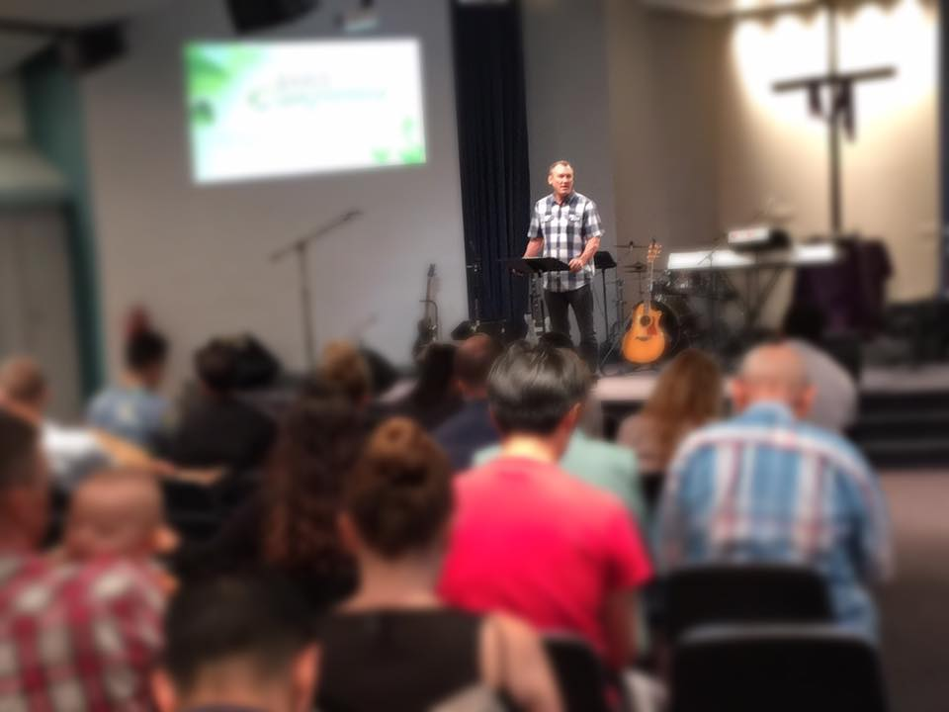
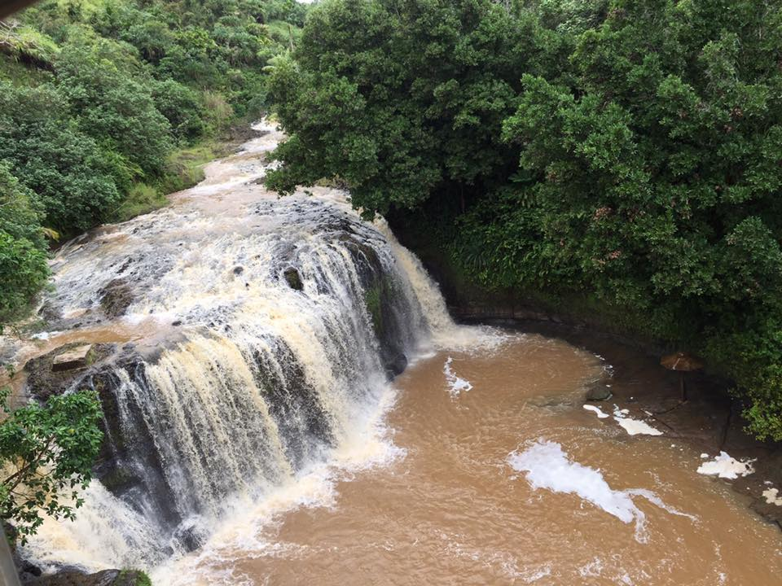
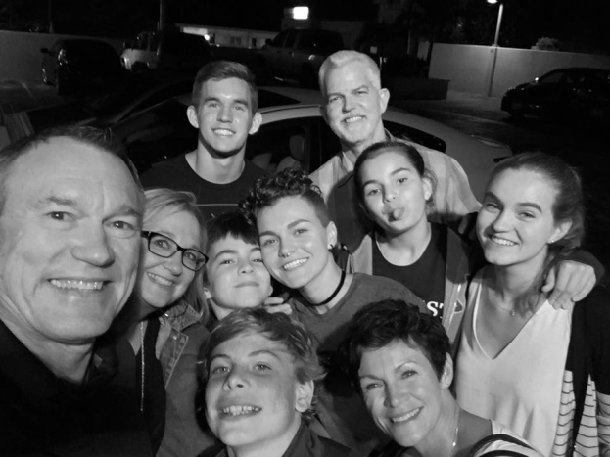
Church Leaders
Bayview Church

Slide 10
Worship Christ as Lord of your life. And if someone asks about your hope as a believer, always be ready to explain it.
1 Peter 3:15
NEW LIVING TRANSLATION

Slide 11
Proclaiming the Gospel
TO A ROMAN CATHOLIC

Slide 12
“Go into all the world and proclaim the gospel to the whole creation.”
Mark 16:15
ENGLISH STANDARD VERSION

Slide 13
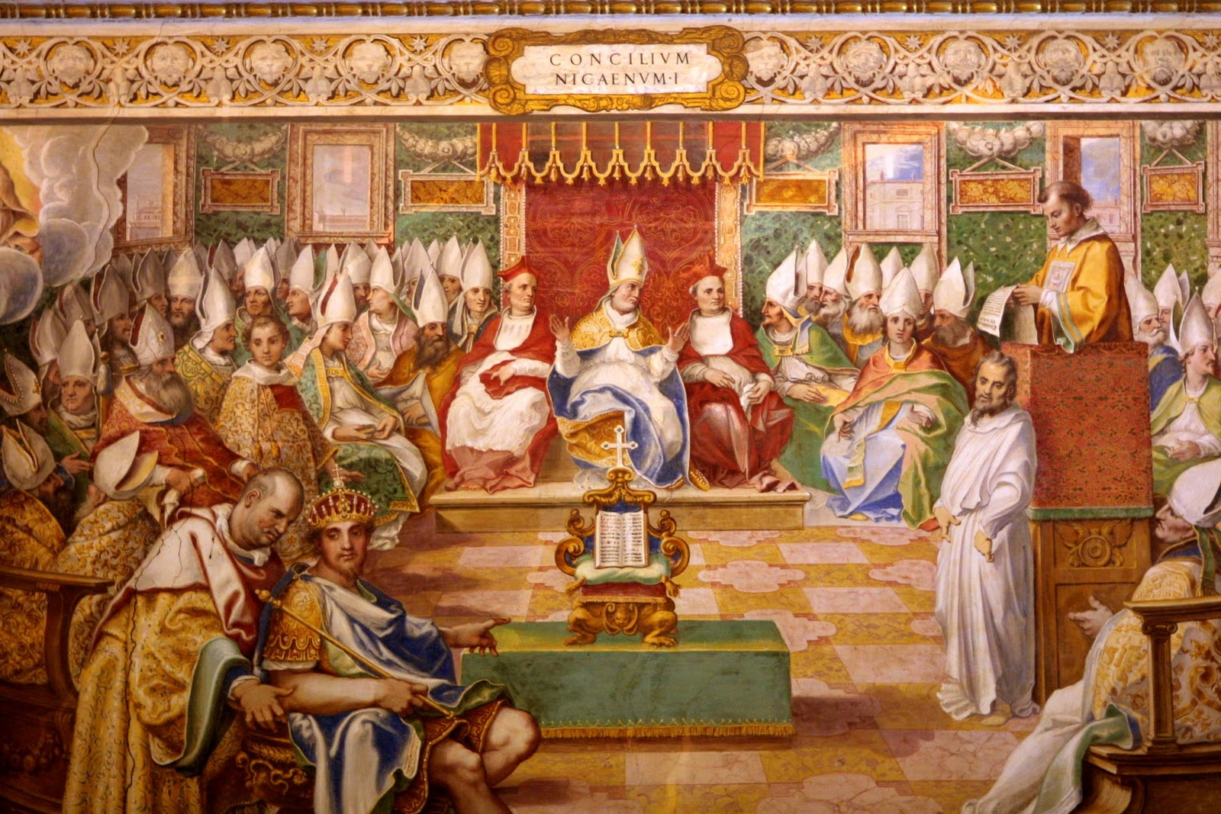
Council of Nicea AD325

Slide 14
We believe in one God, the Father almighty, maker of heaven and earth, of all things visible and invisible.
And in one Lord Jesus Christ, the only Son of God, begotten from the Father before all ages, God from God, Light from Light, true God from true God, begotten, not made; of the same essence as the Father.
Nicene Creed

Slide 15
Through him all things were made. For us and for our salvation he came down from heaven; he became incarnate by the Holy Spirit and the virgin Mary, and was made human. He was crucified for us under Pontius Pilate; he suffered and was buried. The third day he rose again, according to the Scriptures. He ascended to heaven and is seated at the right hand of the Father.

Slide 16
He will come again with glory to judge the living and the dead. His kingdom will never end.
And we believe in the Holy Spirit, the Lord, the giver of life. He proceeds from the Father and the Son, and with the Father and the Son is worshiped and glorified. He spoke through the prophets. We believe in one holy universal and apostolic church. We affirm one baptism for the forgiveness of sins. We look forward to the resurrection of the dead, and to life in the world to come. Amen.

Slide 18
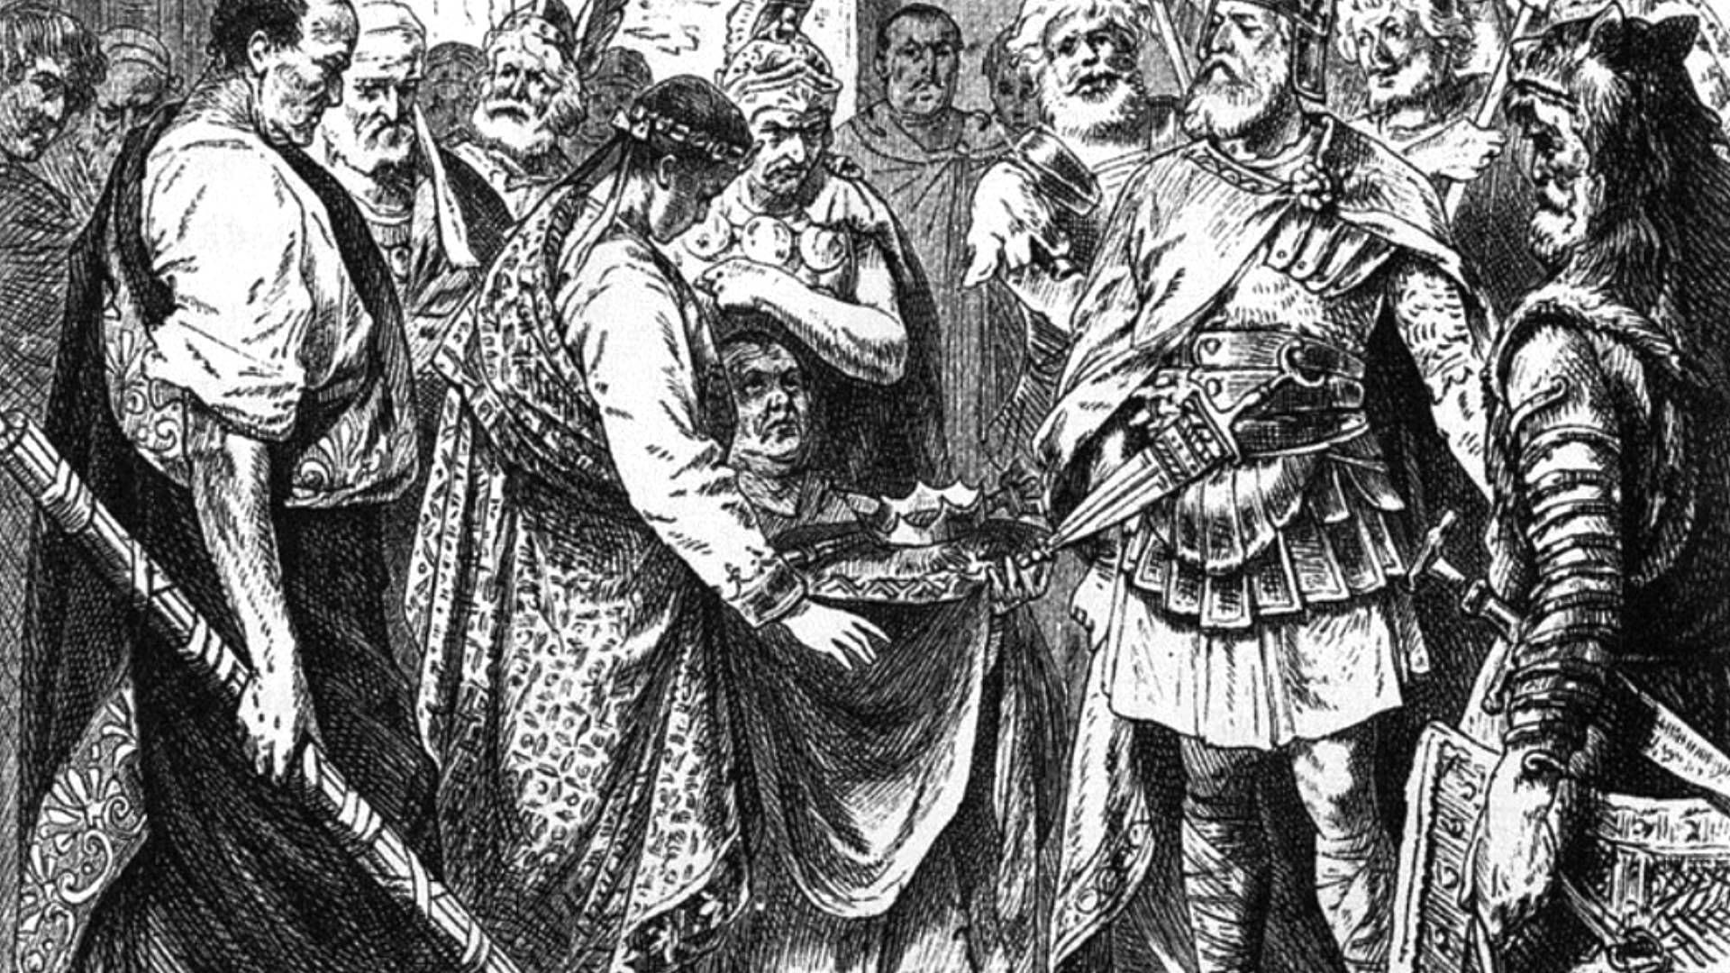
Dark Ages

Slide 20
Proclaiming the Gospel
TO A ROMAN CATHOLIC

Slide 21
Remember words have
DIFFERENT MEANINGS

Slide 22
This false teaching is like a little yeast that spreads through the whole batch of dough!
Galatians 5:9
NEW LIVING TRANSLATION

Slide 23
7 Sacraments
Baptism – receiving God’s grace Communion – receiving Jesus Confirmation – filling of the Holy Spirit
Penance – forgiveness of sins
Last Rites – free from sin
Marriage –special grace Holy Order –laying of hands/outpouring of the spirit

Slide 25
We can
APPROACH GOD OURSELVES

Slide 26
So then, since we have a great High Priest who has entered heaven, Jesus the Son of God, let us hold firmly to what we believe. This High Priest of ours understands our weaknesses, for he faced all of the same testings we do, yet he did not sin. So let us come boldly to the throne of our gracious God. There we will receive his mercy, and we will find grace to help us when we need it most.
Hebrews 4:14-16
NEW LIVING TRANSLATION

Slide 27
sola scriptura—Scripture alone
sola fide—faith alone
sola gratia—grace alone
sola Christus—Christ alone
sola Deo gloria—for the glory of God alone

Slide 28
There is one God and one Mediator who can reconcile God and humanity—the man Christ Jesus.
1 Timothy 2:5
NEW LIVING TRANSLATION

Slide 30
“He’s just the carpenter’s son, and we know Mary, his mother, and his brothers—James, Joseph, Simon, and Judas. All his sisters live right here among us. Where did he learn all these things?”
Matthew 13:55-56
NEW LIVING TRANSLATION

Slide 32
We are justified
BY FAITH IN JESUS ALONE

Slide 33
We are made right with God by placing our faith in Jesus Christ. And this is true for everyone who believes, no matter who we are.
Romans 3:22
NEW LIVING TRANSLATION

Slide 34
God saved you by his grace when you believed. And you can’t take credit for this; it is a gift from God. Salvation is not a reward for the good things we have done, so none of us can boast about it.
Ephesians 2:8-9
NEW LIVING TRANSLATION

Slide 35
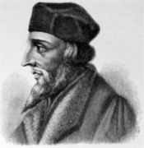
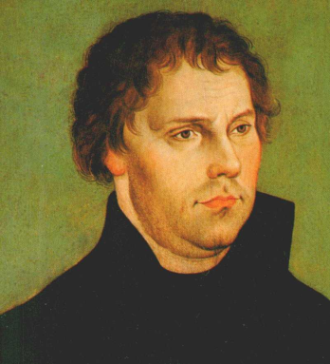
John Wycliffe England
Jan Hus Czech
Martin Luther Germany

