Slide 1


Slide 2
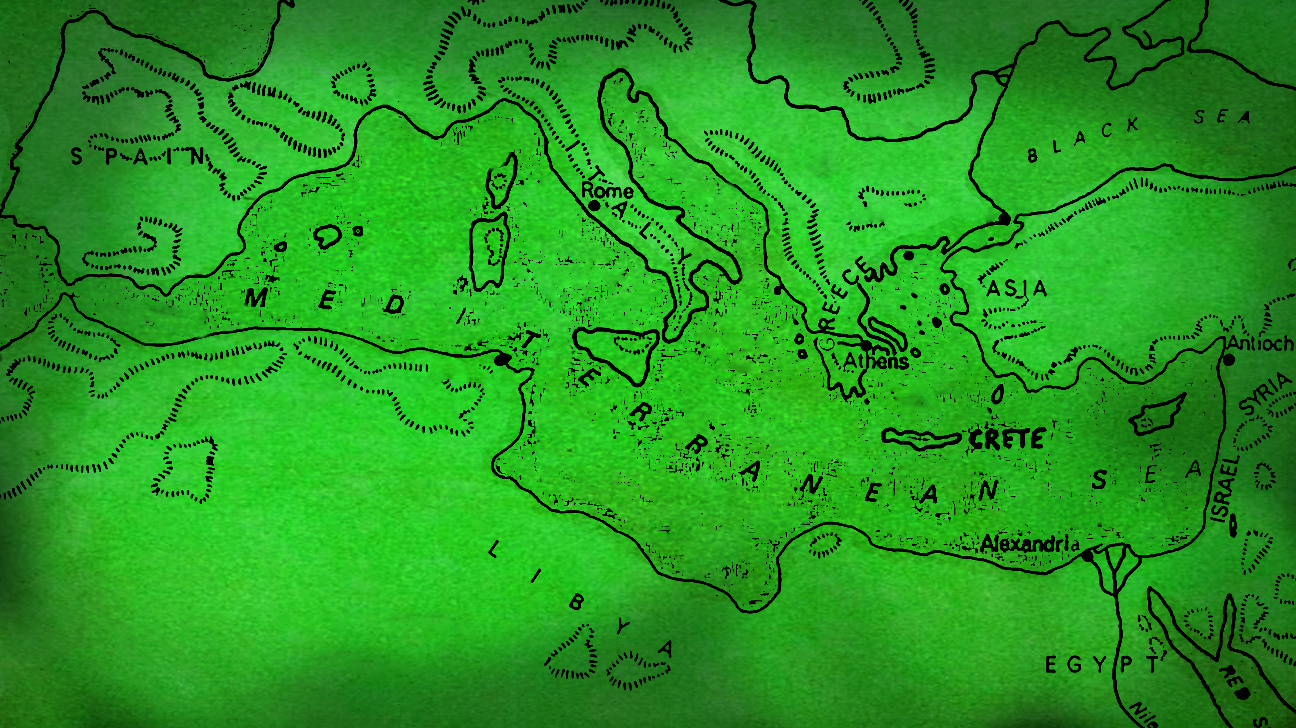
I CAN
DO THAT

Slide 4
Video:
First missionary journey
https://www.youtube.com/watch?v=FiEFdoHTGlY

Slide 5
RECOGNIZE
1
GOD’S VOICE

Slide 6
“the Holy Spirit said…..”
Acts 13:2
new living translation

Slide 7
Does it Agree with the Bible?

Slide 8
Does it Agree with the Bible?
Does it Make Me More Like Christ?

Slide 9
Does it Agree with the Bible?
Does it Make Me More Like Christ?
Do other Christians Confirm it?

Slide 10
Does it Agree with the Bible?
Does it Make Me More Like Christ?
Do other Christians Confirm it?
Are Circumstances somewhat favorable?

Slide 11
Does it Agree with the Bible?
Does it Make Me More Like Christ?
Do other Christians Confirm it?
Are Circumstances somewhat favorable?
Do You Sense God’s Peace about it?

Slide 13
SHARE
2
THE GOOD NEWS

Slide 14
“After preaching the Good News…”
Acts 13:21
new living translation

Slide 15
“We are here to proclaim that through this man Jesus there is forgiveness for your sins!
Everyone who believes in him is made right in God’s sight—something the law of Moses could never do.”
Acts 13:38-39
new living translation

Slide 16
https://www.youtube.com/watch?v=DTv5KEcyGQw

Slide 18
STRENGTHEN
3
OTHER BELIEVERS

Slide 19
“…where they strengthened the believers.
They encouraged them to continue in the faith,
reminding them that we must suffer many hardships
to enter the Kingdom of God.
Acts 14:22
new living translation

Slide 20
“…where they strengthened the believers.
They encouraged them to continue in the faith,
reminding them that we must suffer many hardships
to enter the Kingdom of God.
Acts 14:22
new living translation

Slide 22

JOIN
4
A BIBLE BELIEVING,

Slide 23
“Paul and Barnabas also
appointed elders in every church.”
Acts 14:23
new living translation

Slide 25
TRUST
5
IN THE GOD OF THE UNIVERSE

Slide 26
Paul and Barnabas also appointed elders in every church.
With prayer and fasting,
they turned the elders over to the care of the Lord,
in whom they had put their trust.
Acts 14:23
new living translation

Slide 28
Most successful leaders, teams, and individuals
spend time on things BIGGER THAN THEMSELVES.

