Slide 1
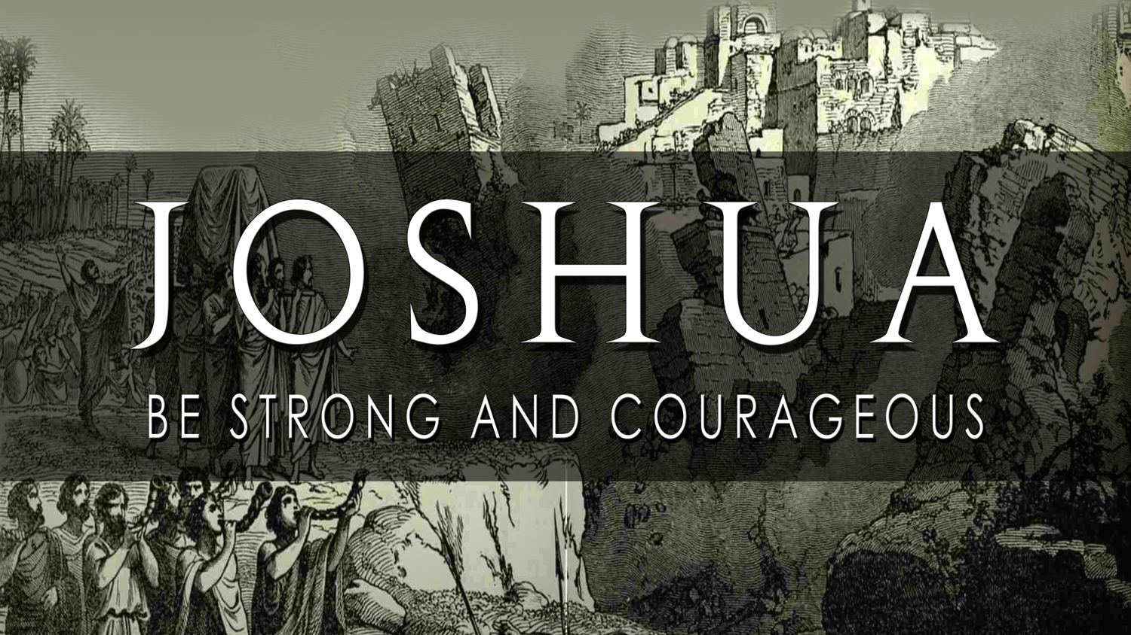
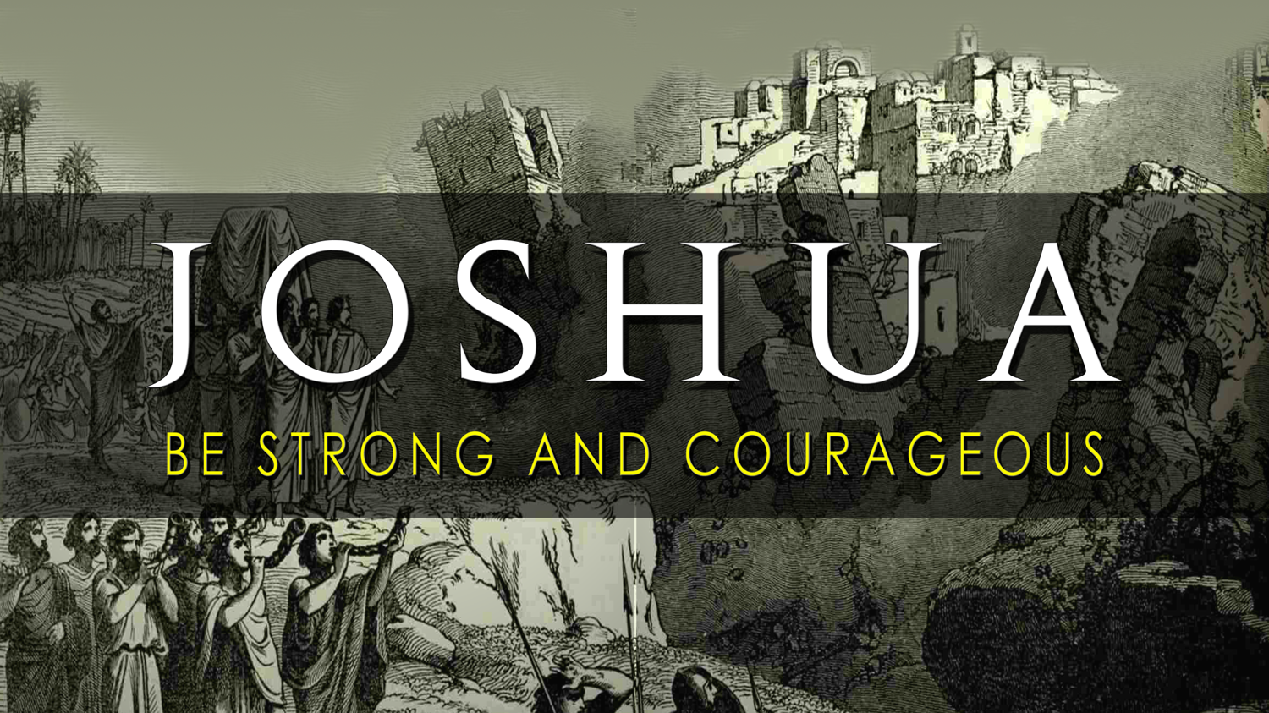

Slide 3
Blunders to Blessings
JOSHUA 10 / THE LONGEST DAY

Slide 4
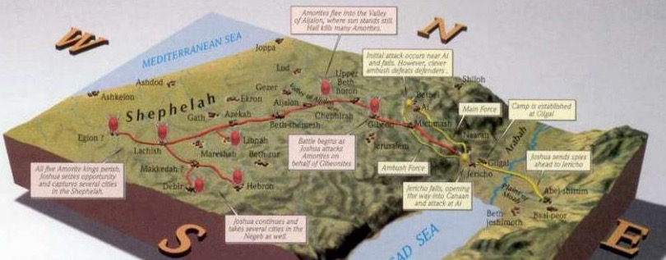
Gibeon

Slide 6
1
EXPECT Consequences
FROM YOUR SIN

Slide 7
“Come and help me destroy Gibeon,” he urged them, “for they have made peace with Joshua and the people of Israel.”
Joshua 10:4
New Living Translation

Slide 9
“Your eyes are too pure to look on evil;
you cannot tolerate wrong”
Habakkuk 1:13
“be sure that your sin will find you out”
Numbers 32:23
“Do not be deceived: God cannot be mocked.
A man reaps what he sows”
Galatians 6:7.

Slide 11
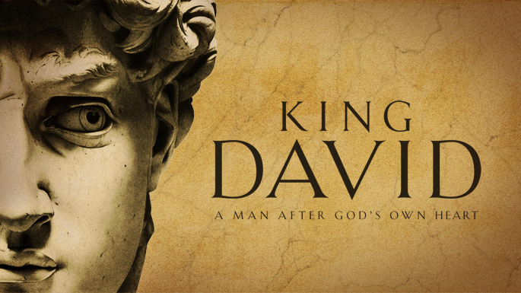

Slide 12
This is what the Lord says: Because of what you have done, I will cause your own household to rebel against you.
2 Samuel 12:11
New living translation

Slide 13
“the Lord has forgiven you, and you won’t die for this sin. Nevertheless, because you have shown utter contempt for the word of the Lord by doing this, your child will die.”
2 Samuel 12:13-14
New living translation

Slide 14
For the Lord disciplines those he loves,
and he punishes each one
he accepts as his child.
Hebrews 12:6
New living translation

Slide 16
GOD STILL
2
KEEPS HIS PROMISES

Slide 17
CONDITIONAL PROMISES
UNCONDITIONAL PROMISES

Slide 18
“No one will be able to stand against you
as long as you live. For I will be with you
as I was with Moses.
I will not fail you or abandon you.”
Joshua 1:5
New Living Translation

Slide 19
“Do not be afraid of them,” the Lord said to Joshua, “for I have given you victory over them. Not a single one of them will be able to stand up to you.”
Joshua 10:8
New Living Translation

Slide 21
“God’s way is perfect.
All the Lord’s promises prove true.”
PSALM 18:30
New Living Translation

Slide 23
The LORD is compassionate and merciful,
slow to get angry and filled with unfailing love.
He will not constantly accuse us,
nor remain angry forever.
He does not punish us for all our sins;
he does not deal harshly with us, as we deserve.
For his unfailing love toward those who fear him
is as great as the height of the heavens above
the earth. He has removed our sins as far
from us as the east is from the west.

Slide 24
The LORD is like a father to his children,
tender and compassionate
to those who fear him.
For he knows how weak we are;
he remembers we are only dust.
Our days on earth are like grass;
like wildflowers, we bloom and die.
The wind blows, and we are gone—as though we had never been here. But the love of the LORD remains forever with those who fear him.
PSALM 103:8-19
New Living Translation

Slide 26
FOR CHRISTIANS
3
NO MISTAKE IS FINAL

Slide 27
They totally wiped out the five armies
except for a tiny remnant that managed
to reach their fortified towns.
Then the Israelites returned safely to Joshua
in the camp at Makkedah.
After that, no one dared to speak
even a word against Israel.
Joshua 10:20-21
New Living Translation

Slide 29
https://www.youtube.com/watch?v=MrBmteES8Wg

Slide 31
Gibeon

Slide 32
Gibeon

Slide 34
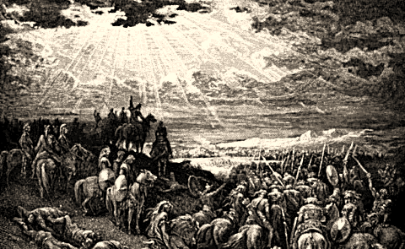
So the sun stood still and the moon stayed in place

Slide 35
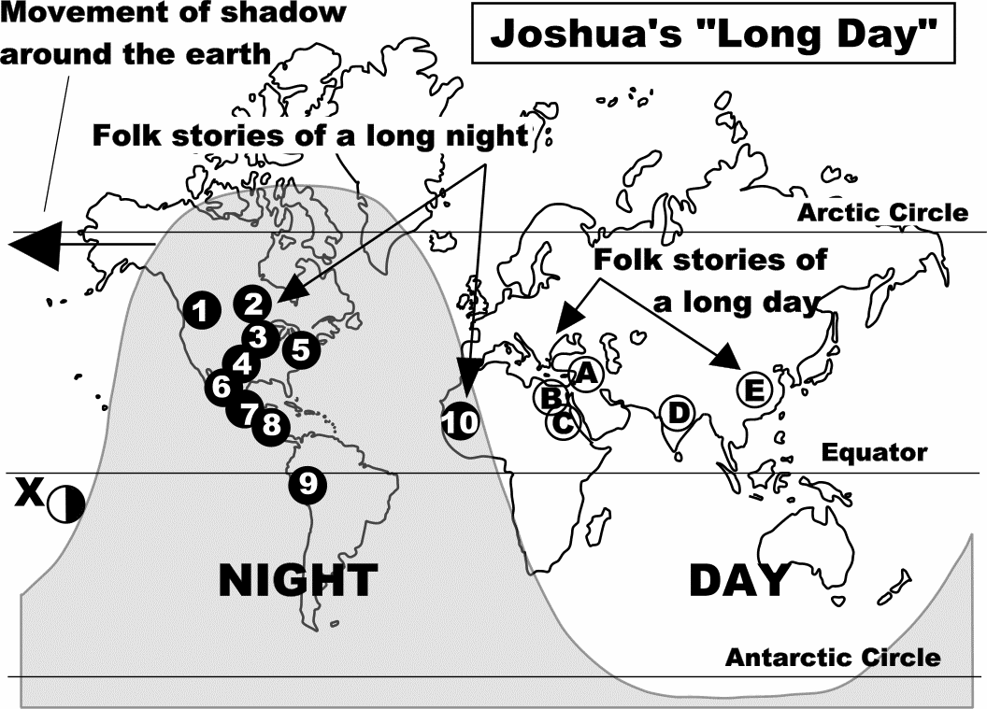

Slide 36
Believe in Miracles or…
First
prove that there is no God
Second
prove that the Bible is of purely human origin.

