Slide 1
People
OF THE
NATIVITY

Slide 2
WHY
SHEPHERDS?

Slide 3
Realize You
1
ARE SPECIAL

Slide 4
That night there were shepherds staying in the fields nearby, guarding their flocks of sheep.
luke 2:8 new living translation

Slide 5
33 Then he said, “When Pharaoh calls for you and asks you about your occupation, 34 you must tell him, ‘We, your servants, have raised livestock all our lives, as our ancestors have always done.’ When you tell him this, he will let you live here in the region of Goshen, for the Egyptians despise shepherds.”
genesis 46:33-34 new living translation

Slide 6
DON’T BE
2
AFRAID

Slide 7
9 Suddenly, an angel of the Lord appeared among them, and the radiance of the Lord’s glory surrounded them. They were terrified, 10 but the angel reassured them. “Don’t be afraid!” he said. “I bring you good news that will bring great joy to all people.
luke 2:9-10 new living translation

Slide 8
JOHN CENA

Slide 9
BELIEVE
3
IT

Slide 10
When the angels had returned to heaven, the shepherds said to each other, “Let’s go to Bethlehem! Let’s see this thing that has happened, which the Lord has told us about.”
luke 2:15 new living translation

Slide 11
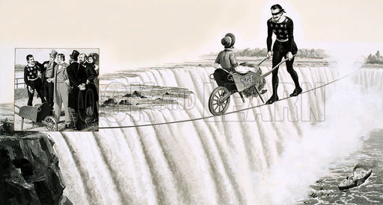
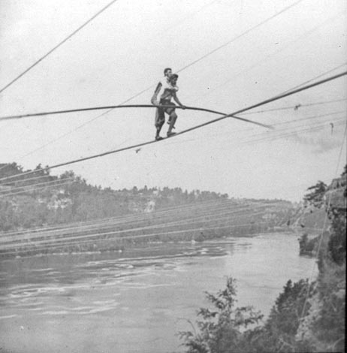
CHARLES BLONDIN

Slide 12
BLONDIN

Slide 13
Then he said, “I tell you the truth, unless you turn from your sins and become like little children, you will never get into the Kingdom of Heaven
matthew 18:3 new living translation

Slide 14
For the Lord delights in his people; he crowns the humble with victory.
psalm 149:4 new living translation

Slide 15
RESPOND
4
IMMEDIATELY

Slide 16
They hurried to the village and found Mary and Joseph. And there was the baby, lying in the manger.
luke 2:16 new living translation

Slide 17
TELL PEOPLE
5
ABOUT IT

Slide 18
17 After seeing him, the shepherds told everyone what had happened and what the angel had said to them about this child.
20 The shepherds went back to their flocks, glorifying and praising God for all they had heard and seen. It was just as the angel had told them.
luke 2:17,20 new living translation

Slide 19
People
OF THE
NATIVITY

