Slide 3
FROM
JONAH
lessons learned
TO US

Slide 4
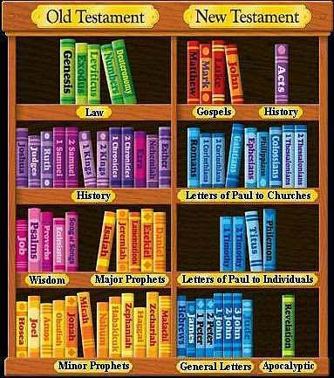

Slide 5
2 Kings 14:25
new living translation
“Jeroboam II recovered the territories of Israel between Lebo-hamath and the Dead Sea, just as the Lord, the God of Israel, had promised through Jonah son of Amittai, the prophet from Gath-hepher.”

Slide 6
Matthew 12:40
new living translation
“For as Jonah was in the belly of the great fish for three days and three nights, so will the Son of Man be in the heart of the earth for three days and three nights.”

Slide 7
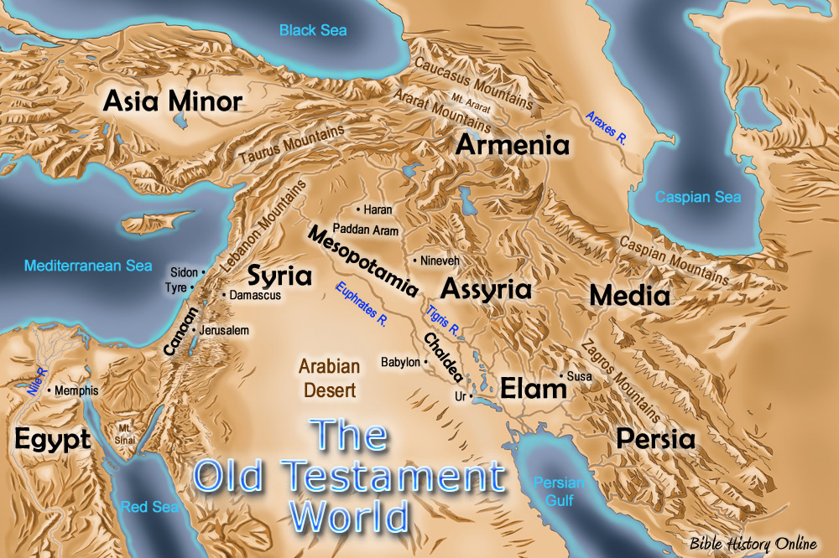

Slide 10
1
GOD WILL OFTEN ASK US
to do things we don’t want to do

Slide 11
Jonah 1:2
new living translation
“Get up and go to the great city of Nineveh. Announce my judgment against it because I have seen how wicked its people are.”

Slide 13
Exodus 3:10-11
new living translation
"Now go, for I am sending you to Pharaoh. You must lead my people Israel out of Egypt.”
But Moses protested to God, “Who am I to appear before Pharaoh? Who am I to lead the people of Israel out of Egypt?”

Slide 14
Acts 9:10-15
new living translation
Now there was a believer in Damascus named Ananias. The Lord spoke to him in a vision, calling, “Ananias!” “Yes, Lord!” he replied. The Lord said, “Go over to Straight Street, to the house of Judas. When you get there, ask for a man from Tarsus named Saul. He is praying to me right now.”

Slide 15
Acts 9:10-15
new living translation
”I have shown him a vision of a man named Ananias coming in and laying hands on him so he can see again.” “But Lord,” exclaimed Ananias,
“I’ve heard many people talk about the terrible things this man has done to the believers in Jerusalem! And he is authorized by the leading priests to arrest everyone who calls upon your name.”
But the Lord said, “Go…”

Slide 17
2
WE CAN ALWAYS FIND A BOAT
sailing in the wrong direction

Slide 18
Jonah 1:3
new living translation
But Jonah got up and went in the opposite direction to get away from the Lord. He went down to the port of Joppa, where he found a ship leaving for Tarshish. He bought a ticket and went on board, hoping to escape from the Lord by sailing to Tarshish.

Slide 19
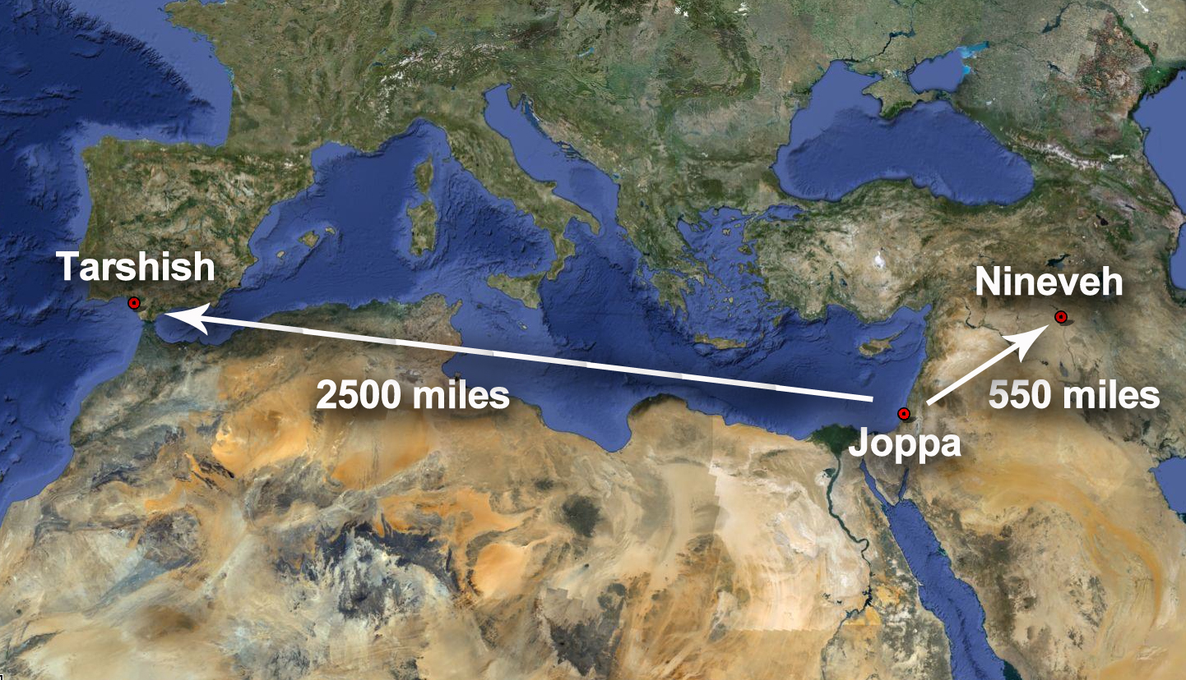

Slide 21
3
GOD MAY SEND A STORM
to grab our attention

Slide 22
Jonah 1:4
new living translation
But the Lord hurled a powerful wind over the sea, causing a violent storm that threatened to break the ship apart.

Slide 24
SOMETIMES GOD WANTS TO GET SOMETHING OUT OF US
4
before He get us out of something

Slide 25
Jonah 1:15
new living translation
Then the sailors picked Jonah up
and threw him into the raging sea.

Slide 27
5
GOD IS THE GOD
of second chances

Slide 28
Jonah 3:1
new living translation
Then the Lord spoke to Jonah a second time: “Get up and go to the great city of Nineveh, and deliver the message I have given you.”

Slide 29
JONAH
a j o u r n e y t o s u r r e n d e r

