Slide 1
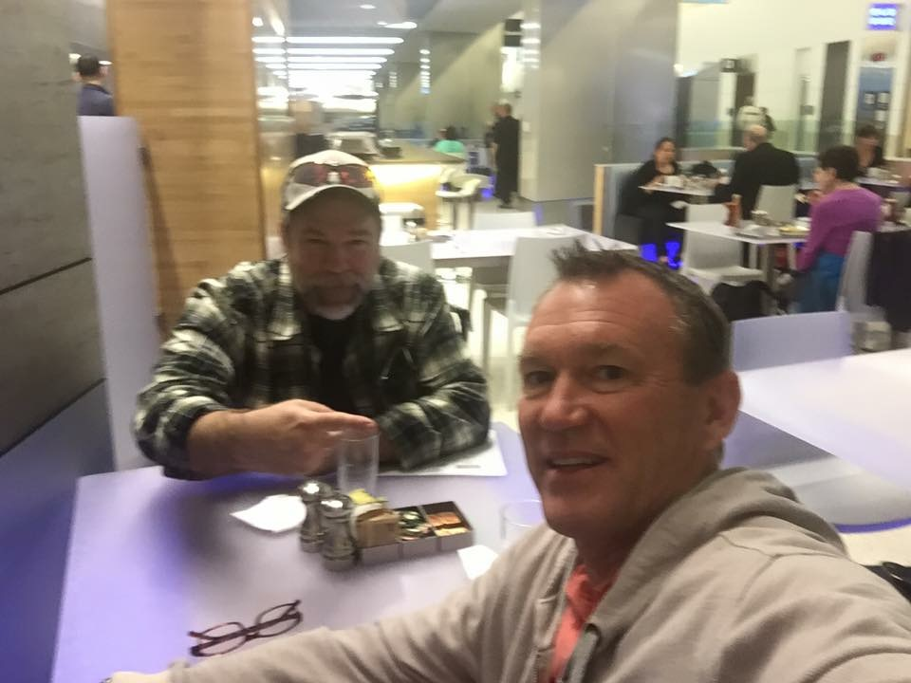

Slide 2
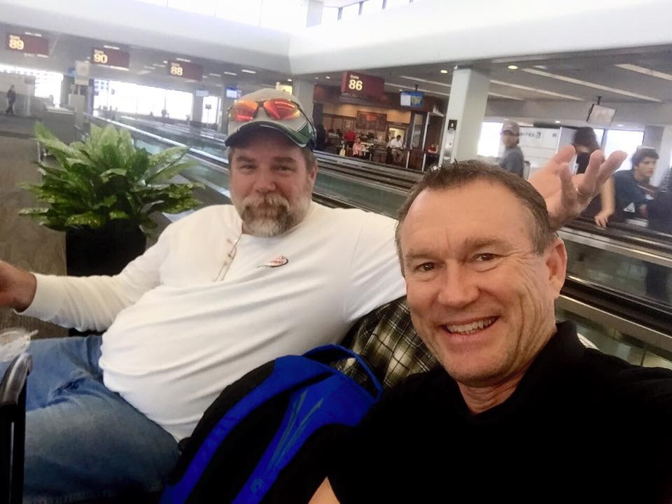

Slide 6
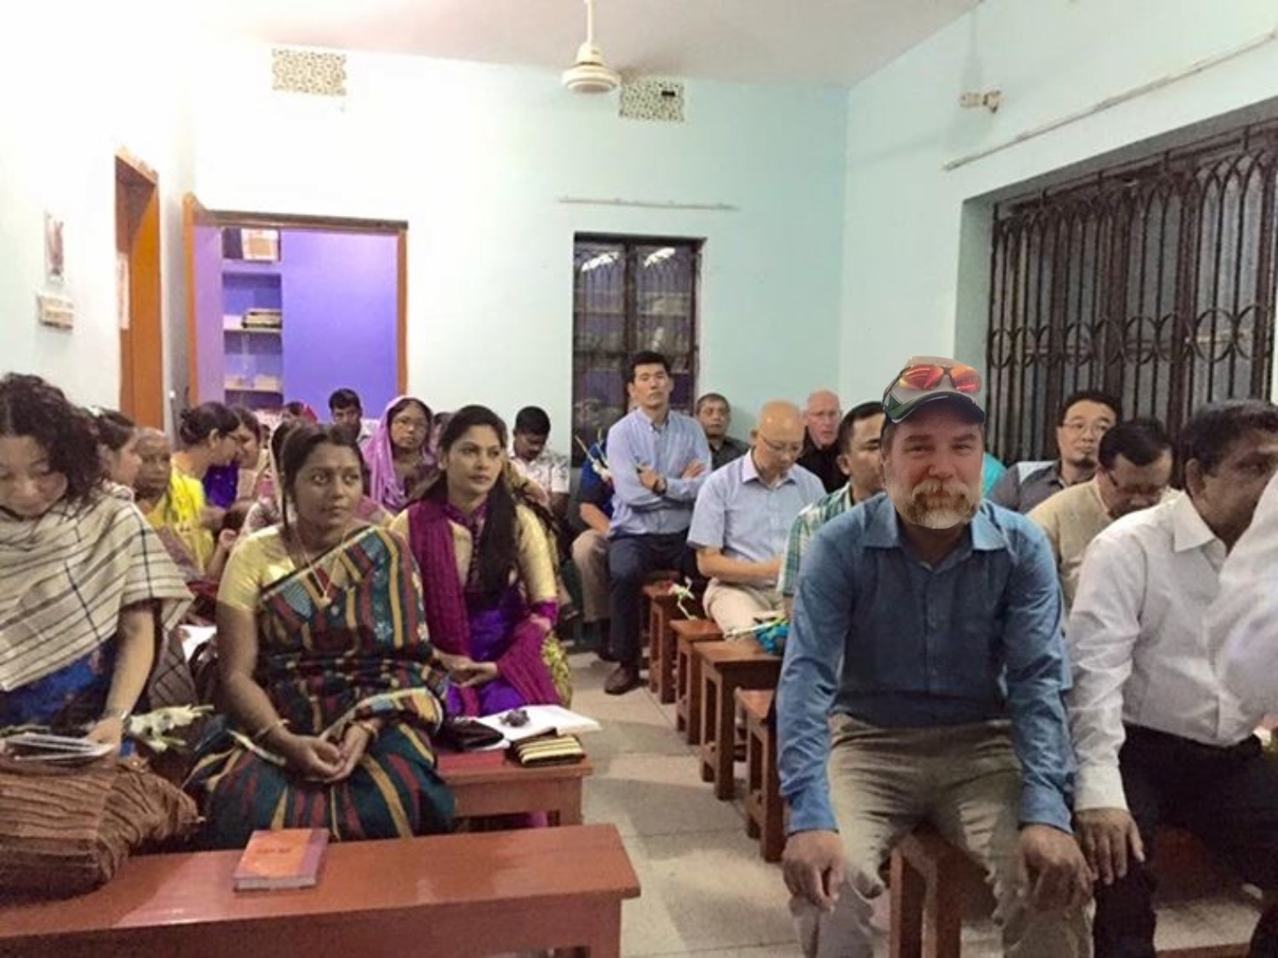

Slide 8
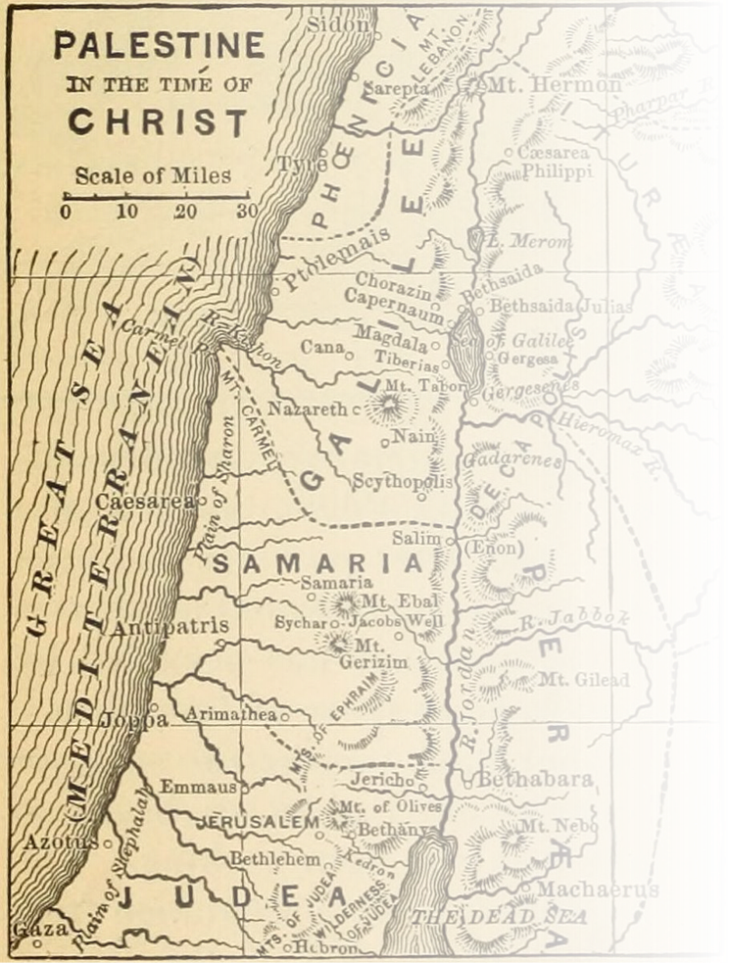
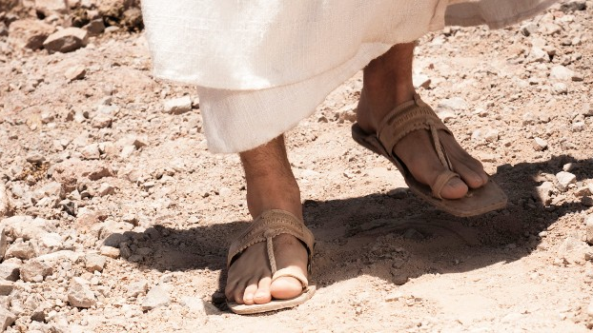
Where Jesus Walked
40 days in the footsteps of Christ

Slide 9
Get up and walk
Where Jesus Walked

Slide 10
jesusjourneybook.com

Slide 12
The Setting
Inside the city, near the Sheep Gate, was the pool of Bethesda, with five covered porches.
John 5:2 New Living Translation

Slide 13
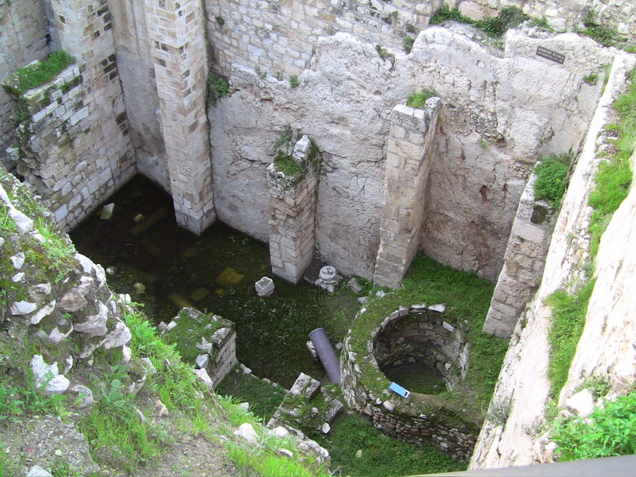

Slide 14
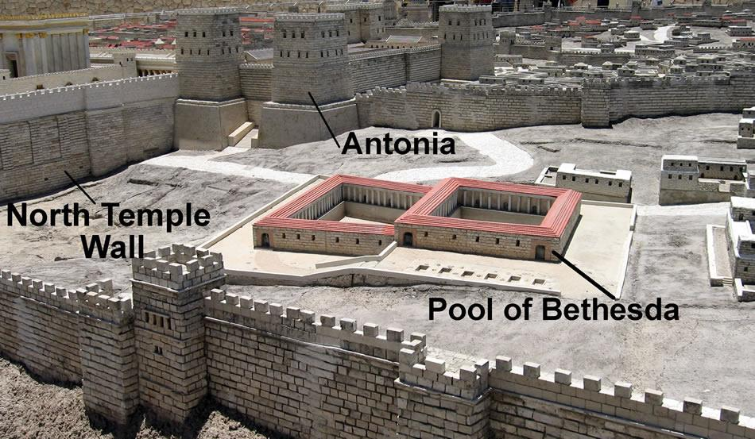

Slide 15
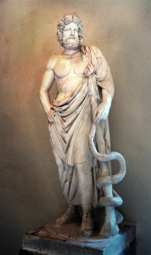
Asclepius ancient Greek god of medicine and healing

Slide 16
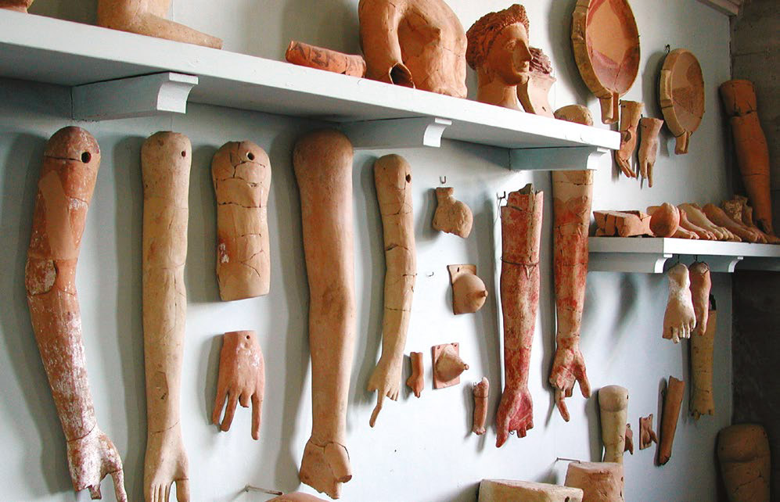

Slide 18
How Can I Be Changed?
Where Jesus Walked

Slide 19
1
Admit my methods have been ineffective
One of the men lying there had been sick for thirty-eight years.
John 5:3 New Living Translation
Characteristics of performance-based religion:

Slide 21
2
Desire to Be Made Whole
When Jesus saw him and knew he had been ill for a long time, he asked him, “Would you like to get well?”
John 5:4 New Living Translation
Characteristics of performance-based religion:

Slide 22
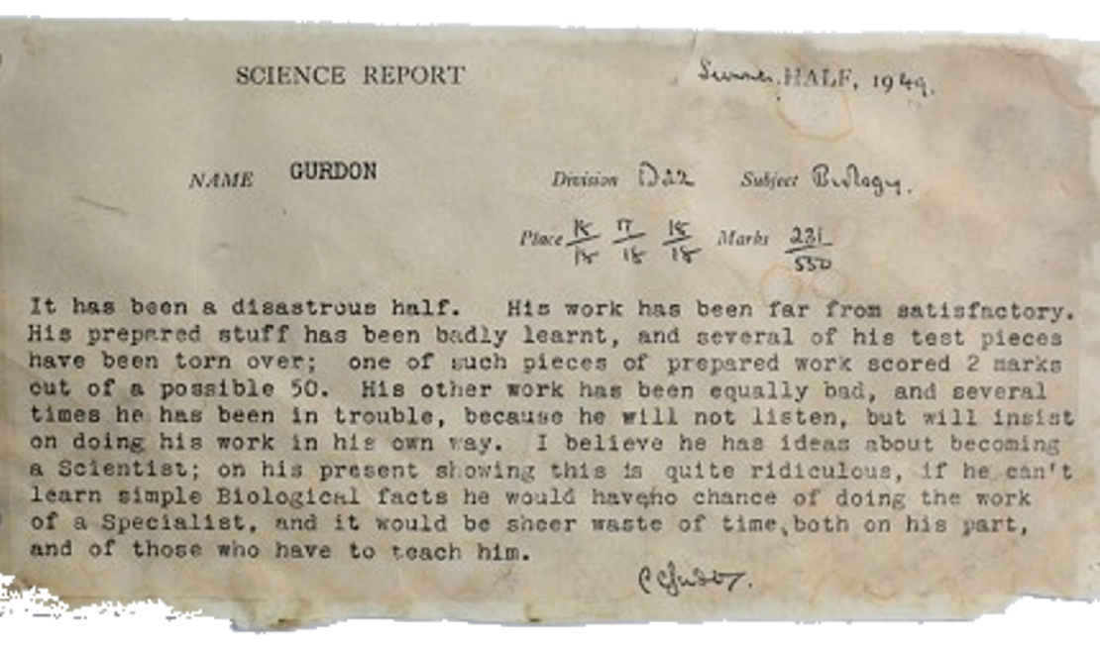
John Gurdon last in his class of 250 1949 Great Britain

Slide 23
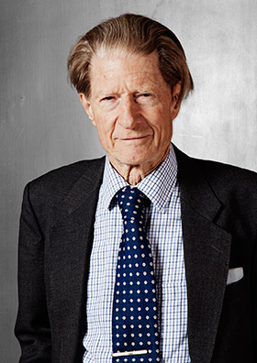
Sir John Gurdon United Kingdom Nobel Prize in Physiology or Medicine 2012
Awarded £750,000

Slide 24
‘These people honor me with their lips,
but their hearts are far from me.
Their worship is a farce, for they teach man-made ideas as commands from God.
Matthew 15:9 New Living Translation

Slide 25
Why Not?

Slide 26
Why Not?
I’m familiar with it
Just the way I am
Rewarded by it

Slide 27
Why Not?
I’m familiar with it
Just the way I am
Rewarded by it
What is your mat?

Slide 29
3
Act in Faith on the offer Jesus is giving.
“Stand up, pick up your mat, and walk!”
John 5:8 New Living Translation
Characteristics of performance-based religion:

Slide 31
Stop looking at the Pool of misery

Slide 32
Stop looking at the Pool of misery
Stop Trying to Get there on your own

Slide 33
Stop looking at the Pool of misery
Stop Trying to Get there on your own
Turn all your hurts over to Jesus

Slide 34
Stop looking at the Pool of misery
Stop Trying to Get there on your own
Turn all your hurts over to Jesus
Don’t stay in the lifestyle of sin

Slide 35
“…afterward Jesus found him in the Temple and told him, “Now you are well; so stop sinning, or something even worse may happen to you.”
John 5:14 New Living Translation

Slide 36
https://www.youtube.com/watch?v=KjcUBcdERhI
The horse whisperer
1:50 to 5:14

Slide 37
Bottom Line
Once you know he loves you, enjoy God’s saddle and bridle of grace.

Slide 38
Where Jesus Walked
40 days in the footsteps of Christ

