Slide 2
Power
the study of the holy spirit

Slide 3
On one occasion, while he was eating with them, he gave them this command: “Do not leave Jerusalem, but wait for the gift my Father promised, which you have heard me speak about.
ACTS 1:4
new living translation
he’s more than a force

Slide 4
But you will receive power when the Holy Spirit comes on you;
ACTS 1:8
new living translation
he’s more than a force

Slide 5
know the power
of the holy spirit
1

Slide 6
HE CREATES
The earth was formless and empty, and darkness covered the deep waters. And the Spirit of God was hovering over the surface of the waters.
GENESIS 1:2
new living translation
he’s more than a force

Slide 7
Then God said, “Let us make human beings in our image, to be like us.”
GENESIS 1:26
new living translation

Slide 8
HE EMPOWERS
Take Joshua son of Nun, who has the Spirit in him,
NUMBERS 27:18
new living translation
he’s more than a force

Slide 9
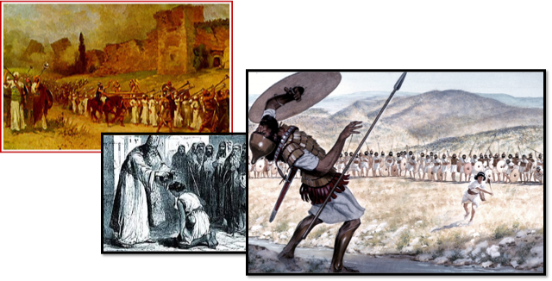

Slide 10
HE INSPIRES
Above all, you must realize that no prophecy in Scripture ever came from the prophet’s own understanding, or from human initiative. No, those prophets were moved by the Holy Spirit, and they spoke from God.
2 PETER 1:20-21
new living translation
he’s more than a force

Slide 11
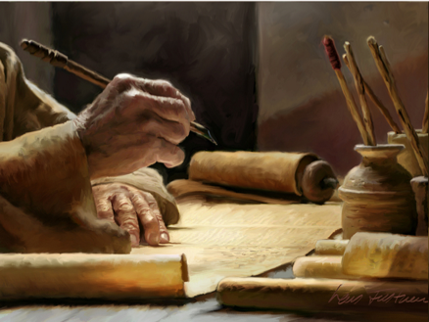

Slide 12
HE LEADS
Then Jesus, full of the Holy Spirit, returned from the Jordan River. He was led by the Spirit in the wilderness,
LUKE 4:1
new living translation
he’s more than a force

Slide 13
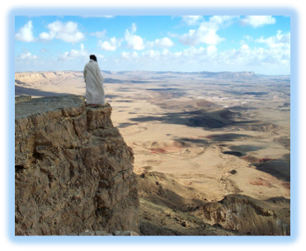

Slide 14
HE INDWELLS
Don’t you realize that all of you together are the temple of God and that the Spirit of God lives in you?
1 CORINTHIANS 3:16
new living translation
he’s more than a force

Slide 15
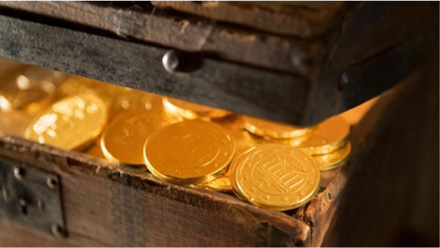

Slide 16
HE SEALS
When you believed, you were marked in him with a seal, the promised Holy Spirit, who is a deposit guaranteeing our inheritance
EPHESIANS 1:13-14
new living translation
he’s more than a force

Slide 18
uNDERSTAND THAT our mission is impossible
without the holy spirit
2

Slide 19
HE WILL CONVICT
And when he comes, he will convict the world of its sin, and of God’s righteousness, and of the coming judgment
JOHN 16:8
new living translation
he’s more than a force

Slide 20
HE WILL GUIDE
When the Spirit of truth comes, he will guide you into all truth.
JOHN 16:13
new living translation
he’s more than a force

Slide 21
HE WILL HELP
And I will ask the Father, and he will give you another Helper, to be with you forever
JOHN 14:16
new living translation
he’s more than a force

Slide 22
HE WILL GLORIFY JESUS
He will bring me glory by telling you whatever he receives from me
JOHN 16:14
new living translation
he’s more than a force

Slide 23
LET THE Spirit
help us to witness
3

Slide 24
POWER
⁴ Peter and John looked at him intently, and Peter said, “Look at us!” ⁵ The lame man looked at them eagerly, expecting some money.
ACTS 3:4-5
new living translation
he’s more than a force

Slide 25
⁶ But Peter said, “I don’t have any silver or gold for you. But I’ll give you what I have. In the name of Jesus Christ the Nazarene, get up and walk!”
⁷ Then Peter took the lame man by the right hand and helped him up. And as he did, the man’s feet and ankles were instantly healed and strengthened.
ACTS 4:6-7
new living translation
he’s more than a force

Slide 26
⁸ He jumped up, stood on his feet, and began to walk! Then, walking, leaping, and praising God, he went into the Temple with them….
ACTS 3:8
new living translation
he’s more than a force

Slide 27
They brought in the two disciples and demanded, “By what power, or in whose name, have you done this?” ⁸ Then Peter, filled with the Holy Spirit, said to them, … ¹⁰“Let me clearly state to all of you and to all the people of Israel that he was healed by the powerful name of Jesus Christ the Nazarene, the man you crucified but whom God raised from the dead.
ACTS 4:7-8, 10
new living translation
he’s more than a force

Slide 28
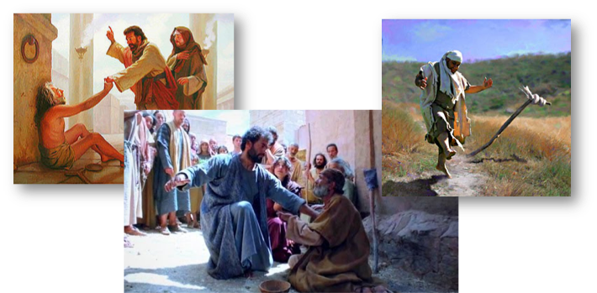

Slide 29
BOLDNESS
The members of the council were amazed when they saw the boldness of Peter and John, for they could see that they were ordinary men with no special training in the Scriptures. They also recognized them as men who had been with Jesus.
ACTS 4:13
new living translation
he’s more than a force

Slide 30
HOPE
But Stephen, full of the Holy Spirit, gazed steadily into heaven and saw the glory of God, and he saw Jesus standing in the place of honor at God’s right hand.
ACTS 7:55
new living translation
he’s more than a force

Slide 31
THE HOLY SPIRIT
EACH ONE REACH ONE

