Slide 3
GOD’S
AMAZING
GRACE

Slide 5
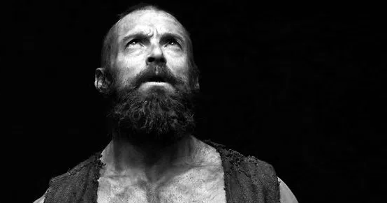
Saul
BORN IN TARSUS
ROMAN CITIZEN
SPOKE AT LEAST 3 LANGUAGES (Greek, Latin, Hebrew)
EDUCATED UNDER RENOWED RABBI GAMALIEL

Slide 6
Tarsus
Meanwhile, Saul was uttering threats with every breath and was eager to kill the Lord’s followers.
Acts 9: 1
new living translation
Jerusalem

Slide 7
So he went to the high priest. He requested letters addressed to the synagogues in Damascus, asking for their cooperation in the arrest of any followers of the Way he found there. He wanted to bring them—both men and women—back to Jerusalem
in chains.
Tarsus
Damascus
Acts 9: 1-2
new living translation
Jerusalem

Slide 9
1
FALL IN LOVE WITH THE
CHURCH

Slide 10
As he was approaching Damascus on this mission, a light from heaven suddenly shone down around him. He fell to the ground and heard a voice saying to him, “Saul! Saul! Why are you persecuting me?”
Acts 9: 3-4
new living translation

Slide 12
For husbands, this means love your wives, just as Christ loved the church. He gave up his life for her to make her holy and clean, washed by the cleansing of God’s word. He did this to present her to himself as a glorious church without a spot or wrinkle or any other blemish.
Let us be glad and rejoice,
and let us give honor to him.
For the time has come for the wedding feast of the Lamb,
and his bride has prepared herself.
Ephesians 5:25-27
new living translation
Revelation 19:7
new living translation

Slide 13
You can’t love Jesus and hate his bride.

Slide 15
PAY ATTENTION TO THE
2
GOADS

Slide 16
“Who are you, lord?” Saul asked.
And the voice replied,
“I am Jesus, the one you are persecuting!
Acts 9:5 new living translation

Slide 17
I heard a voice saying to me in the Hebrew language, ‘Saul, Saul, why are you persecuting me? It is hard for you to kick against the goads.’ And I said, ‘Who are you, Lord?’ And the Lord said, ‘I am Jesus whom you are persecuting.
Acts 26:14-15 english standard version

Slide 18
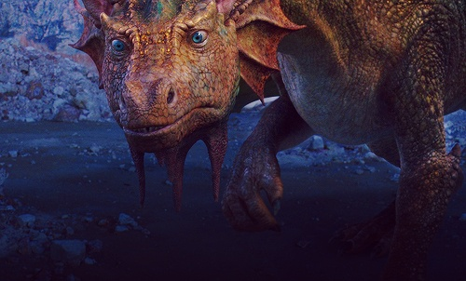
Well, he peeled the beastly stuff right off – just as I thought I’d done it myself the other three times, only they hadn’t hurt…

Slide 20
3
TAKE THE
BLINDERS OFF

Slide 21
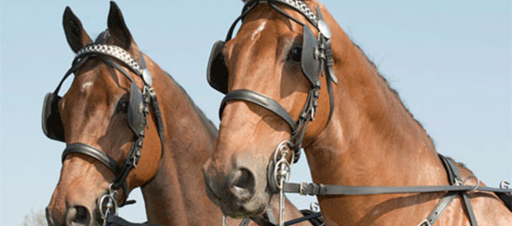

Slide 22
The men with Saul stood speechless, for they heard the sound of someone’s voice but saw no one! Saul picked himself up off the ground, but when he opened his eyes he was blind. So his companions led him by the hand to Damascus. He remained there blind for three days and did not eat or drink.
Acts 9:7-9 new living translation

Slide 23
SIN BLINDNESS

Slide 24
SIN BLINDNESS
RELIGIOUS BLINDNESS

Slide 26
4
BE CONTINUALLY AMAZED BY
GOD’S GRACE

Slide 27
Now there was a believer in Damascus named Ananias. The Lord spoke to him in a vision, calling, “Ananias!” “Yes, Lord!” he replied.
The Lord said, “Go over to Straight Street, to the house of Judas. When you get there, ask for a man from Tarsus named Saul.”
Acts 9:10-11 new living translation

Slide 28
He is praying to me right now. I have shown him a vision of a man named Ananias coming in and laying hands on him so he can see again.”
“But Lord,” exclaimed Ananias,
“I’ve heard many people talk about the terrible things this man has done to the believers in Jerusalem!
And he is authorized by the leading priests to arrest everyone who calls upon your name. But the Lord said ‘Go!’”
Acts 9:12-15 new living translation

Slide 29
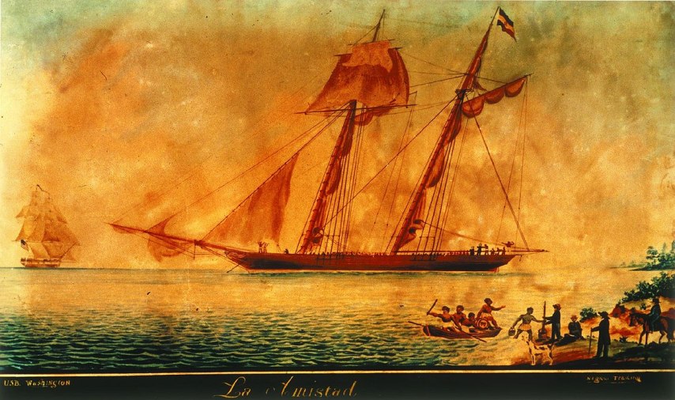
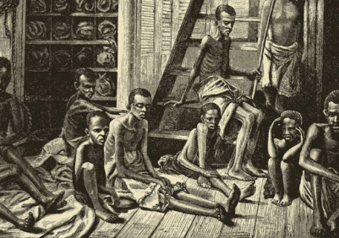
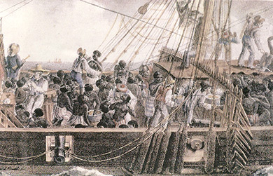
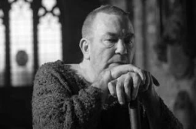
“[There is no] commerce so iniquitous, so cruel, so oppressive, as the African Slave Trade [of which I was involved]... I hope it will always be a subject of humiliating reflection to me…”
John Newton former slave ship captain

Slide 31
REALIZE YOU ARE CHOSEN TO GIVE
5
GLORY TO GOD

Slide 32
But the Lord said, “Go….”
for Saul is my chosen instrument to take my message to the Gentiles and to kings, as well as to the people of Israel.”
Acts 9:15-16 new living translation

Slide 34
If I am not wretched, God’s grace is not that amazing.

