Slide 2
Corinth

Slide 3
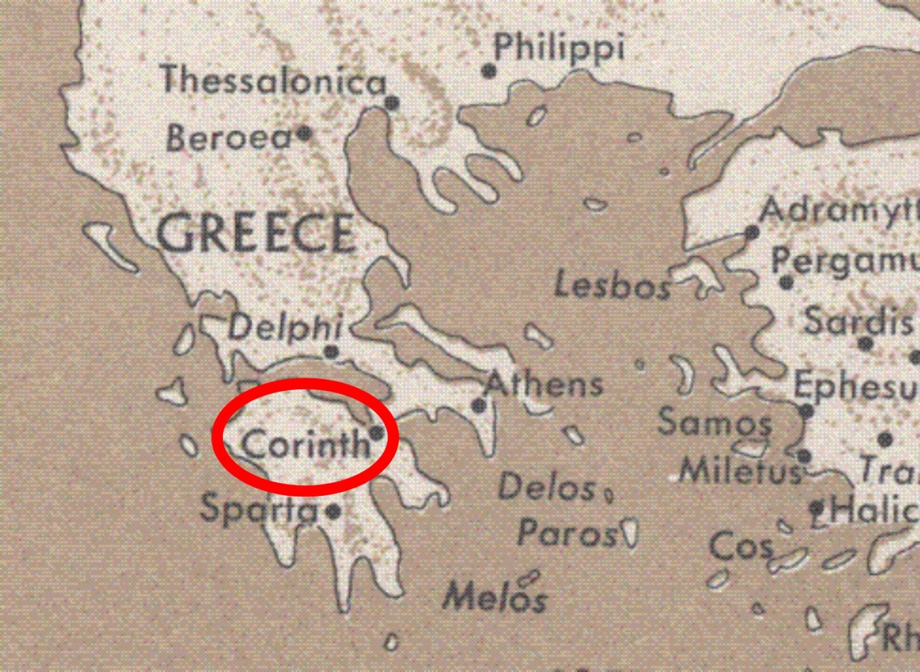

Slide 5
Moral Purity

Slide 7
Guard Your Heart
You say, “I am allowed to do anything”—but not everything is good for you. And even though “I am allowed to do anything,” I must not become a slave to anything.
1 Cor. 6: 12

Slide 8
“above all else, guard your heart, for it affects everything you do.”
Proverbs 4:23

Slide 9
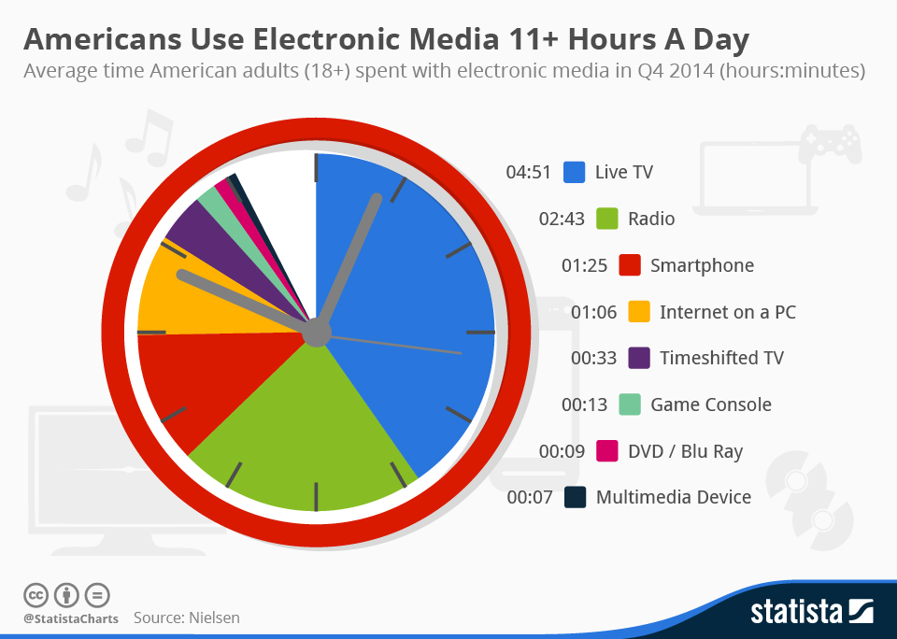

Slide 11
For a time is coming when people will no longer listen to sound and wholesome teaching. They will follow their own desires and will look for teachers who will tell them whatever their itching ears want to hear. They will reject the truth and chase after myths.
1 Timothy 4:3-4

Slide 12
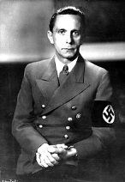
“If you tell a lie big enough and keep repeating it, people will eventually come to believe it.”
Joseph Goebbels
Reich Minister of Propaganda of Nazi Germany from 1933 to 1945.

Slide 13
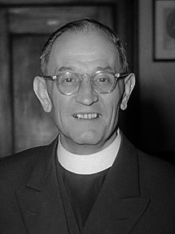
First they came for the socialists, and I did not speak out—Because I was not a socialist.
Then they came for the trade unionists, and I did not speak out—Because I was not a trade unionist.
Then they came for the Jews, and I did not speak out— Because I was not a Jew.
Then they came for me—and there was no one left to speak for me.
Martin Niemöller
German Lutheran pastor

Slide 15
Do Life God’s Way
But you can’t say that our bodies were made for sexual immorality. They were made for the Lord, and the Lord cares about our bodies
1 Cor. 6:13

Slide 16
“how can anyone keep his way pure?
By living according to your Word.”
Ps. 119:9

Slide 17
Abortion: “You watched me as I was being formed in utter seclusion, as I was woven together in the dark of the womb.”
Psalm 139:15

Slide 18
Marriage “And he said, “‘This explains why a man leaves his father and mother and is joined to his wife, and the two are united into one.’” Matthew 19:4

Slide 19
Transgender “In the image of God he created them; male and female he created them.”
Gen 1:27

Slide 20
Claiming to be wise, they instead became utter fools. And instead of worshiping the glorious, ever-living God, they worshiped idols made to look like mere people and birds and animals and reptiles.” Romans 1:22-23

Slide 22
Dwell on the Consequences
Run from sexual sin! No other sin so clearly affects the body as this one does.
1 Cor. 6:18

Slide 24
“the lips of an immoral woman are as sweet as honey, and her mouth is smoother than oil but the result is a s bitter as poison, sharp as a double-edged sword.”
Pr. 5:3,4

Slide 26
Honor God with your Purity
Don’t you realize that your body is the temple of the Holy Spirit, who lives in you and was given to you by God? You do not belong to yourself, for God bought you with a high price. So you must honor God with your body.
1 Cor. 6:19-20

Slide 27
“But because there is so much sexual immorality, each man should have his own wife, and each woman should have her own husband.”
1 Corinthians 7:2

Slide 28
Guard your mind Ask for and receive God’s forgiveness Live by God’s standard Pray every day to be filled by God spirit

Slide 29
Moral Purity

