Slide 3
https://www.youtube.com/watch?v=KDlCFqy7KG4
THE

Slide 4
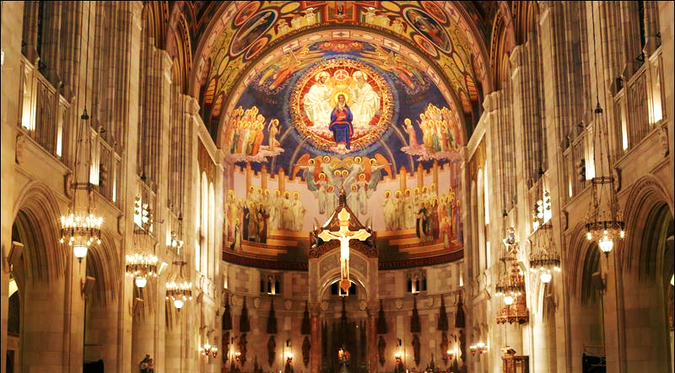
THE

Slide 5
THE

Slide 6
1
we don’t have to live with guilt and shame anymore
THE

Slide 7
He was beaten so we could be whole. He was whipped so we could be healed. ⁶ All of us, like sheep, have strayed away. We have left God’s paths to follow our own. Yet the Lord laid on him the sins of us all.
Isaiah 53:5-6 New Living Translation
THE

Slide 8
⁷ He was oppressed and treated harshly, yet he never said a word. He was led like a lamb to the slaughter. And as a sheep is silent before the shearers, he did not open his mouth. ⁹ He had done no wrong and had never deceived anyone. But he was buried like a criminal; he was put in a rich man’s grave
THE
Isaiah 53:7,9 New Living Translation

Slide 9
He was handed over to die because of our sins, and he was raised to life to make us right with God.
Romans 4:25 New Living Translation
THE

Slide 10
Who then will condemn us? No one— for Christ Jesus died for us and was raised to life for us, and he is sitting in the place of honor at God’s right hand, pleading for us.
Romans 8:34 New Living Tranlation
THE

Slide 11
THE

Slide 12
2
we don’t have to fear death
THE

Slide 13
For God so loved the world, that he gave his only begotten Son, that whosoever believeth in him should not perish, but have everlasting life.
John 3:16 King James Version
THE

Slide 14
Christ died for our sins, just as the Scriptures said. He was buried, and he was raised from the dead on the third day, just as the Scriptures said. 5 He was seen by Peter and then by the Twelve. 6 After that, he was seen by more than 500 of his followers at one time, most of whom are still alive, though some have died. Then he was seen by James and later by all the apostles.
THE
1 Corinthians 15:3-7 New Living Translation

Slide 15
THE

Slide 16
3
we get to have God’s spirit inside us
THE

Slide 17
But you will receive power when the Holy Spirit comes upon you. And you will be my witnesses, telling people about me everywhere—in Jerusalem, throughout Judea, in Samaria, and to the ends of the earth.”
Acts 1:8 New Living Translation
THE

Slide 18
I also pray that you will understand the incredible greatness of God’s power for us who believe him. This is the same mighty power that raised Christ from the dead and seated him in the place of honor at God’s right hand in the heavenly realms.
Ephesians 1:19-20 New Living Translation
THE

Slide 19
THE

Slide 20
4
we are unconditionally loved by God
THE

Slide 21
God showed how much he loved us by sending his one and only Son into the world so that we might have eternal life through him. This is real love—not that we loved God, but that he loved us and sent his Son as a sacrifice to take away our sins.
1 John 4:9-10 New Living Translation
THE

Slide 22
THE

Slide 23
5
We have a greater purpose for our lives
THE

Slide 24
If you insist on saving your life, you will lose it. Only those who throw away their lives for my sake and for the sake of the Good News will ever know what it means to really live.
Mark 8:35 The Living Bible
THE

Slide 25
THE

Slide 26
6
we can be certain of a future in heaven
THE

Slide 27
and we have a priceless inheritance— an inheritance that is kept in heaven for you, pure and undefiled, beyond the reach of change and decay.
1 Peter 1:4 New Living Translation
THE

Slide 28
THE

