Slide 2
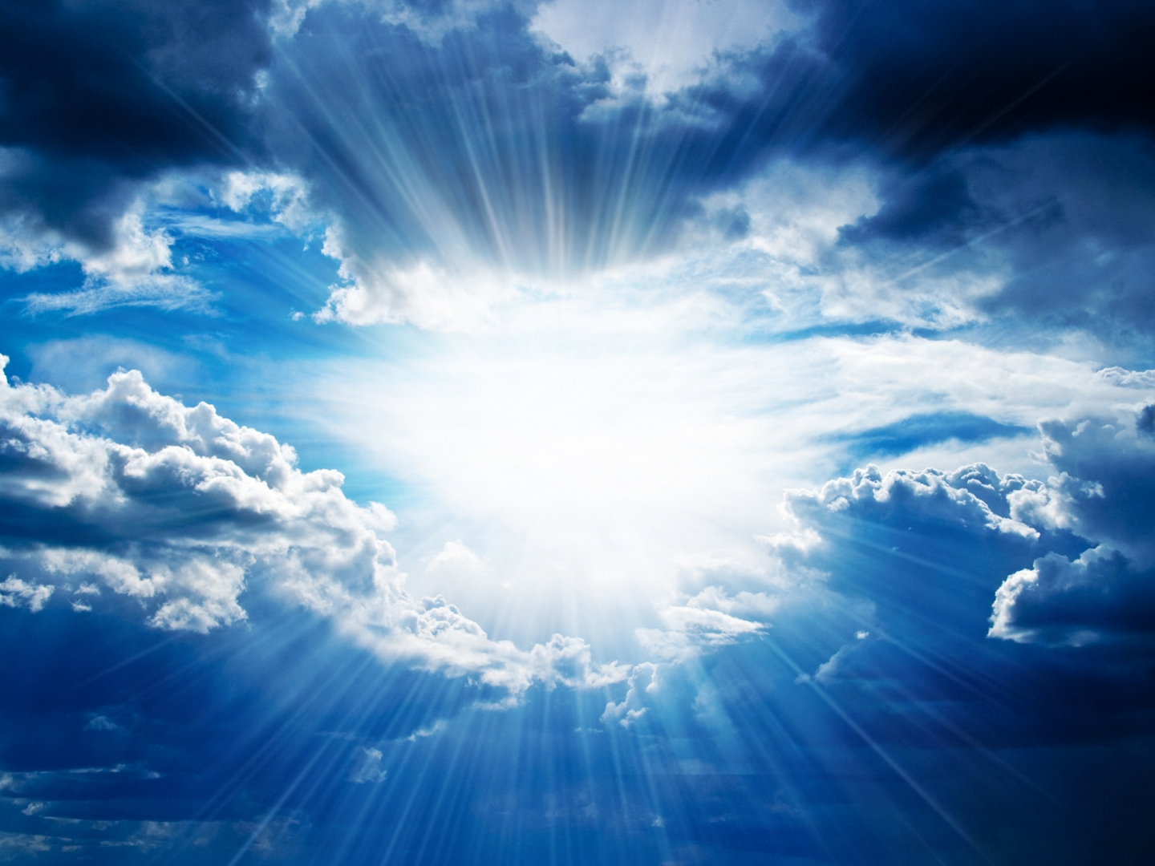
E N C O U N T E R
A F T E R T H E F L O O D

Slide 3
NOAH

Slide 4
https://www.youtube.com/watch?v=kZimU6E78OU

Slide 5
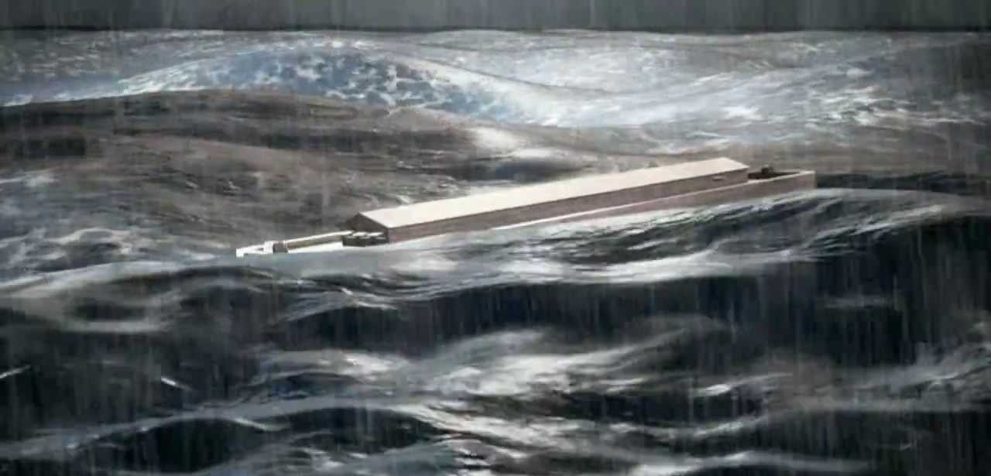

Slide 6
“everything they thought or imagined was consistently and totally evil.” GENESIS 6:5 NLT

Slide 7
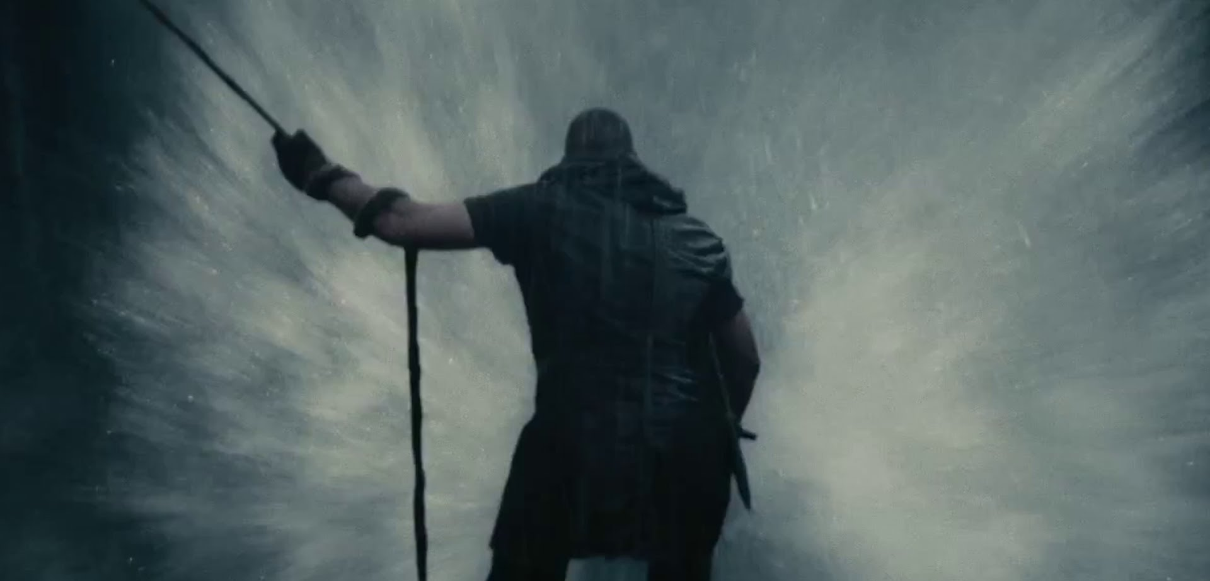
“Then the Lord closed the door behind them.”
GENESIS 7:16 NLT

Slide 8
HOLD YOUR COURSE
1
“And the floodwaters covered the earth for 150 days. But God remembered Noah and all the wild animals and livestock with him in the boat.”
GENESIS 7:24-8:1 new living translation

Slide 9
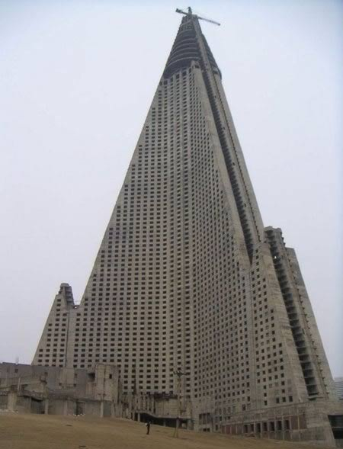
Ryugyong Hotel North Korea construction started 1987

Slide 10
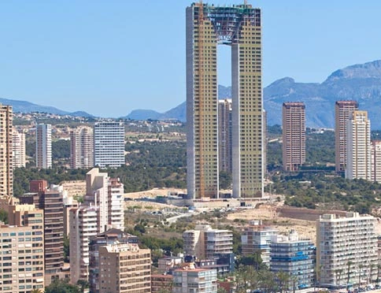
Intempo Spain construction started 2007

Slide 11
Fontainebleau Las Vegas Construction started 2008 $2.9 billion 68-story 3,889-room hotel

Slide 12
E N C O U N T E R
A F T E R T H E F L O O D

Slide 13
REMEMBER THE LORD
2
“Then Noah built an altar to the Lord, and there he sacrificed as burnt offerings the animals and birds that had been approved for that purpose. And the Lord was pleased with the aroma of the sacrifice.”
GENESIS 8:20-21 new living translation

Slide 14
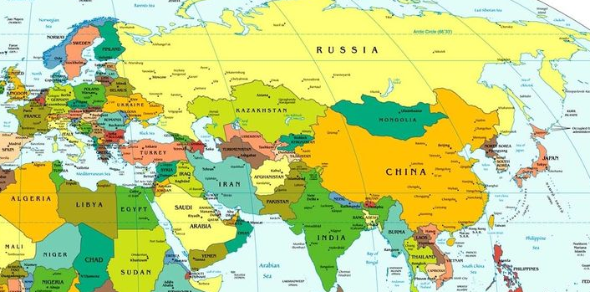
.Mt Ararat 16,946 ft

Slide 15
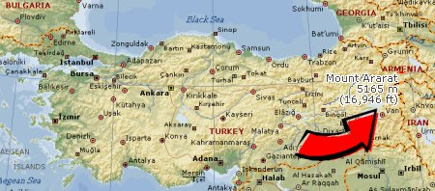
.Mt Ararat

Slide 16
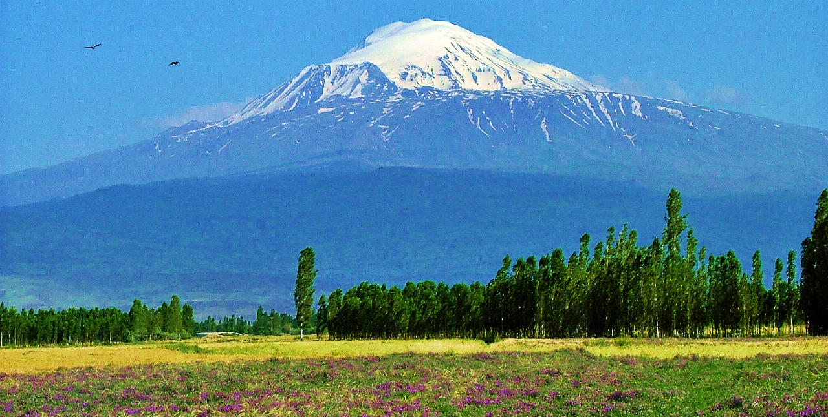
the boat came to rest on the mountains of Ararat. Genesis 8:4

Slide 17
DON’T LOWER YOUR GUARD
3
“One day he drank some wine he had made, and he became drunk and lay naked inside his tent.”
GENESIS 9:21 new living translation

Slide 18
1 CORINTHIANS 10:12 NEW KING JAMES VERSION
Let him who thinks he stands take heed lest he fall

Slide 19
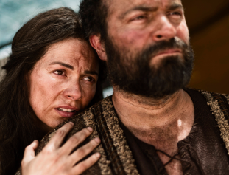
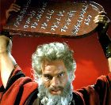
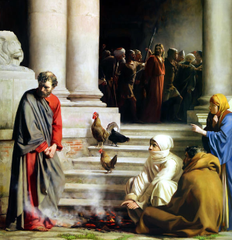
-Abraham lied -Moses committed murder and lost his temper -Elijah struggled with depression -David committed adultery -Peter denied he knew Jesus

Slide 20
PROVERBS 23:31-32 NEW LIVING TRANSLATION
Don’t gaze at the wine, seeing how red it is,
how it sparkles in the cup, how smoothly it goes down.
For in the end it bites like a poisonous snake;
it stings like a viper

Slide 21
ROMANS 14:21-22 NEW LIVING TRANSLATION
It is better not to eat meat or drink wine or do anything else if it might cause another believer to stumble. You may believe there’s nothing wrong with what you are doing, but keep it between yourself and God.

Slide 22
WORK TO RESTORE OTHERS
Then Shem and Japheth took a robe, held it over their shoulders, and backed into the tent to cover their father. As they did this, they looked the other way so they would not see him naked.
GENESIS 9:23 new living translation
4

Slide 23
GALATIANS 6:1 NEW LIVING TRANSLATION
Dear brothers and sisters, if another believer is overcome by some sin, you who are godly should gently and humbly help that person back onto the right path. And be careful not to fall into the same temptation yourself.

Slide 24
JAMES 5:19-20
NEW LIVING TRANSLATION
My dear brothers and sisters, if someone among you wanders away from the truth and is brought back, you can be sure that whoever brings the sinner back from wandering will save that person from death and bring about the forgiveness of many sins.

Slide 25
1 PETER 4:8
NEW LIVING TRANSLATION
Most important of all, continue to show deep love for each other, for love covers a multitude of sins.

Slide 26
The Christian life is a series of new beginnings

