Slide 2
Book of the TWELVE

Slide 3
Book of the TWELVE

Slide 4
Book of the TWELVE

Slide 5
JONAH &
HABAKKUK
Our Response in the Midst of Evil People

Slide 6
JONAH
Our Response in the Midst of Evil People

Slide 7
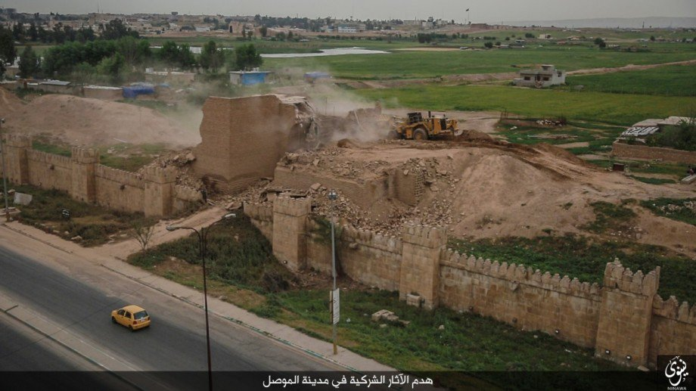

Slide 11
10 When God saw what they had done and how they had put a stop to their evil ways, he changed his mind and did not carry out the destruction he had threatened.
1 This change of plans greatly upset Jonah, and he became very angry. 2 So he complained to the Lord about it: “Didn’t I say before I left home that you would do this, Lord? That is why I ran away to Tarshish! I knew that you are a merciful and compassionate God, slow to get angry and filled with unfailing love. You are eager to turn back from destroying people. 3 Just kill me now, Lord! I’d rather be dead than alive if what I predicted will not happen.”
Jonah 3:10-4:3

Slide 12
GOD WILL OFTEN ASK
you to do the things you don’t want to do
1

Slide 13
43 “You have heard the law that says, ‘Love your neighbor’ and hate your enemy. 44 But I say, love your enemies! Pray for those who persecute you… 46 If you love only those who love you, what reward is there for that? Even corrupt tax collectors do that much. 47 If you are kind only to your friends, how are you different from anyone else? Even pagans do that. 48 But you are to be perfect, even as your Father in heaven is perfect.
MATTHEW 5:43-48

Slide 14
GOD IS SLOW
to show wrath
2

Slide 15
The Lord isn't really being slow about his promise, as some people think. No, he is being patient for your sake. He does not want anyone to be destroyed, but wants everyone to repent.
2 PETER 3:9

Slide 16
GOD WILL ULTIMATELY
bring justice
3

Slide 17
26 Dear friends, if we deliberately continue sinning after we have received knowledge of the truth, there is no longer any sacrifice that will cover these sins. 27 There is only the terrible expectation of God’s judgment and the raging fire that will consume his enemies.
28 For anyone who refused to obey the law of Moses was put to death without mercy on the testimony of two or three witnesses. 29 Just think how much worse the punishment will be for those who have trampled on the Son of God, and have treated the blood of the covenant, which made us holy, as if it were common and unholy,

Slide 18
and have insulted and disdained the Holy Spirit who brings God’s mercy to us. 30 For we know the one who said,
“I will take revenge.
I will pay them back.”
He also said,
“The Lord will judge his own people.”
31 It is a terrible thing to fall into the hands of the living God.
Hebrews 10:26-30

Slide 19
HABAKKUK
Our Response in the Midst of Evil People

Slide 22
Feb. 14: Marjory Stoneman Douglas High School in Parkland, Florida
Feb. 8: Metropolitan High School in New York City
Feb. 5: Harmony Learning Center in Maplewood, Minnesota
Feb. 5: Oxon Hill High School in Oxon Hill, Maryland
Jan. 31: Lincoln High School in Philadelphia, Pennsylvania
Jan. 26: Dearborn High School in Dearborn, Michigan
Jan. 25: Murphy High School in Mobile, Alabama
Jan. 23: Marshall County High School in Benton, Kentucky
Jan. 22: Italy High School in Italy, Texas
Jan. 22: NET Charter High School in New Orleans, Louisiana
Jan. 20: Wake Forest University in Winston-Salem, North Carolina
Jan. 15: Wiley College in Marshall, Texas
Jan. 10: Grayson College in Denison, Texas
Jan. 10: California State University, San Bernardino in San Bernardino
Jan. 9: Coronado Elementary School in Sierra Vista, Arizona
Jan. 6: School bus in Forest City, Iowa
Jan. 4: New Start High School in Burien, Washington
Jan. 3: East Olive Elementary School in St. John's Michigan

Slide 24
AN EXPRESSION OF FAITH
1

Slide 25
“Look at the proud! They trust in themselves, and their lives are crooked. But the righteous will live by their faithfulness to God.
HABAKKUK 2:4

Slide 26
Even though the fig trees have no blossoms, and there are no grapes on the vines; even though the olive crop fails, and the fields lie empty and barren; even though the flocks die in the fields, and the cattle barns are empty, yet I will rejoice in the Lord! I will be joyful in the God of my salvation!
HABAKKUK 3:17-18

Slide 27
THE IMPORTANCE OF FAITH
2

Slide 30
WHAT FAITH BELIEVES
3

Slide 31
WHAT FAITH BELIEVES
Faith believes that God is too wise to make a mistake.

Slide 32
WHAT FAITH BELIEVES
Faith believes that God is too wise to make a mistake.
Faith believes that God is too kind to be cruel.

Slide 33
WHAT FAITH BELIEVES
Faith believes that God is too wise to make a mistake.
Faith believes that God is too kind to be cruel.
Faith believes that God always knows best and does best in His time.

Slide 35
WHAT FAITH BELIEVES
Faith believes that God is too wise to make a mistake.
Faith believes that God is too kind to be cruel.
Faith believes that God always knows best and does best in His time.
Faith believes that God is in control, and therefore we can rest easily.

Slide 37
God is here for you. He will never leave you. He cares too much for you. Even if the night is dark and the storm is raging, know that God is here.

