Slide 1
People
OF THE
NATIVITY

Slide 3
worship
Like the
MAGI

Slide 4
Worship
1
Jesus

Slide 5
“Where is the newborn king of the Jews? We saw his star as it rose, and we have come to worship him.”
Matthew 2:2 new living translation

Slide 6
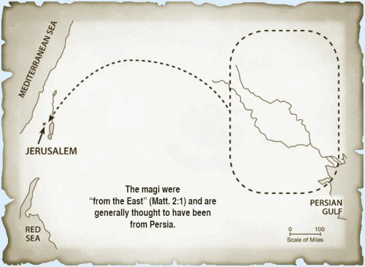

Slide 8
Then the king appointed Daniel to a high position and gave him many valuable gifts. He made Daniel ruler over the whole province of Babylon, as well as chief over all his wise men.
Daniel 2:48 new living translation

Slide 9
A star will rise from Jacob;
a scepter will emerge from Israel…. A ruler will rise in Jacob…
Numbers 24:17,19 new living translation

Slide 11
‘You must worship the Lord your God
and serve only him.
Luke 4:8 new living translation

Slide 13
Worship
2
through the
Uncertainties

Slide 14
“Where is the one who has been born king of the Jews”
Matthew 2:2 new living translation

Slide 16
For God has not given us a spirit of fear and timidity, but of power, love, and self-discipline.
2 Timothy 1:7 new living translation

Slide 18
Be strong and courageous. Do not be terrified; do not be discouraged, for the LORD your God will be with you wherever you go."
Joshua 1:9 new living translation

Slide 20
Worship
3
generously

Slide 21
“…and they fell down and worshiped him. Then, opening their treasures, they offered him gifts…”
Matthew 2:11 new living translation

Slide 22
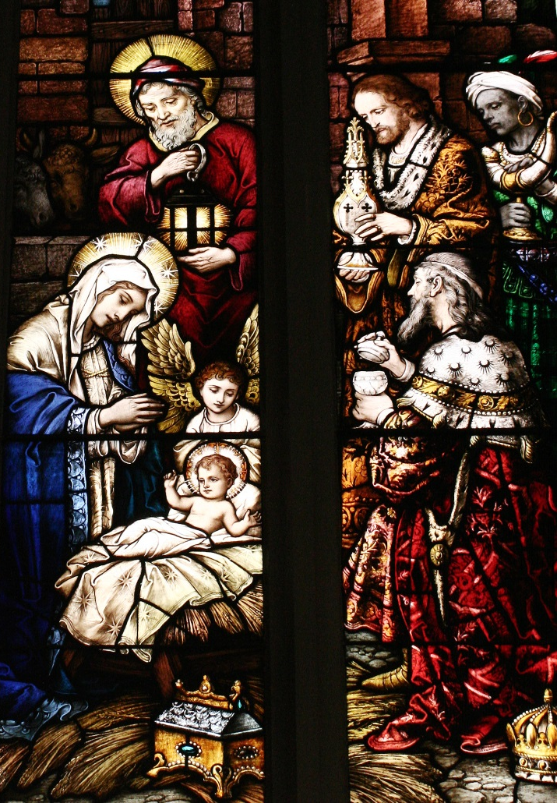
Magi

Slide 23
A tithe of everything from the land, whether grain from the soil or fruit from the trees, belongs to the LORD; it is holy to the LORD. Leviticus 27:30
“Every man according as he purposed in his heart, so let him give: not grudgingly, or of necessity: for God loves a cheerful giver.” 2 Cor. 9:7
“On the first day of the week let each one of you lay something aside” 1 Cor. 16:2

Slide 25
Let Worship
4
Change you

Slide 26
“…they departed to their own country
by another way.…”
Matthew 2:12 new living translation

Slide 28
People
OF THE
NATIVITY

