Slide 1
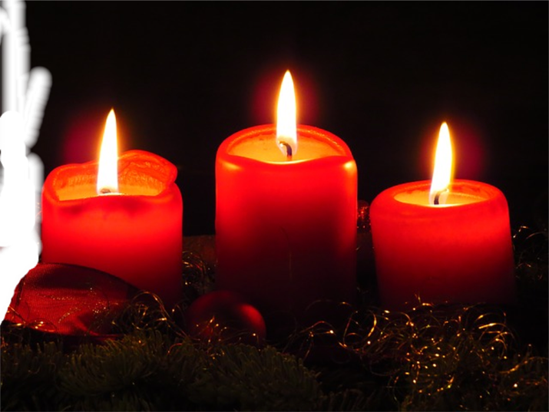
The Messiah is Coming

Slide 3
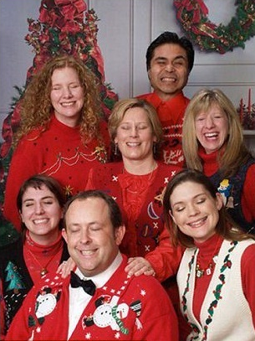
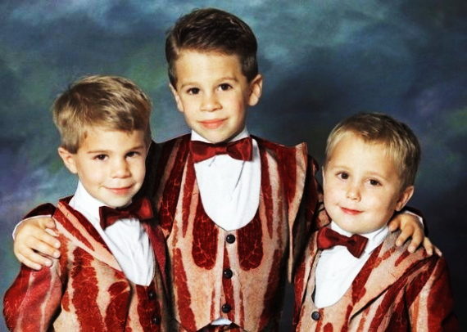

Slide 5
Hope
This darkness will not last

Slide 6
Comfort
Four Sources of comfort

Slide 7
Comfort
“comfort, comfort my people.”
Isaiah 40:1 new living translation

Slide 9
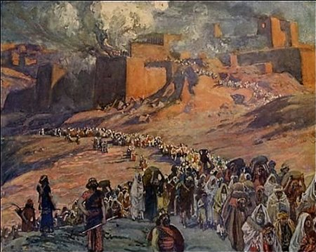
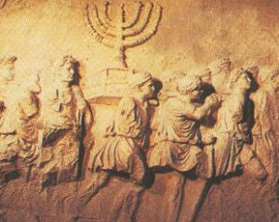

Slide 12
If you believe that…

Slide 13
God’s grace is greater
1.

Slide 14
Isaiah 40:2 new living translation
“Speak tenderly to Jerusalem.
Tell her that her sad days are gone
and her sins are pardoned.
Yes, the Lord has punished her twice over
for all her sins.”

Slide 15
God’s grace

Slide 16
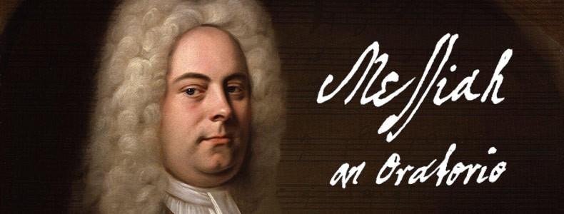
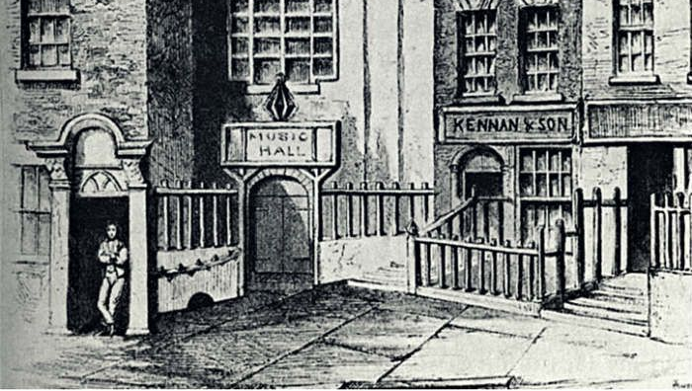
Handel’s Messiah premiered April 13, 1742, received rave reviews and exceeded expectations raising 400 pounds and freeing 142 men from debtor’s prison.

Slide 17
Isaiah 40:3 new living translation
Listen! It’s the voice of someone shouting, “Clear the way through the wilderness for the Lord! Make a straight highway through the wasteland for our God!

Slide 18
Isaiah 40:4-5 new living translation
⁴ Fill in the valleys, and level the mountains and hills. Straighten the curves, and smooth out the rough places. ⁵ Then the glory of the Lord will be revealed, and all people will see it together. The Lord has spoken!”

Slide 20
Luke 3:4-6 new living translation
Isaiah had spoken of John when he said,
“He is a voice shouting in the wilderness, ‘Prepare the way for the Lord’s coming! Clear the road for him!
The valleys will be filled, and the mountains and hills made level. The curves will be straightened, and the rough places made smooth. And then all people will see the salvation sent from God.’”

Slide 21
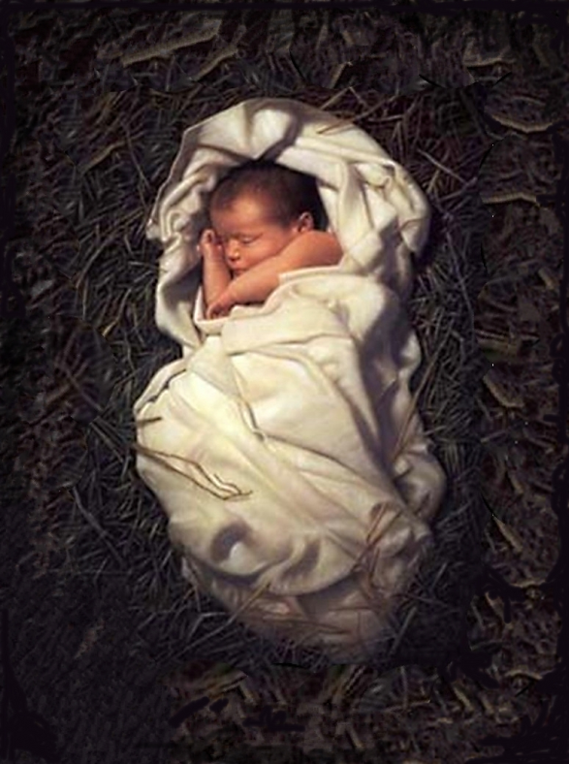

Slide 22
God’s Promise is forever
2.

Slide 23
Isaiah 40:6-8 new living translation
“Shout that people are like the grass. Their beauty fades as quickly as the flowers in a field. The grass withers and the flowers fade beneath the breath of the Lord. And so it is with people. The grass withers and the flowers fade,
but the word of our God stands forever.”

Slide 24
1 Peter 1:24-25 new living translation
As the Scriptures say,
“People are like grass;
their beauty is like a flower in the field.
The grass withers and the flower fades.
But the word of the Lord remains forever.”

Slide 25
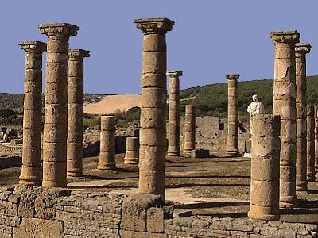
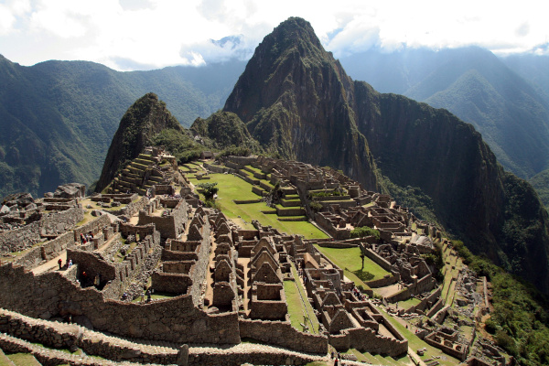

Slide 27
God’s Power is stronger
3

Slide 28
Isaiah 40:9 new living translation
O Zion, messenger of good news, shout from the mountaintops! Shout it louder, O Jerusalem.
Shout, and do not be afraid. Tell the towns of Judah,
“Your God is coming!”

Slide 29
Isaiah 40:10 new living translation
Yes, the Sovereign Lord is coming in power.
He will rule with a powerful arm.
See, he brings his reward with him as he comes.

Slide 30
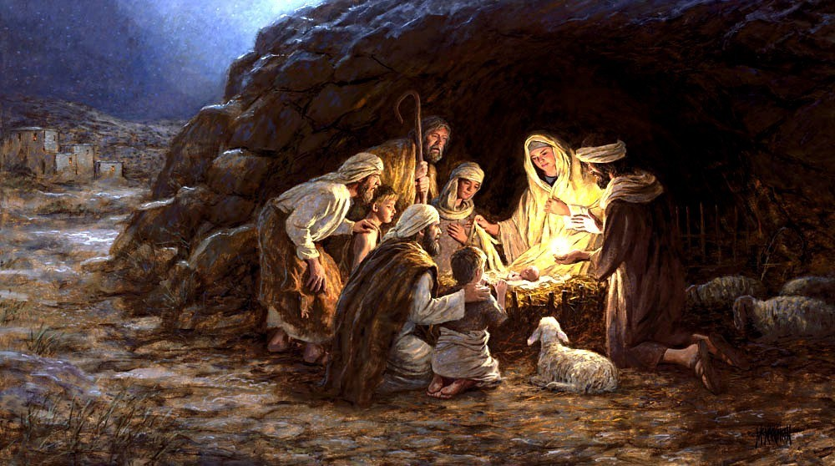

Slide 32
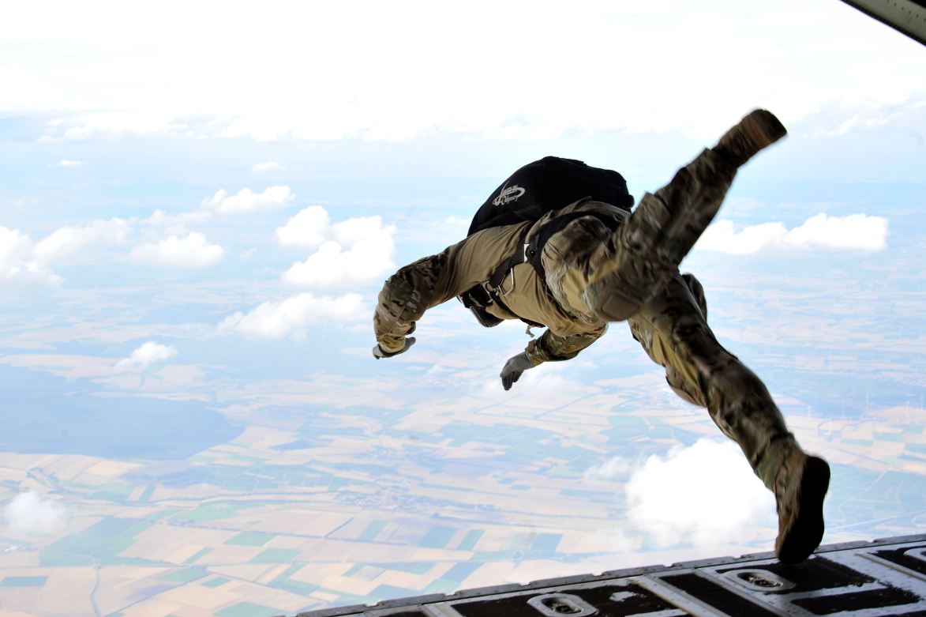

Slide 33
4.
God’s Love is closer

Slide 34
Isaiah 40:11 new living translation
He will feed his flock like a shepherd.
He will carry the lambs in his arms,
holding them close to his heart.
He will gently lead the mother sheep with their young.
.

Slide 35
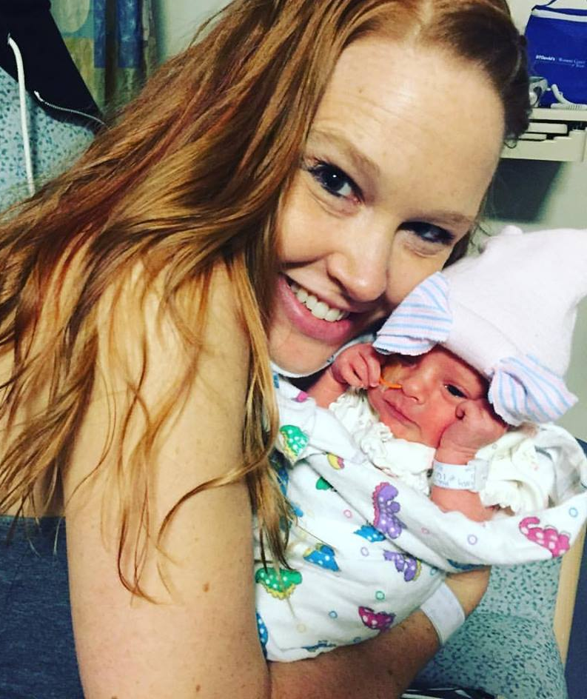

Slide 36
So What?

Slide 37
If you believe that..
God’s grace is greater
God’s promise is forever
God’s power is stronger
God’s love is closer

Slide 38
You will find true comfort and joy

Slide 39
The Messiah is Coming

