Slide 4
You prepare a feast for me
in the presence of my enemies.
You honor me by anointing my head with oil.
My cup overflows with blessings.
Psalm 23:5

Slide 5
Living in the goodness of God
How to Experience an
Overflowing Life

Slide 6
Psalm 23

Slide 7
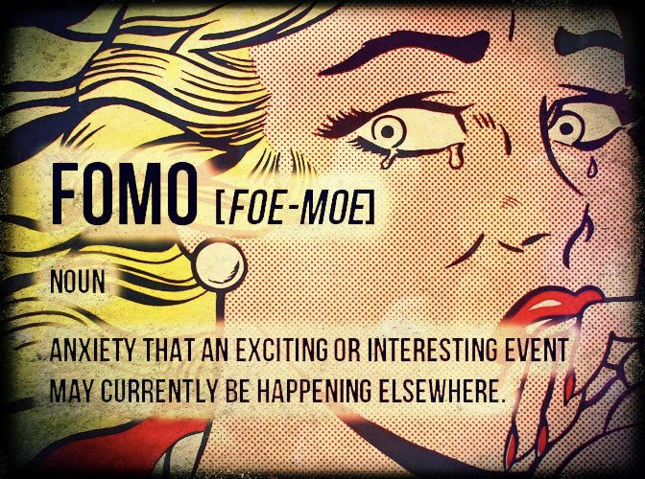
FOMO

Slide 8
Psalm 23

Slide 9
SHORTAGE MINDSET
“A man brought Elisha the prophet some loaves of bread. Elisha said, ‘Give it to the people so they can eat.’ Elisha’s servant said ‘There's not enough here for a hundred people.’
2 KINGS 4:42-43 (CEV)

Slide 10
SHORTAGE MINDSET

Slide 11
SHORTAGE MINDSET
The Focus LIMITED RESOURCES
The Result AN OVERWHELMED LIFE

Slide 15
Psalm 23

Slide 16
SURPLUS MINDSET
‘There's not enough here for a hundred people.’ ‘Just give it to them,’ replied Elisha. ‘The Lord has promised that there will be more than enough.’ So the servant gave the bread to the people. They ate until full and still had some left over, just as God had promised.”
2 KINGS 4:42-44 (CEV)

Slide 17
SURPLUS MINDSET
The Focus UNLIMITED RESOURCES
The Result AN OVERFLOWING LIFE

Slide 21
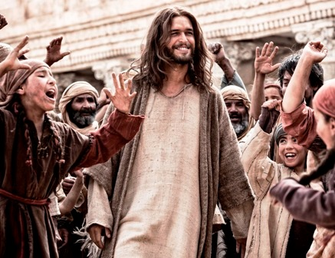

Slide 22
MY CUP is MY LIFE
“On the last day of the festival, Jesus stood and shouted to the crowds: ‘If you are thirsty, come to me and drink! Everyone who really believes in me will have rivers of living water flowing out of their lives."
John 7:37-38 (NLT)

Slide 23
Psalm 23

Slide 24
STAY CONNECTED TO JESUS EVERYDAY
1
“Yes, I am the vine; you are the branches. Those who remain in me, and I in them, will produce much fruit. For apart from me you can do nothing….but if you remain in me and my words remain in you, you may ask for anything you want, and it will be granted!
John 15:5,7

Slide 27
STOP COMPLAINING AND
START BEING GRATEFUL
2
“In everything you do,
stay away from complaining and arguing.”
Philippians 2:14

Slide 28
STOP COMPLAINING AND
START BEING GRATEFUL
2
“No matter what happens, always be thankful,
for this is God's will for you
who belong to Christ Jesus.”
1 Thessalonians 5:18

Slide 29
Psalm 23

Slide 30
STOP COMPARING AND
START BEING CONTENT
3
I have learned how to be content with whatever I have. I know how to live on almost nothing or with everything. I have learned the secret of living in every situation, whether it is with a full stomach or empty, with plenty or little.
Philippians 4:11-12

Slide 31
Psalm 23

Slide 32
STOP BEING STINGY AND
START BEING GENEROUS
4
Bring the whole tithe into the storehouse, so that there may be food in My house, and test Me now in this,” says the Lord of hosts, “if I will not open for you the windows of heaven and pour out for you a blessing until it overflows!
MALACHI 3:10 (NASB)

Slide 33
STOP BEING STINGY AND
START BEING GENEROUS
4
“For you are careful to tithe even the tiniest income from your herb gardens, but you ignore the more important aspects of the law—justice, mercy, and faith. You should tithe, yes, but do not neglect the more important things.
Matthew 23:23

Slide 34
Remember this—a farmer who plants only a few seeds will get a small crop. But the one who plants generously will get a generous crop. You must each decide in your heart how much to give. And don’t give reluctantly or in response to pressure. “For God loves a person who gives cheerfully.” And God will generously provide all you need. Then you will always have everything you need and plenty left over to share with others.
2 Corinthians 9:6-8

Slide 35
Wherever your treasure is,
there the desires of your heart will also be.
Matthew 6:21

Slide 36
Psalm 23

Slide 37
God wants us to have an Abundant Life
I have come to give you everything in abundance, more than you expect—life in its fullness until you overflow!
John 10:10 (the Passion Translation)

