Slide 2
LIVING FAITH

Slide 3
“Living faith always leads to action”
-WARREN WIERSBE

Slide 5
https://www.youtube.com/watch?v=xFntFdEGgws

Slide 6
SAVING FAITH believing in God

Slide 7
SAVING FAITH believing in God
DOCTRINAL FAITH learning more about God

Slide 8
SAVING FAITH believing in God
DOCTRINAL FAITH learning more about God PRACTICAL FAITH obeying God in everyday life

Slide 10
1
YOUR FAITH SHOULD DEMONSTRATE
intelligence

Slide 11
Then Joshua secretly sent out two spies from the Israelite camp at Acacia Grove. He instructed them, “Scout out the land on the other side of the Jordan River, especially around Jericho.”
Joshua 2:1
New Living Translation

Slide 12
And the people of Berea were more open-minded than those in Thessalonica, and they listened eagerly to Paul’s message. They searched the Scriptures day after day to see if Paul and Silas were teaching the truth.
Acts 17:11
New Living Translation

Slide 13
Faith in Christ is an intelligent faith. It is based on the weight of the evidence.
Josh mCdowell

Slide 15
Archeology
Prophecy
Literature

Slide 17
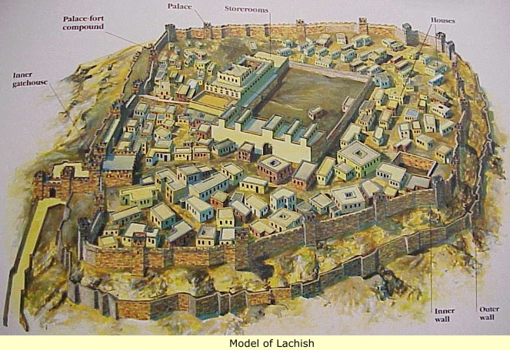

Slide 19
2
YOUR FAITH SHOULD DEMONSTRATE
freedom

Slide 20
So the two men set out and came to the house of a prostitute named Rahab and stayed there that night.
Joshua 2:1
New Living Translation

Slide 22
It was by faith that Rahab the prostitute was not destroyed with the people in her city who refused to obey God. For she had given a friendly welcome to the spies.
Hebrews 11:31 New Living Translation

Slide 24
3
YOUR FAITH SHOULD DEMONSTRATE
compassion

Slide 25
Now swear to me by the Lord that you will be kind to me and my family since I have helped you. Give me some guarantee that when Jericho is conquered, you will let me live, along with my father and mother, my brothers and sisters, and all their families.”
JOSHUA 2:12-13 New Living Translation

Slide 27
4
YOUR FAITH SHOULD DEMONSTRATE
Obedience

Slide 28
Meanwhile, Joshua said to the two spies, “Keep your promise. Go to the prostitute’s house and bring her out, along with all her family.”
JOSHUA 6:12 New Living Translation

Slide 30
-do things you’ve never done before

Slide 31
-do things you’ve never done before -focus on God

Slide 32
-do things you’ve never done before -focus on God -believe that God is not done working

