Slide 2
STAY
ON TARGET

Slide 3
Jerusalem

Slide 4
https://www.youtube.com/watch?v=D_kb8Y6qABg
Stay on Target

Slide 6
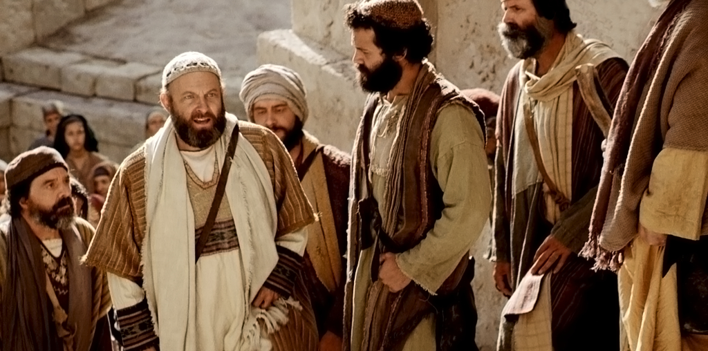
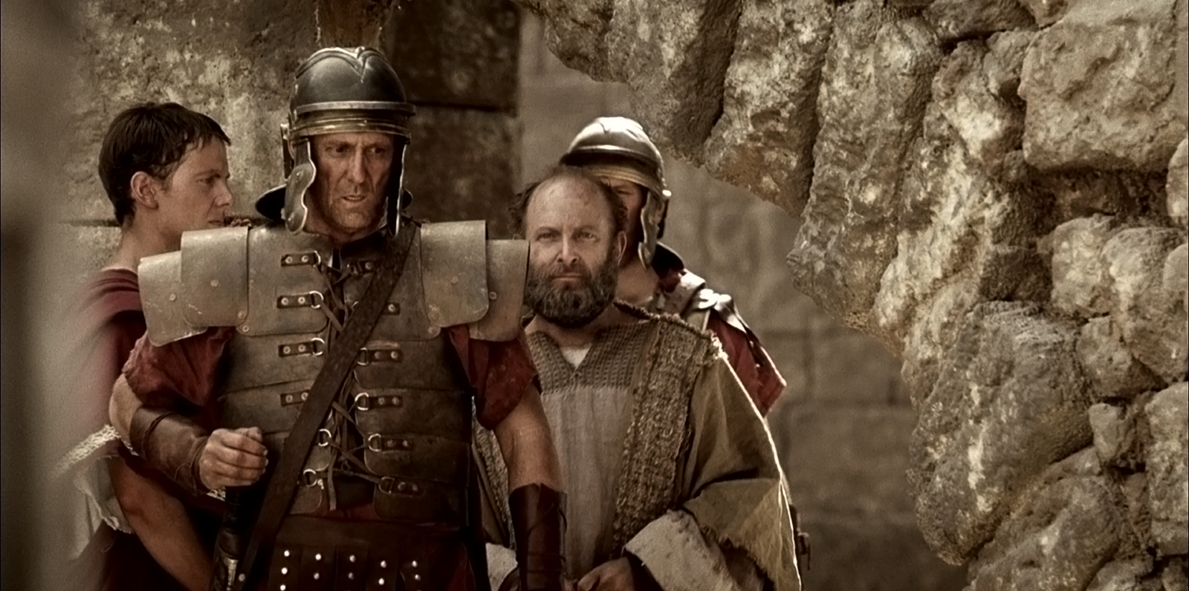

Slide 7
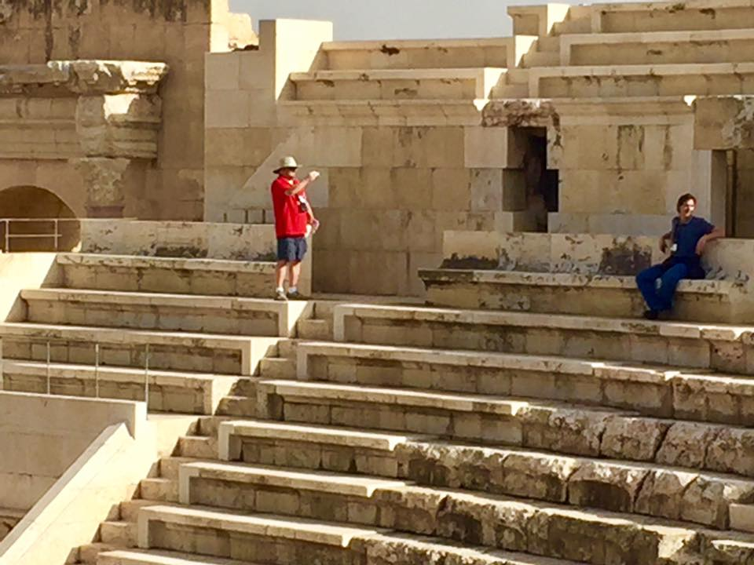
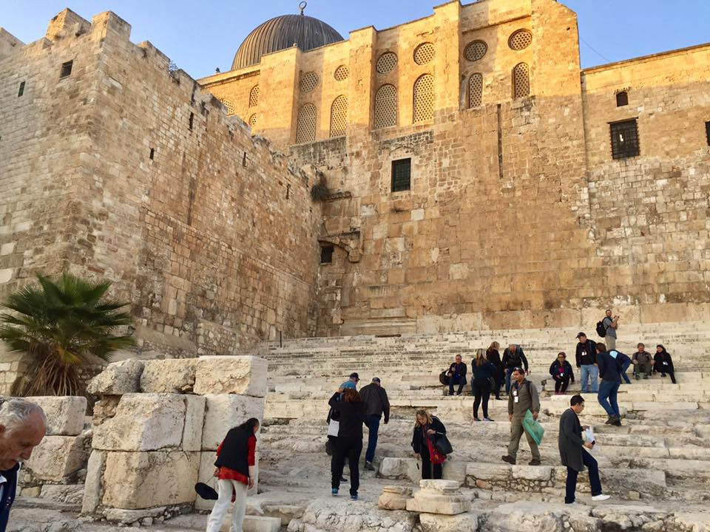

Slide 9
1
REMEMBER WHO WE SERVE

Slide 10
We gave you strict orders never again to teach in this man’s name!” he said. “Instead, you have filled all Jerusalem with your teaching about him, and you want to make us responsible for his death!”
But Peter and the apostles replied,
“We must obey God rather than any human authority.”
Acts 5: 28-29
new living translation

Slide 11
“Everyone must submit to governing authorities. For all authority comes from God, and those in positions of authority have been placed there by God. So anyone who rebels against authority is rebelling against what God has instituted, and they will be punished.”
Romans 13:1-2 new living translation

Slide 12
“I urge you, first of all, to pray for all people. Ask God to help them; intercede on their behalf, and give thanks for them. Pray this way for kings and all who are in authority so that we can live peaceful and quiet lives marked by godliness and dignity. This is good and pleases God our Savior.”
1 Timothy 2:1-3 new living translation

Slide 13
“I don’t really care if you voted for the president or not, he’s been placed there by the Lord, and I would say that about our last president. We are told to pray for those in authority, so I think it’s time to stop saying ‘He’s not my president.’”
Pastor Greg Laurie Harvest Christian Fellowship Riverside, CA Family Life Radio Interview: May 15, 2017

Slide 15
• Christians should resist a government that commands or compels evil and should work nonviolently within the laws of the land to change a government that permits evil.
• Civil disobedience is permitted when the government’s laws or commands are in direct violation of God’s laws and commands.
• If a Christian disobeys an evil government, unless he can flee from the government, he should accept that government’s punishment for his actions.
• Christians are certainly permitted to work to install new government leaders within the laws that have been established.

Slide 17
2
EXPECT TROUBLE

Slide 18
The apostles left the high council rejoicing
that God had counted them worthy
to suffer disgrace for the name of Jesus.
Acts 5:21 new living translation

Slide 19
“God blesses you when people mock you and persecute you and lie about you and say all sorts of evil things against you because you are my followers. Be happy about it! Be very glad! For a great reward awaits you in heaven. And remember, the ancient prophets were persecuted in the same way.”
Matthew 5:11-12 new living translation

Slide 20
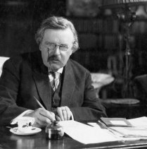
“Jesus promised his disciples three things—that they would be completely fearless, absurdly happy, and in constant trouble.”
G.K. Chesterton British author

Slide 22
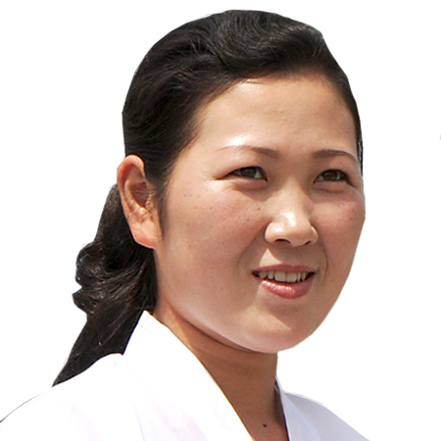
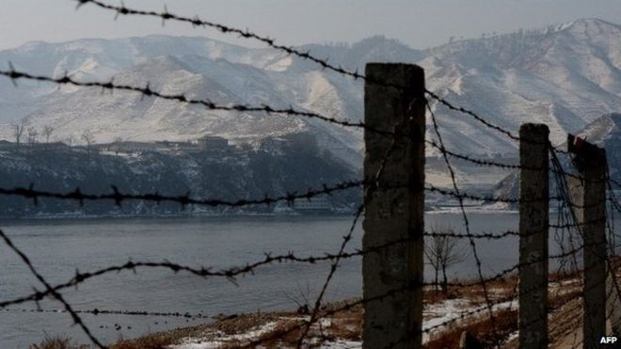
Ae-Cha

Slide 24
3
BE CONTINUALLY

Slide 25
And every day, in the Temple and from house to house,
they continued….
Acts 5:42 new living translation

Slide 26
•continual purity
•continual power
•continual persecution
•continual persistence

Slide 28
4
SHARE THE RIGHT MESSAGE

Slide 29
And every day, in the Temple and from house to house,
they continued to teach and preach this message:
“Jesus is the Messiah.”
Acts 5:42 new living translation

Slide 30
Romans Road
Romans 3:23 For everyone has sinned; we all fall short of God’s glorious standard.
Romans 5:8 But God showed his great love for us by sending Christ to die for us while we were still sinners.
Romans 6:23 For the wages of sin is death, but the free gift of God is eternal life through Christ Jesus our Lord.
Romans 10:9 If you openly declare that Jesus is Lord and believe in your heart that God raised him from the dead, you will be saved.

Slide 31
Admit: Romans 3:23 For everyone has sinned; we all fall short of God’s glorious standard.
Believe: John 3:16 For God so loved the world, that he gave his one and only Son, that whoever believes in Him will not perish, but have eternal life.
Confess: Romans 10:9 If you confess with your mouth that Jesus is Lord and believe in your heart that God raised him from the dead, you will be saved.

Slide 33
Dear God, I know that I am a sinner and there is nothing that I can do to save myself. Today I give my life to Jesus, who alone is the One who bore my sin when He died on the cross. I believe that Jesus was raised from the dead as a guarantee of my own eternal life. As best as I can, I now transfer my trust to you. I am grateful that You has promised to receive me despite my many sins and failures. Thank you for the assurance that you will walk with me through the rest of my life.
In Jesus’ Name. Amen

