Slide 2
Book of the TWELVE

Slide 3
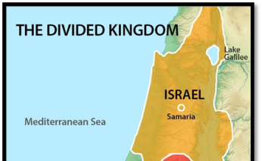

Slide 4
AMOS
Come back to god and live

Slide 5
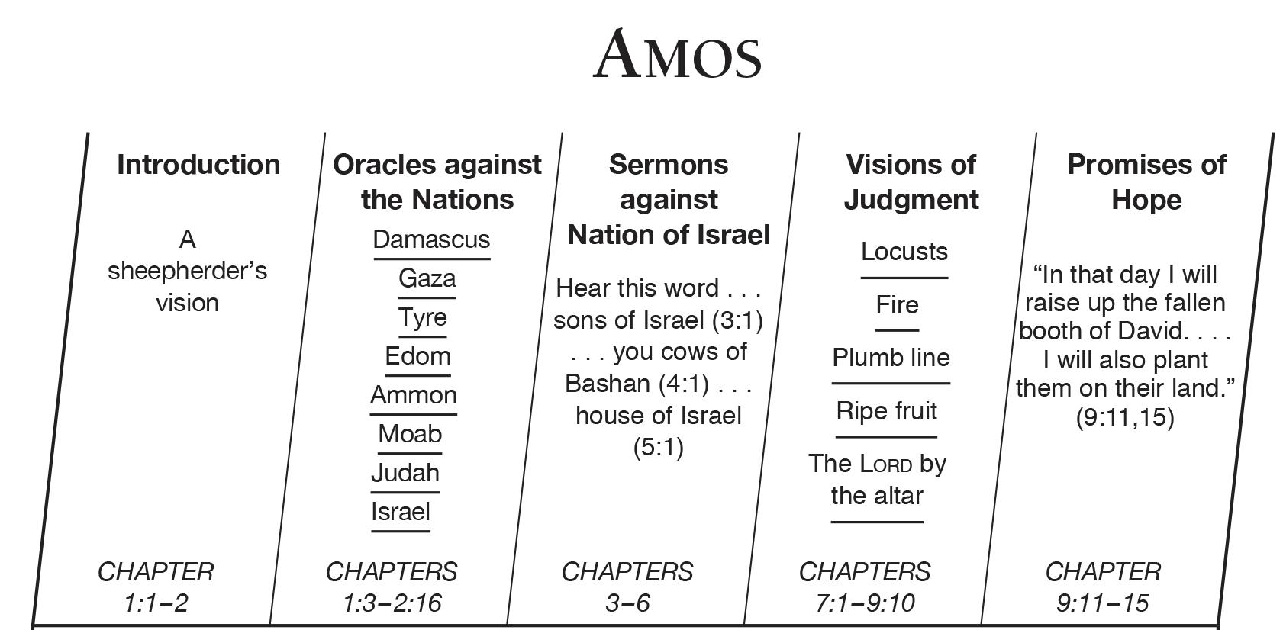

Slide 6
AMOS
Just a shepherd “I’m not a professional prophet, and I was never trained to be one. I’m just a shepherd, and I take care of sycamore-fig trees. But the Lord called me away from my flock and told me, ‘Go and prophesy to my people in Israel.’ Now then, listen to this message from the Lord. Amos 7:14

Slide 8
3 PROBLEMS
They sell honorable people for silver and poor people for a pair of sandals. They trample helpless people in the dust and shove the oppressed out of the way. Both father and son sleep with the same woman, corrupting my holy name. At their religious festivals, they lounge in clothing their debtors put up as security. In the house of their gods, they drink wine bought with unjust fines.
Amos 2:6-8

Slide 9
3 PROBLEMS
They sell honorable people for silver and poor people for a pair of sandals. They trample helpless people in the dust and shove the oppressed out of the way. Both father and son sleep with the same woman, corrupting my holy name. At their religious festivals, they lounge in clothing their debtors put up as security. In the house of their gods, they drink wine bought with unjust fines.
Amos 2:6-8
INJUSTICE

Slide 10
3 PROBLEMS
They sell honorable people for silver and poor people for a pair of sandals. They trample helpless people in the dust and shove the oppressed out of the way. Both father and son sleep with the same woman, corrupting my holy name. At their religious festivals, they lounge in clothing their debtors put up as security. In the house of their gods, they drink wine bought with unjust fines.
Amos 2:6-8
IMMORALITY

Slide 11
3 PROBLEMS
They sell honorable people for silver and poor people for a pair of sandals. They trample helpless people in the dust and shove the oppressed out of the way. Both father and son sleep with the same woman, corrupting my holy name. At their religious festivals, they lounge in clothing their debtors put up as security. In the house of their gods, they drink wine bought with unjust fines.
Amos 2:6-8
IDOLATRY

Slide 13
4 LESSONS

Slide 14
THINK OF OTHERS
As Better Than Ourselves
1

Slide 15
Away with your noisy hymns of praise!
I will not listen to the music of your harps. Instead, I want to see a mighty flood of justice, an endless river of righteous living.
Amos 5:23-24

Slide 16
Listen to me, you fat cows living in Samaria, you women who oppress the poor and crush the needy, and who are always calling to your husbands,
“Bring us another drink!”
Amos 4:1

Slide 17
Don’t be selfish; don’t try to impress others. Be humble, thinking of others as better than yourselves. Don’t look out only for your own interests, but take an interest in others, too.
Philippians 2:3-4

Slide 19
https://www.youtube.com/watch?v=24aXV5DKmhM

Slide 21
How We Treat The Poor
Matters
2

Slide 22
“you who rob the poor…cheating the helpless…dishonest measures….cheat the buyer…..mix the grain….enslave the poor…
I will never forget the wicked things you have done! The earth will tremble for your deeds, and everyone will mourn.
Amos 8:4-8

Slide 23
“Do what is good and run from evil so that you may live! Then the LORD God of Heaven’s Armies will be your helper, just as you have claimed. Hate evil and love what is good; turn your courts into true halls of justice. Perhaps even yet the LORD God of Heaven’s Armies will have mercy on the remnant of his people.
Amos 5:14-15

Slide 24
Justice:
treating people equitably. It means acquitting or punishing every person on the merits of the case, regardless of race or social status. Anyone who does the same wrong should be given the same penalty.
It also means giving people their rights.

Slide 26
3
God’s Gifts Come With
Responsibilities

Slide 27
It was I who rescued you from Egypt
and led you through the desert for forty years…
Amos 2:10

Slide 29
God’s Is The God Of
Promises
4

Slide 30
I will bring my exiled people of Israel
back from distant lands, and they will rebuild their ruined cities
and live in them again. They will plant vineyards and gardens; they will eat their crops and drink their wine.
I will firmly plant them there
in their own land. They will never again be uprooted from the land I have given them,” says the LORD your God.
Amos 9:14-15

Slide 31
I will never completely destroy the family of Israel.
Amos 9:8

Slide 33
Repent, Receive, Restore

Slide 34
Repent, Receive, Restore
Believe, receive, Apply

Slide 35
AMOS
Come Back to the Lord and Live

