Slide 4
The Lord is my shepherd;
I have all that I need.
He lets me rest in green meadows;
he leads me beside peaceful streams.
He renews my strength…
Psalm 23:1-3

Slide 5
Psalm 23

Slide 6
Living in the goodness of God
How God’s Goodness Can Restore You

Slide 7
Psalm 23

Slide 8
Then Jesus said, “Come to me,
all of you who are weary and carry heavy burdens, and I will give you rest. Take my yoke upon you. Let me teach you, because I am humble and gentle at heart, and you will find rest for your souls.
For my yoke is easy to bear, and the burden I give you is light.”
Matthew 11:28-30

Slide 9
Psalm 23

Slide 10
WHAT DAMAGES US?

Slide 11
Unaddressed Grudges
Surely resentment destroys the fool,
and jealousy kills the simple.
job 5:2

Slide 12
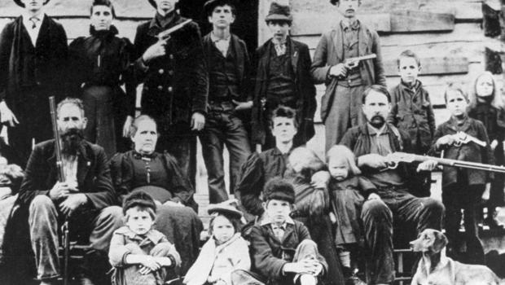

Slide 13
Unaddressed guilt
“My guilt has overwhelmed me like a burden too heavy to bear ... I’m bowed down and brought low; all day long I go about mourning.” Psalm 38:4,6

Slide 14
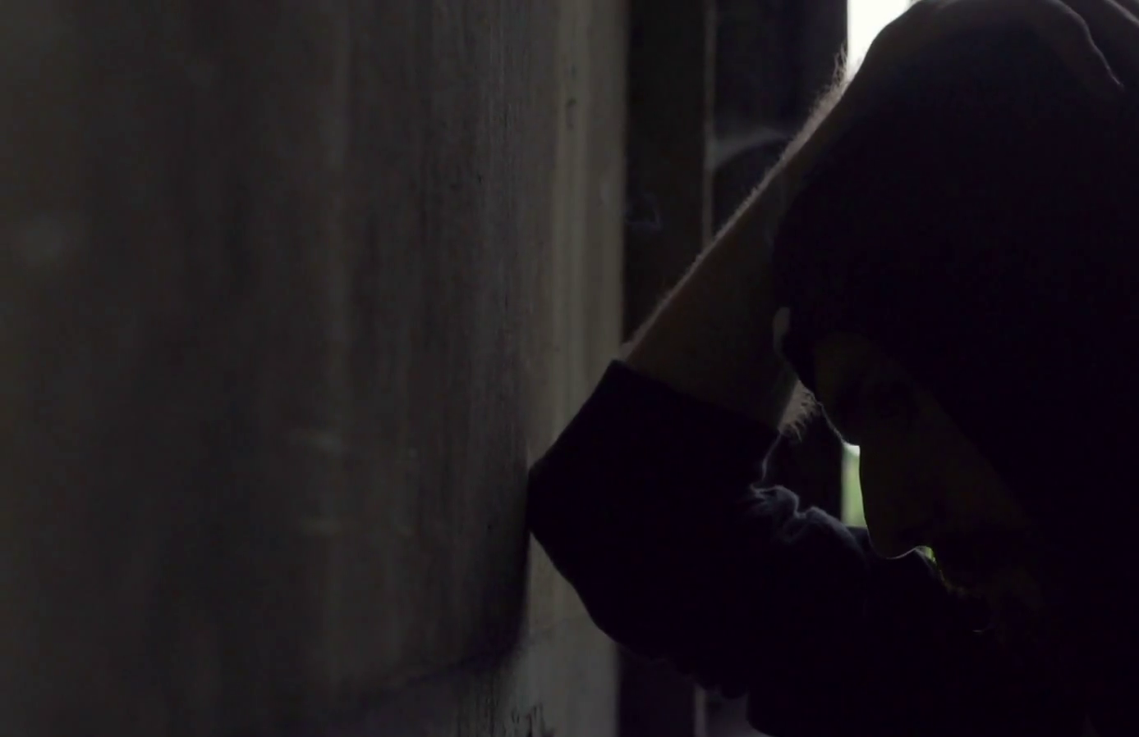
KING DAVID Psalm 38
My guilt overwhelms me— it is a burden too heavy to bear. ⁵ My wounds fester and stink because of my foolish sins. ⁶ I am bent over and racked with pain. All day long I walk around filled with grief. ⁷ A raging fever burns within me, and my health is broken. ⁸ I am exhausted and completely crushed. My groans come from an anguished heart.

Slide 15
Unaddressed Grief
“Lord, have mercy, because I am in misery. My eyes are weak from so much crying, and my whole being is tired from grief.” Psalm 31:9

Slide 17
HOW DOES JESUS RESTORE OUR SOUL?

Slide 18
1
Jesus makes something good out of bad
You intended to harm me,
but God intended it all for good. Genesis 50:20

Slide 19
Psalm 23

Slide 20
2
Jesus takes my guilt on himself
But he was pierced for our rebellion,
crushed for our sins.
He was beaten so we could be whole.
He was whipped so we could be healed. Isaiah 53:5

Slide 21
Psalm 23

Slide 22
3
Jesus feels my grief and Heals my heart
He was despised and rejected—
a man of sorrows, acquainted with deepest grief. Isaiah 53:3

Slide 23
Psalm 23

Slide 24
HOW SHOULD WE RESPOND?

Slide 25
Trust that Jesus forgave YOU
So now there is no condemnation for those who belong to Christ Jesus. Romans 8:1

Slide 26
Forgive YOur offenders
Get rid of all bitterness, rage, anger, harsh words, and slander, as well as all types of evil behavior. Instead, be kind to each other, tenderhearted, forgiving one another, just as God through Christ has forgiven you.
Ephesians 4:31-32

Slide 27
Yoke up With Jesus
Take my yoke upon you.
Matthew 11:29

Slide 28
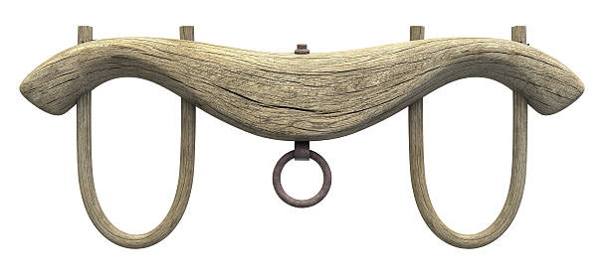

Slide 29
Then Jesus said, “Come to me,
all of you who are weary and carry heavy burdens, and I will give you rest. Take my yoke upon you. Let me teach you, because I am humble and gentle at heart, and you will find rest for your souls.
For my yoke is easy to bear, and the burden I give you is light.”
Matthew 11:28-30

Slide 30
when you're yoked up with Jesus,
it's impossible for you to run
into the ditch
Psalm 23

