Slide 2
TRIAL

Slide 3
THE

Slide 4
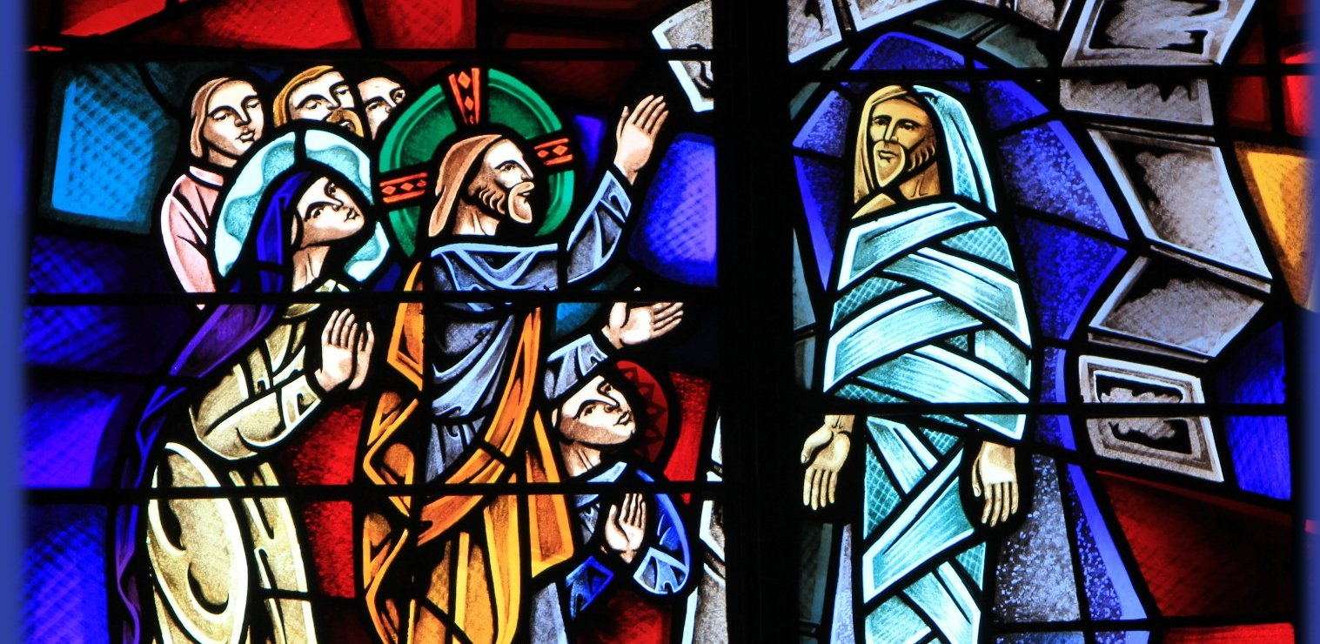
THE

Slide 5
Caiaphas, who was high priest at that time, said, “You don’t know what you’re talking about! You don’t realize that it’s better for you that one man should die for the people than for the whole nation to be destroyed.”
John 11:49-50 New Living Translation
THE

Slide 6
He did not say this on his own; as high priest at that time he was led to prophesy that Jesus would die for the entire nation. And not only for that nation, but to bring together and unite all the children of God scattered around the world.
John 11:51-52 New Living Translation
THE

Slide 7
THE

Slide 8
1
act fairly and justly
THE

Slide 9
“Appoint judges and officials for yourselves from each of your tribes in all the towns the LORD your God is giving you. They must judge the people fairly. You must never twist justice or show partiality. Never accept a bribe, for bribes blind the eyes of the wise and corrupt the decisions of the godly. Let true justice prevail, so you may live and occupy the land that the LORD your God is giving you.”
THE
Deuteronomy 16:18-20 New International Version

Slide 10
If community had 120 heads of family: council of justice….Sanhedrin of 23 men
Smaller community: 3-7 Elders would judge matters of concern
THE

Slide 11
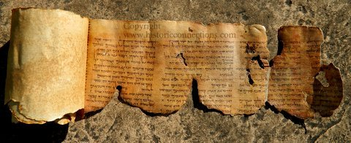
three primary criminal procedure laws
1. public trial – public trial
2. the right of self-defense - a lawyer to be present
3. no one could be convicted of anything unless convicted or proven to be guilty by two or three witnesses.
THE

Slide 12
-execution could not be accomplished until the third day.
-witnesses had to cast the first stone in the execution.
-a woman could not be a witness, because she would not have the courage to give the first blow to the condemned person.
-Jewish law said no person can himself testify against himself, and on the basis of that single testimony, be held guilty.
-No criminal trial could be carried through the night -Jews did not have the right of execution
THE

Slide 13
So now, come back to your God. Act with love and justice, and always depend on him.
Hosea 12:6 New Living Translation
THE

Slide 14
Hate evil and love what is good; turn your courts into true halls of justice. Perhaps even yet the LORD God of Heaven’s Armies will have mercy on the remnant of his people.
Amos 5:5 New Living Translation
THE

Slide 15
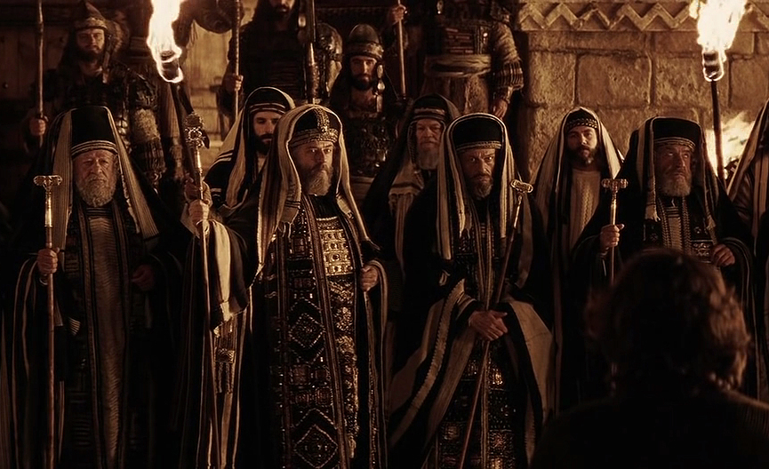
In Jerusalem, the great council, great Sanhedrin, consisted of 70 men who were elders, 24 chief priests, 24 elders, 23 scribes plus the high priest…makes 71
THE

Slide 16
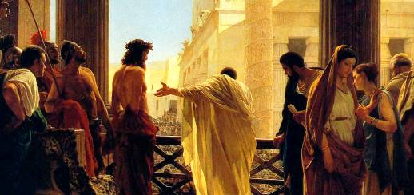
Annas – former high priest Caiaphas – current high priest Sanhedrin – early Friday morning Pilate – questions Jesus Herod Antipas – from Galilee Pilate – condemns Jesus
THE

Slide 17
THE

Slide 18
2
beware of the love of money
THE

Slide 19
For the love of money is the root of all kinds of evil. And some people, craving money, have wandered from the true faith and pierced themselves with many sorrows.
1 Timothy 6:10 New Living Translation
THE

Slide 20
First they took him to Annas, since he was the father-in-law of Caiaphas, the high priest at that time. Caiaphas was the one who had told the other Jewish leaders, “It’s better that one man should die for the people.”
John 18:13-14 New Living Translation
THE

Slide 21
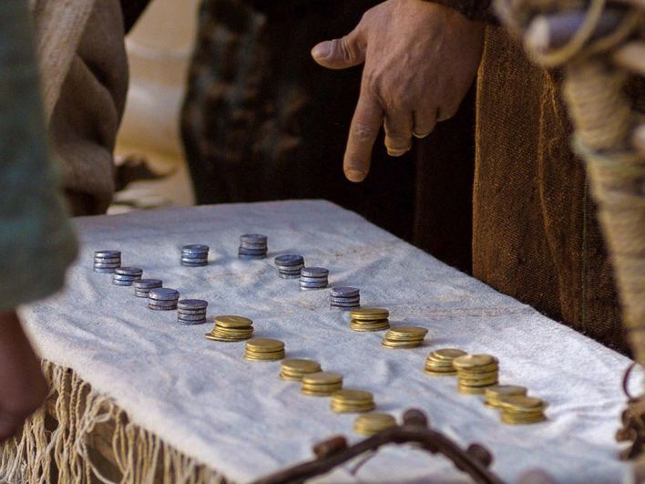
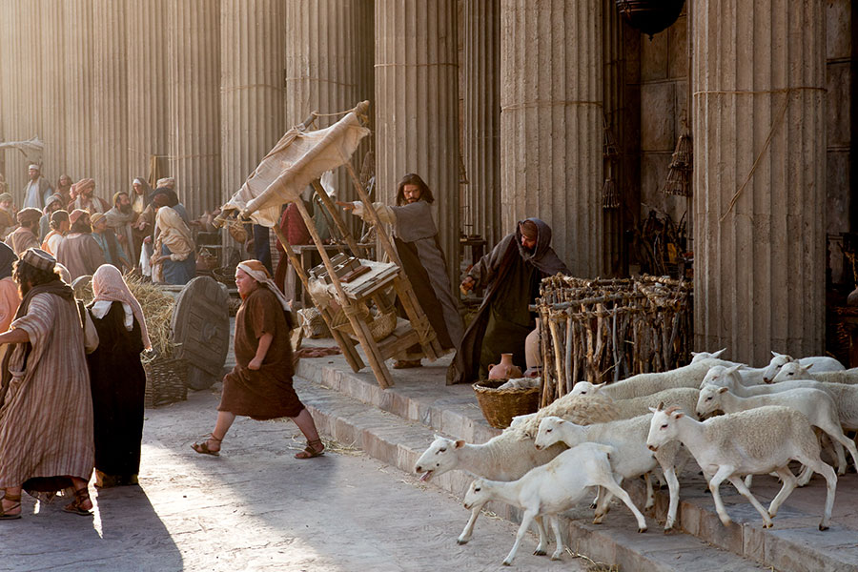
THE

Slide 22
THE

Slide 23
Why are you asking me this question?
John 18:21 New Living Translation
THE

Slide 24
3
step out of the shadows of injustice
THE

Slide 25
Now there was a good and righteous man named Joseph. He was a member of the Jewish high council, but he had not agreed with the decision and actions of the other religious leaders. He was from the town of Arimathea in Judea, and he was waiting for the Kingdom of God to come.
Luke 23:50-51 New Living Translation
THE

Slide 26
Peter followed him at a distance
Matthew 26:58 New Living Translation
THE

Slide 27
THE

Slide 28
4
Jesus is absolutely perfect
THE

Slide 29
…but Jesus remained silent
Matthew 26:63 New Living Translation
THE

Slide 30
He was oppressed and treated harshly, yet he never said a word. He was led like a lamb to the slaughter. And as a sheep is silent before the shearers, he did not open his mouth.
Isaiah 53:7 New Living Translation
THE

Slide 31
THE

Slide 32
5
beware of evil moments
THE

Slide 33
Then the high priest said…
Matthew 26:63 New Living Translation
THE

Slide 34
“You have said it. And in the future you will see the Son of Man seated in the place of power at God’s right hand and coming on the clouds of heaven.
Matthew 26:642 New Living Translation
THE

Slide 35
I saw someone like a son of man[d]coming with the clouds of heaven. He approached the Ancient One and was led into his presence. 14 He was given authority, honor, and sovereignty over all the nations of the world, so that people of every race and nation and language would obey him. His rule is eternal—it will never end. His kingdom will never be destroyed.
Daniel 7:12-13 New Living Translation
THE

Slide 36
THE

