Slide 2
INFLUENCE THOSE
AROUND YOU

Slide 3
Jerusalem

Slide 5
1
SEE THE NEEDS AROUND YOU

Slide 6
“As they approached the Temple, a man lame from birth was being carried in. Each day he was put beside the Temple gate, the one called the Beautiful Gate, so he could beg from the people going into the Temple. 3 When he saw Peter and John about to enter, he asked them for some money.”
Acts 3: 2-3 new living translation

Slide 7
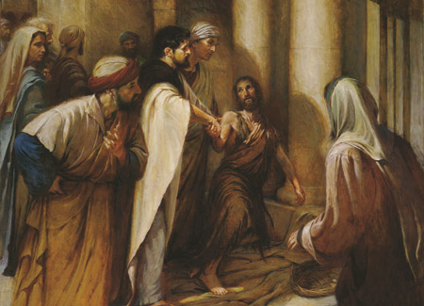

Slide 8
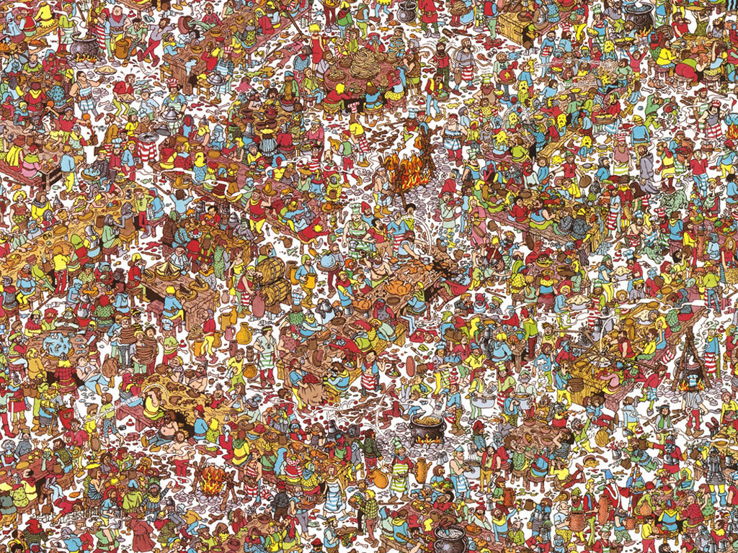

Slide 11
2
FOCUS ON WHAT YOU HAVE

Slide 12
Then Peter said, “Silver or gold I do not have, but what I do have I give you. In the name of Jesus Christ of Nazareth, walk.”
Acts 3:6 new living translation

Slide 13
VIDEO OF KID WITHOUT MUCH

Slide 15
3
DON’T OBSESS ON PAST FAILURES

Slide 16
Peter saw his opportunity and addressed the crowd.
“People of Israel,” he said, “what is so surprising about this? And why stare at us as though we had made this man walk by our own power or godliness?”
Acts 3:12 new living translation

Slide 18
4
MAKE IT ALL ABOUT JESUS

Slide 19
For it is the God of Abraham, Isaac, and Jacob—the God of all our ancestors—who has brought glory to his servant Jesus by doing this. This is the same Jesus…You rejected this holy, righteous one…You killed the author of life, but God raised him from the dead. And we are witnesses of this fact! “Through faith in the name of Jesus, this man was healed—and you know how crippled he was before. Faith in Jesus’ name has healed him before your very eyes.
Acts 3:13-16 new living translation

Slide 20
There is salvation in no one else! God has given no other name under heaven by which we must be saved.”
Acts 4:12 new living translation

Slide 22
5
PRAY FOR SOMETHING BIG

Slide 23
The members of the council were amazed
when they saw the boldness of Peter and John,
for they could see that they were ordinary men with
no special training in the Scriptures.
They also recognized them as men
who had been with Jesus.
Acts 4:13 new living translation

Slide 25
The members of the council were amazed
when they saw the boldness of Peter and John,
for they could see that they were ordinary men with
no special training in the Scriptures.
They also recognized them as men
who had been with Jesus.
Acts 4:13 new living translation

Slide 27
“And now, O Lord, hear their threats, and give us,
your servants, great boldness in preaching your word.
Stretch out your hand with healing power;
may miraculous signs and wonders be done through
the name of your holy servant Jesus.”
Acts 4:29-30 new living translation

