Slide 1
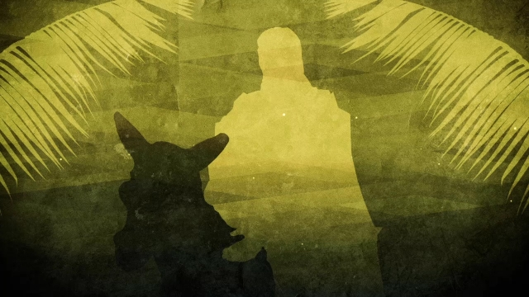
Happy Palm Sunday

Slide 2
Little Things Well

Slide 4
Well done, good and faithful servant! You have been faithful with a few things; I will put you in charge of many things. Come and share your master’s happiness!
Matthew 25:21 whatever you did for one of the least of these brothers and sisters of mine, you did for me. Matthew 25:40 If you are faithful in little things,
you will be faithful in large ones. Luke 16:10

Slide 5
1
Accept the Opportunities You Have Been Given
“he sent two disciples ahead.”
Luke 19:29 NLT

Slide 6
Now when David had served God’s purpose in his own generation, he fell asleep. Acts 13:36 Jesus said “For the works that the Father has given me to finish” John 5:36
And let us run with endurance the race God has set before us. Hebrew 12:1

Slide 7
Gideon: “I will be with you.” Judges 6:16 Moses: “I will be with you” Exodus 3:12 Joshua: “I will be with you” Joshua 1:5

Slide 9
2
Don’t Give Up
“If anyone asks, ‘Why are you untying that colt?’ just say, ‘The Lord needs it.’”
Luke 19:31 NLT

Slide 10
Even when you go through Suffering
“In this world you will have trouble. But take heart! I have overcome the world.” John 16:33 NIV

Slide 11
Even when you fail and make mistakes Humble yourselves before the Lord, and he will lift you up. James 4:10 NIV

Slide 12
Even when your faith is weak
“You of little faith, why are you so afraid?” Then he got up and rebuked the winds and the waves, and it was completely calm.” Matt 8:26

Slide 14
3
God Expects to work through you
“and found it just as he had told them.”
Luke 19:32 NIV

Slide 15
Rejoice, O people of Zion! Shout in triumph, O people of Jerusalem! Look, your king is coming to you. He is righteous and victorious, yet he is humble, riding on a donkey— riding on a donkey’s colt Zechariah 9:9 NLT

Slide 16
Money bribe would be used to buy a field. Zechariah 11:12-13
Messiah would be falsely accused. Psalm 35:11
Messiah would be silent before his accusers. Isaiah 53:7
Messiah would be spat upon and struck. Isaiah 50:6 Messiah would be hated without cause. Psalm 35:19
Messiah would be crucified with criminals. Isaiah 53:12 Messiah would be given vinegar to drink. Psalm 69:21 Messiah's hands and feet would be pierced. Psalm 22:16
Messiah would be mocked and ridiculed. Psalm 22:7-8
Soldiers would gamble for Messiah's garments. Psalm 22:18
Messiah's bones would not be broken. Exodus 12:46
Messiah would be forsaken by God. Psalm 22:1
Messiah would pray for his enemies. Psalm 109:4 Soldiers would pierce Messiah's side. Zechariah 12:10
Messiah would be buried with the rich. Isaiah 53:9
Messiah would resurrect from the dead. Psalm 16:10; Psalm 49: 42
Messiah would ascend to heaven. Psalm 68:18

Slide 17
351

Slide 19
do those little things well

