Slide 2
GOSPEL
CONVERSATIONS

Slide 4
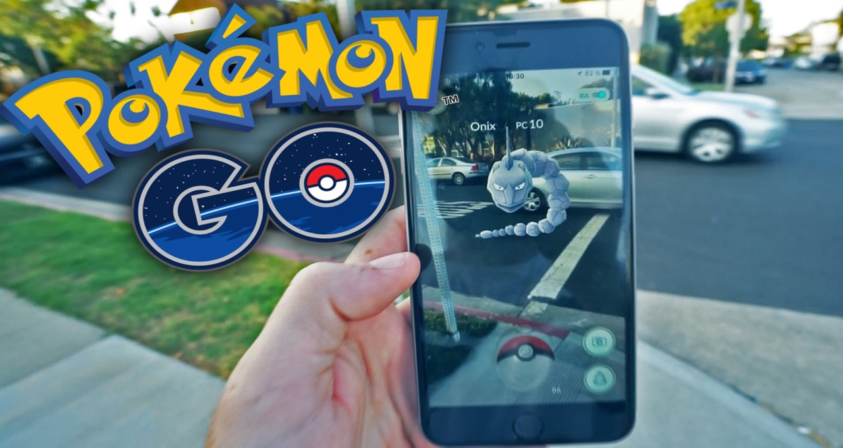
July 2016
Most downloads in first week
650,000,000 downloads
3rd largest country in world
20,000 people last weekend at Grant Park in Chicago

Slide 6
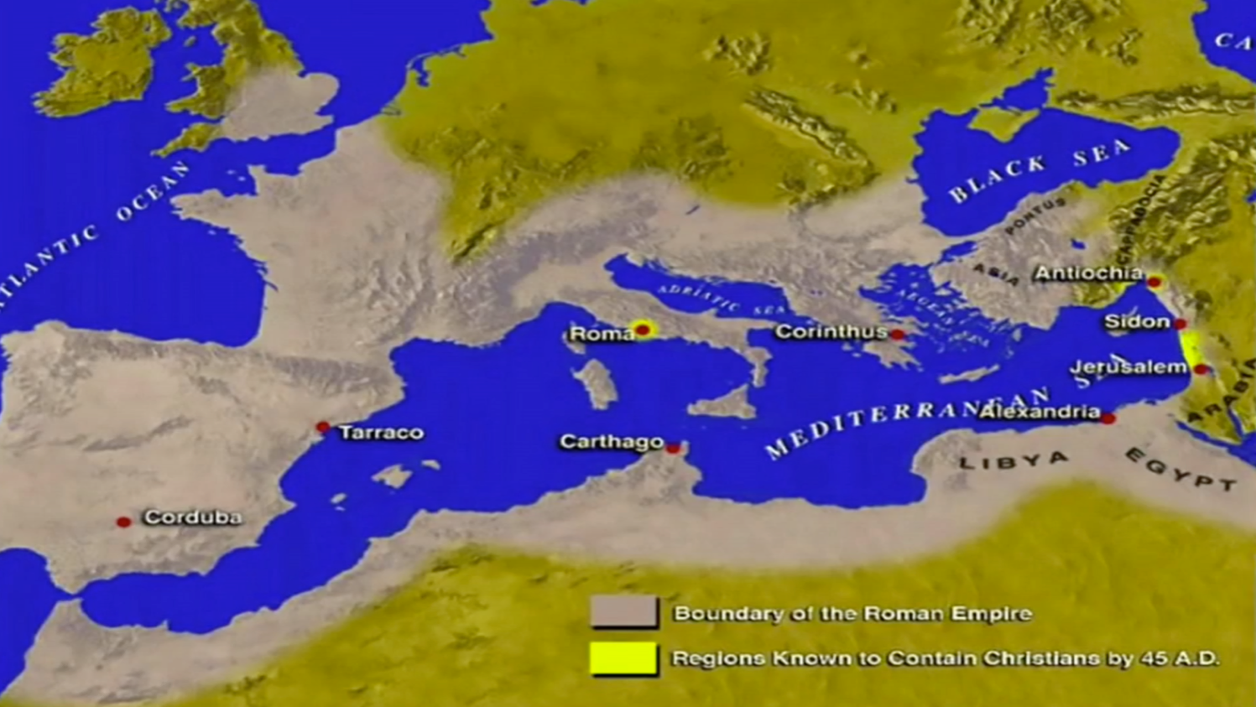

Slide 8
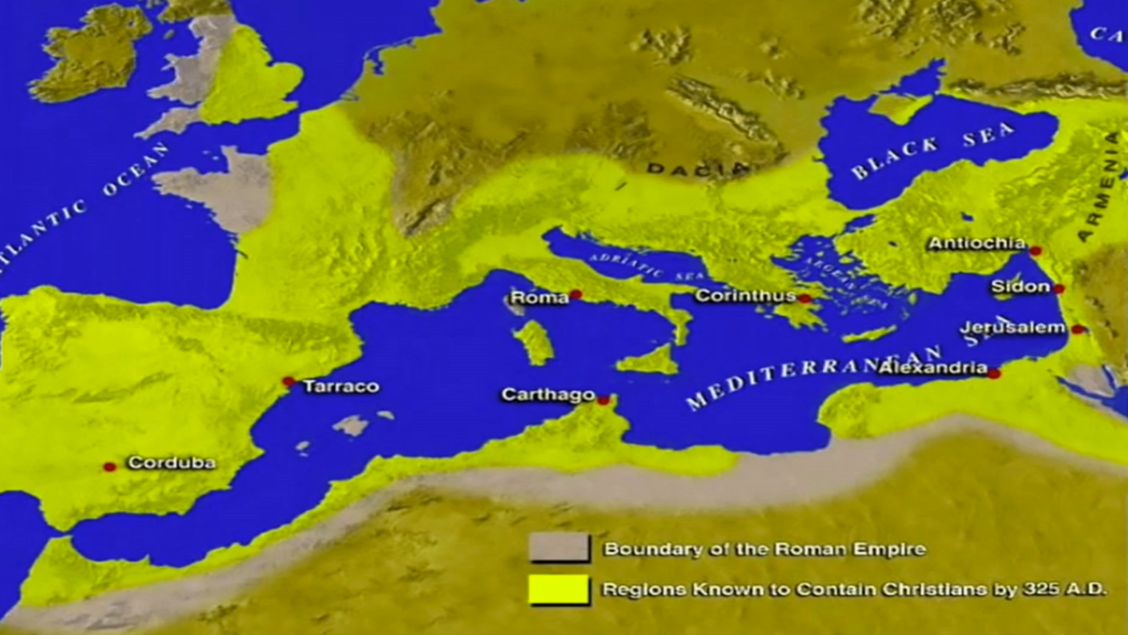

Slide 9
LYDIA
CONVERSATION
1

Slide 10
SLAVE GIRL
CONVERSATION
2

Slide 11
PHILIPPIAN JAILOR
CONVERSATION
3

Slide 12
TO SHOW US SOMETHING
ABOUT THE GOSPEL
1

Slide 13
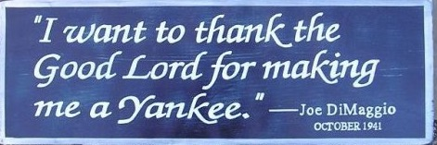

Slide 14
“I bleed Dodger blue and when I die, I'm going to the big Dodger in the sky.”
Tommy Lasorda
“The only Angels in Los Angeles are in Heaven, and they’re looking down on the Dodgers”

Slide 15
TO SHOW US SOMETHING
ABOUT THE GOSPEL
1

Slide 16
TO SHOW US HOW TO REACH
DIFFERENT KINDS
OF PEOPLE
2

