Slide 2
OUR HOPE
IS NOT IN THE BOAT

Slide 4
EXPECT
1
STORMS

Slide 5
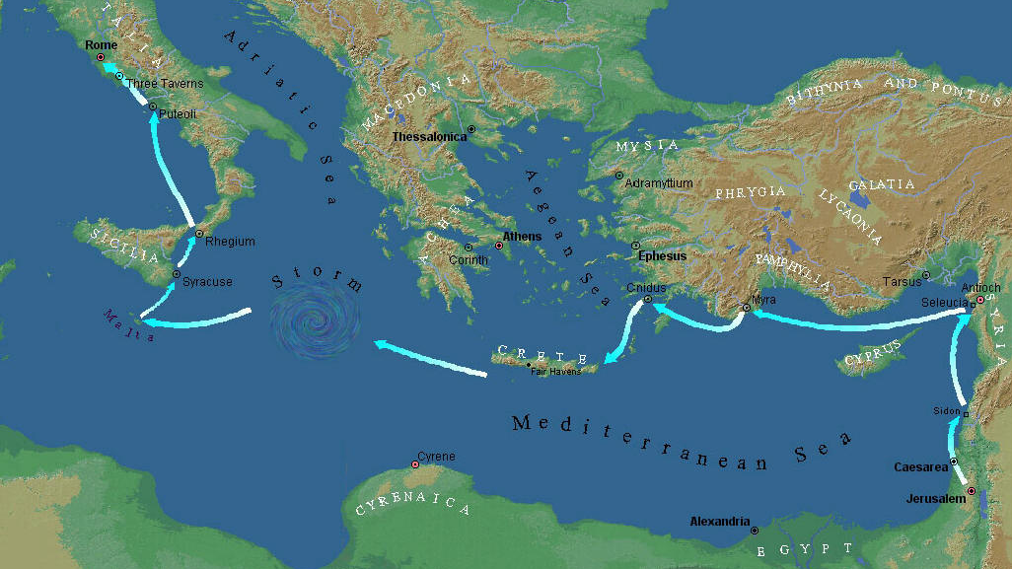
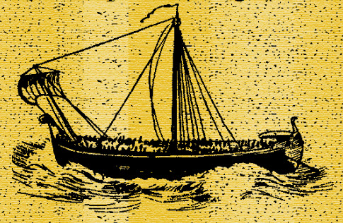

Slide 6
When a light wind began blowing from the south, the sailors thought they could make it. So they pulled up anchor and sailed close to the shore of Crete. But the weather changed abruptly, and a wind of typhoon strength (called a “northeaster”) burst across the island and blew us out to sea.
Acts 27:13-14 new living translation

Slide 8
KEEP
2
SHOWING UP

Slide 9
The sailors couldn’t turn the ship into the wind, so they gave up and let it run before the gale. We sailed along the sheltered side of a small island named Cauda, where with great difficulty we hoisted aboard the lifeboat being towed behind us. Then the sailors bound ropes around the hull of the ship to strengthen it. They were afraid of being driven across to the sandbars of Syrtis off the African coast, so they lowered the sea anchor to slow the ship and were driven before the wind.
Acts 27:15-17 new living translation

Slide 11
Don’t fear

Slide 12
Don’t fear
Don’t fret

Slide 13
Don’t fear
Don’t fret
Don’t faint

Slide 14
Don’t fear
Don’t fret
Don’t faint
Don’t forget

Slide 15
Our ancestors in Egypt were not impressed by the Lord’s miraculous deeds. They soon forgot his many acts of kindness to them. Instead, they rebelled against him at the Red Sea. Even so, he saved them— to defend the honor of his name and to demonstrate his mighty power. He commanded the Red Sea to dry up. He led Israel across the sea as if it were a desert. So he rescued them from their enemies and redeemed them from their foes. Then the water returned and covered their enemies; not one of them survived. Then his people believed his promises. Then they sang his praise. Yet how quickly they forgot what he had done!
Psalm 106: 7-13 new living translation

Slide 17
3
PRIORITIZE
WHAT’S IMPORTANT

Slide 18
We took such a violent battering from the storm that the next day they began to throw the cargo overboard. On the third day, they threw the ship’s tackle overboard with their own hands.
Acts 27:18-19 new living translation

Slide 19
STUCK

Slide 20
Self absorbed T U C K

Slide 21
Self absorbed Tomorrow U C K

Slide 22
Self absorbed Tomorrow Unwilling to trust in God C K

Slide 23
Self absorbed Tomorrow Unwilling to trust in God Comfortable in pain K

Slide 24
Self absorbed Tomorrow Unwilling to trust in God Comfortable in pain Keep looking backwards

Slide 25
Then the sailors tried to abandon the ship; they lowered the lifeboat as though they were going to put out anchors from the front of the ship. But Paul said to the commanding officer and the soldiers, “You will all die unless the sailors stay aboard.” So the soldiers cut the ropes to the lifeboat and let it drift away.
Acts 27:30-32 new living translation

Slide 27
4
TRUST GOD
TO MANGE YOUR LIFE

Slide 28
Paul called the crew together and said, “Men, you should have listened to me in the first place and not left Crete. You would have avoided all this damage and loss. But take courage! None of you will lose your lives, even though the ship will go down. For last night an angel of the God to whom I belong and whom I serve stood beside me, and he said, ‘Don’t be afraid, Paul, for you will surely stand trial before Caesar! What’s more, God in his goodness has granted safety to everyone sailing with you.’ So take courage! For I believe God. It will be just as he said. But we will be shipwrecked on an island.
Acts 27:21-26 new living translation

Slide 29
Paul called the crew together and said, “Men, you should have listened to me in the first place and not left Crete. You would have avoided all this damage and loss. But take courage! None of you will lose your lives, even though the ship will go down. For last night an angel of the God to whom I belong and whom I serve stood beside me, and he said, ‘Don’t be afraid, Paul, for you will surely stand trial before Caesar! What’s more, God in his goodness has granted safety to everyone sailing with you.’ So take courage! For I believe God. It will be just as he said. But we will be shipwrecked on an island.
Acts 27:21-26 new living translation

Slide 30
OUR HOPE IS NOT IN THE BOAT.
Romans 5:3-5 new living translation

Slide 32
4
DO ACTS OF
KINDNESS

Slide 33
Just as day was dawning, Paul urged everyone to eat. “You have been so worried that you haven’t touched food for two weeks,” he said. “Please eat something now for your own good. For not a hair of your heads will perish.” Then he took some bread, gave thanks to God before them all, and broke off a piece and ate it. Then everyone was encouraged and began to eat— all 276 of us who were on board.
Acts 27:33-37 new living translation

Slide 35
Question: Are you an example of panic or hope?
When you’re courageous, you're contagious.

