Slide 2
1
know that God is always working
THE

Slide 3
the disciples came to Jesus and asked, “Where do you want us to prepare the Passover meal for you?” ¹⁸ “As you go into the city,” he told them, “you will see a certain man. Tell him, ‘The Teacher says: My time has come, and I will eat the Passover meal with my disciples at your house.’”
Matthew 26:18 New Living Translation
THE

Slide 4
“My time has not yet come.” John 2:4 NLT
You go on. I’m not going to this festival, because my time has not yet come. John 7:8 NLT
THE

Slide 5
the disciples came to Jesus and asked, “Where do you want us to prepare the Passover meal for you?” ¹⁸ “As you go into the city,” he told them, “you will see a certain man. Tell him, ‘The Teacher says: My time has come, and I will eat the Passover meal with my disciples at your house.’”
Matthew 26:18 New Living Translation
THE

Slide 6
death
the redemption of the human race
provision
passover
THE

Slide 7
Jesus’ trial before Caiaphas ended in the early hours of the morning. Then he was taken to the headquarters of the Roman governor. His accusers didn’t go inside because it would defile them, and they wouldn’t be allowed to celebrate the Passover.
John 18:28 New Living Translation
THE

Slide 8
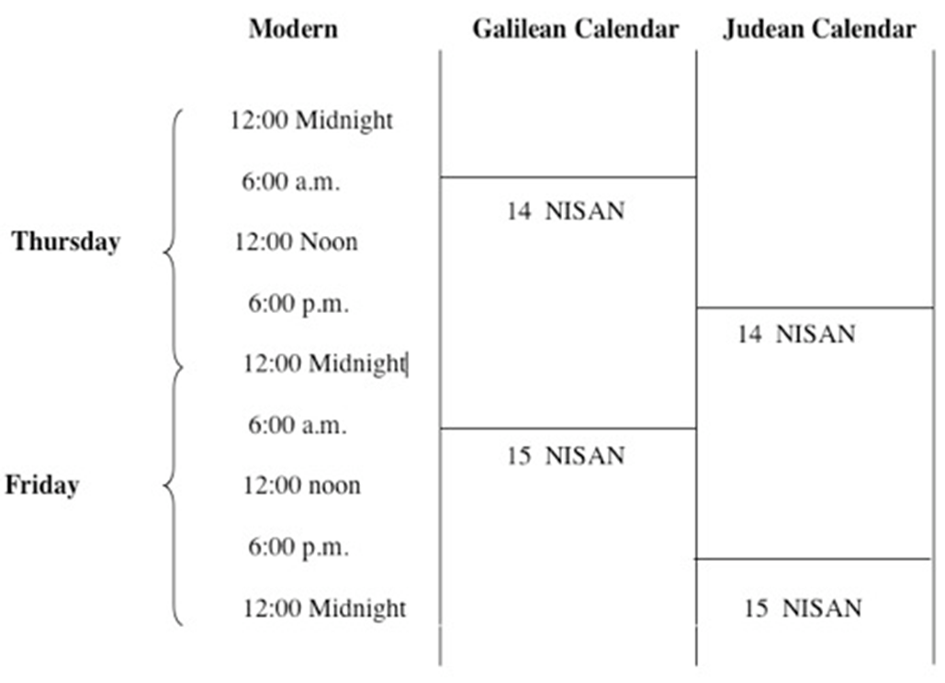
JESUS CELEBRATES PASSOVER
JOHN 18:28
THE

Slide 9
THE

Slide 10
2
get involved in His work
THE

Slide 11
the disciples came to Jesus and asked, “Where do you want us to prepare the Passover meal for you?” “As you go into the city,” he told them, “you will see a certain man. Tell him, ‘The Teacher says: My time has come, and I will eat the Passover meal with my disciples at your house.’ So the disciples did as Jesus told them and prepared the Passover meal there.”
Matthew 26:17-19 New Living Translation
THE

Slide 12
As soon as you enter Jerusalem, a man carrying a pitcher of water will meet you. Follow him.
Luke 22:10 New Living Translation
THE

Slide 13
THE

Slide 14
leavened bread bowl of saltwater
bitter herbs hyssop
paste sticks of cinnamon lamb wine
THE

Slide 15
Wine 1. "I will take you out…“ The Cup of Sanctification
2. "I will save you…“ The Cup of Deliverance
3. "I will redeem you…“ The Cup of Redemption
4. "I will take you as a nation…“ The Cup of Praise
THE

Slide 16
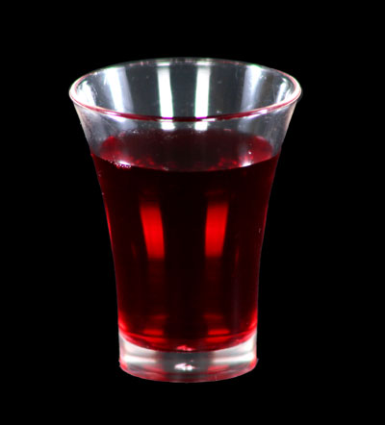
Wine 1. "I will take you out…“ The Cup of Sanctification
2. "I will save you…“ The Cup of Deliverance
3. "I will redeem you…“ The Cup of Redemption
4. "I will take you as a nation…“ The Cup of Praise
THE

Slide 17
3
make major adjustments
THE

Slide 18
While they were eating, he said, “I tell you the truth, one of you will betray me.
Matthew 26:21 New Living Translation
THE

Slide 19
So anyone who eats this bread or drinks this cup of the Lord unworthily is guilty of sinning against[g] the body and blood of the Lord. That is why you should examine yourself before eating the bread and drinking the cup. For if you eat the bread or drink the cup without honoring the body of Christ,[h] you are eating and drinking God’s judgment upon yourself. That is why many of you are weak and sick and some have even died.
1 Corinthians 11:27-30 New Living Translation
THE

Slide 20
Most merciful God, we confess that we have sinned against you in thought, word, and deed, by what we have done, and by what we have left undone. We have not loved you with our whole heart; we have not loved our neighbors as ourselves. We are truly sorry and we humbly repent, for the sake of your Son Jesus Christ, have mercy on us and forgive us; that we may delight in your will, and walk in your ways, to the glory of your Name. Amen.
THE
Book of Common Prayer

Slide 21
THE

Slide 22
https://www.youtube.com/watch?v=9Y9qCsIPzNo
The words after the juice only, not the resurrection

Slide 23
4
remember you are a new creation
THE

Slide 24
This means that anyone who belongs to Christ has become a new person. The old life is gone; a new life has begun
2 Corinthians 5:17 New Living Translation
THE

Slide 25
He took some bread and gave thanks to God for it. Then he broke it in pieces and gave it to the disciples, saying, “This is my body, which is given for you. Do this to remember me.”
Luke 22:19 New Living Translation
THE

Slide 26
5
remember you are forgiven
THE

Slide 27
In the same way, he took the cup of wine after supper, saying, “This cup is the new covenant between God and his people—an agreement confirmed with my blood. Do this to remember me as often as you drink it.”
1 Corinthians 11:25 New Living Translation
THE

Slide 28
God is always working. Join Him
THE

