Slide 1
ONE
MONTH
TO
Teach us to number our days, that we may gain a heart of wisdom. -Psalm 90:12

Slide 4
dash
LIVING
THE
Teach us to number our days, that we may gain a heart of wisdom. -Psalm 90:12

Slide 5
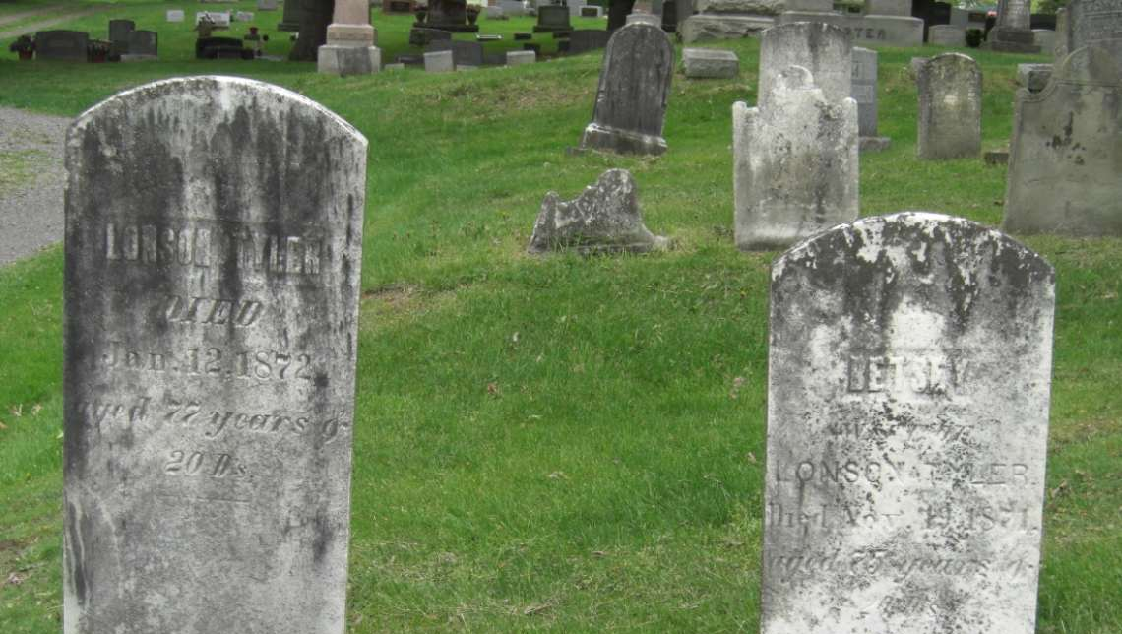

Slide 6
“Death is more universal than life; everyone dies, but not everyone lives” - ALAN SACHS

Slide 8
https://www.youtube.com/watch?v=VbRGmOO-Ed0

Slide 10
Teach us to number our days, that we may gain a heart of wisdom. - Psalm 90:12
1
passionately
JESUS LIVED

Slide 11
John 10:10
new living translation
The thief’s purpose is to steal and kill and destroy. My purpose is to give them a rich and satisfying life.

Slide 12
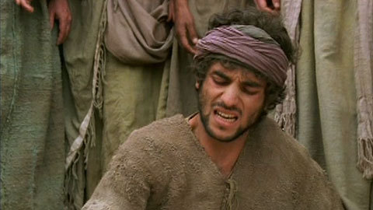
Jesus healed a blind man

Slide 13
John 9:39
new living translation
“I entered this world to render judgment—to give sight to the blind and to show those who think they see that they are blind.”

Slide 14
John 9:40-41
new living translation
Some Pharisees who were standing nearby heard him and asked, “Are you saying we’re blind?”
“If you were blind, you wouldn’t be guilty,” Jesus replied. “But you remain guilty because you claim you can see.”

Slide 15
someday syndrome

Slide 16
Luke 7: 31-32
new living translation
“To what can I compare the people of this generation?” Jesus asked, “How can I describe them? They are like children playing a game in the public square. They complain to their friends, ‘We played wedding songs, and you didn’t dance, so we played funeral songs, and you didn’t weep.’

Slide 17
Teach us to number our days, that we may gain a heart of wisdom. - Psalm 90:12
2
completely
JESUS LOVED

Slide 18
John 13:1
new living translation
Jesus knew that his hour had come to leave this world and return to his Father. He had loved his disciples during his ministry on earth, and now he loved them to the very end

Slide 19
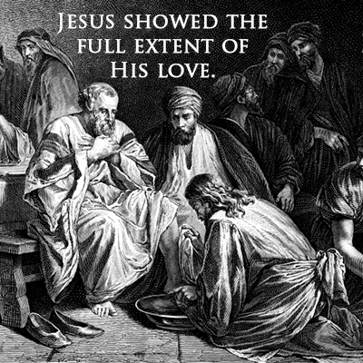

Slide 20
Matthew 22:37-39
new living translation
Jesus replied, “‘You must love the Lord your God with all your heart, all your soul, and all your mind.’ This is the first and greatest commandment. A second is equally important: ‘Love your neighbor as yourself.’

Slide 22
1 Corinthians 13:8
new living translation
Love never fails…..

Slide 23
Teach us to number our days, that we may gain a heart of wisdom. - Psalm 90:12
3
JESUS LEARNED
humbly

Slide 24
John 14 :10
new living translation
The words I speak are not my own, but my Father who lives in me does his work through me. Just believe that I am in the Father and the Father is in me.

Slide 25
John 14 :31-32
new living translation
“I don’t have much more time to talk to you, because the ruler of this world approaches. He has no power over me, but I will do what the Father requires of me, so that the world will know that I love the Father. Come, let’s be going.”

Slide 26
Hebrews 5 :8
new living translation
Even though Jesus was God’s Son,
he learned obedience
from the things he suffered.

Slide 27
Philippines 2 :7-8
new living translation
Instead, he gave up his divine privileges;
he took the humble position of a slave
and was born as a human being.
When he appeared in human form, he humbled himself in obedience to God
and died a criminal’s death on a cross

Slide 28
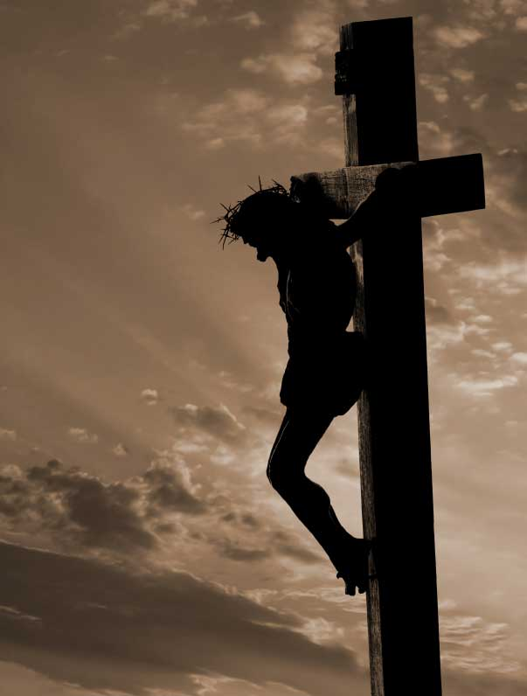
Philippines 2 :7-8
new living translation
Instead, he gave up his divine privileges;
he took the humble position of a slave
and was born as a human being.
When he appeared in human form, he humbled himself in obedience to God
and died a criminal’s death on a cross

Slide 30
Proverbs 3 :6
new living translation
Seek his will in all you do,
and he will show you which path to take.

Slide 31
Matthew 6 :33
new living translation
Seek the Kingdom of God above all else, and live righteously, and he will give you everything you need.

Slide 32
Humbly give God your
TIME
MONEY
WORSHIP
DECISIONS

Slide 34
Teach us to number our days, that we may gain a heart of wisdom. - Psalm 90:12
4
boldly
JESUS LEFT

Slide 35
John 18 :4
new living translation
Jesus fully realized all that was going to happen to him, so he stepped forward to meet them.

Slide 36
Luke 9:51
new living translation
As the time drew near for him to ascend to heaven, Jesus resolutely set out for Jerusalem.

Slide 38
Matthew 25 :23
new living translation
‘Well done, my good and faithful servant. You have been faithful in handling this small amount, so now I will give you many more responsibilities. Let’s celebrate together!’

Slide 39
dash
LIVE
THE
FOR GOD
Teach us to number our days, that we may gain a heart of wisdom. -Psalm 90:12

Slide 40
ONE
MONTH
TO
Teach us to number our days, that we may gain a heart of wisdom. -Psalm 90:12

