Slide 1
For the Lord is always good. He is always loving and kind, and his faithfulness goes on and on to each succeeding generation.
Psalm 100:5 Living Bible

Slide 2
The Lord is my shepherd; I shall not want.
He maketh me to lie down in green pastures: he leadeth me beside the still waters.
He restoreth my soul: he leadeth me in the paths of righteousness for his name's sake.
Yea, though I walk through the valley of the shadow of death, I will fear no evil:
for thou art with me;
thy rod and thy staff they comfort me.
Psalm 23:1-4 (KJV)

Slide 3
Thou preparest a table before me
in the presence of mine enemies:
thou anointest my head with oil;
my cup runneth over.
Surely goodness and mercy shall follow me
all the days of my life:
and I will dwell in the house of the Lord for ever.
Psalm 23:5-6 (KJV)

Slide 6
Living in the goodness of God
Is God Really Good
All The Time?

Slide 8
Psalm 23

Slide 9
And we know that God causes everything to work together for the good of those who love God and are called according to his purpose for them.
Romans 8:28 New Living Translation

Slide 10
Psalm 23

Slide 11
God is Good
1
when I’m worried
The Lord is my shepherd; I have all that I need. Psalm 23:1

Slide 12
God is Good
2
when I’m stressed
He lets me rest in green meadows, he lead me he leads me beside peaceful streams.
Psalm 23:2

Slide 13
God is Good
3
when I’m tired
He renews my strength. Psalm 23:3

Slide 14
God is Good
4
when I’m confused
He guides me along right paths to bring honor to his name. Psalm 23:3

Slide 15
God is Good
5
when I’m fearful
Even when I walk through the darkest valley,
I will not be afraid, for you are close beside me. Psalm 23:4

Slide 16
God is Good
6
when I’m insecure
Your rod and your staff protect and comfort me. Psalm 23:4

Slide 17
God is Good
7
when I’m attacked
You prepare a feast for me in the presence of my enemies. Psalm 23:5

Slide 18
God is Good
8
when I’m inconsistent
Surely your goodness and unfailing love will pursue me all the days of my life. Psalm 23:5

Slide 19
God is Good
9
when I’m leaving this world
…and I will live in the house of the Lord
forever. Psalm 23:6

Slide 20
Psalm 23

Slide 21
How to stay focused on the Goodness of God

Slide 22
Psalm 23

Slide 23
1
Remember the Source of our Success

Slide 24
Then he said, “Beware! Guard against every kind of greed. Life is not measured by how much you own.” Luke 12:13

Slide 25
prideful ingratitude

Slide 26
“It’s the voice of a god, not of a man!”
Instantly, an angel of the Lord struck Herod with a sickness, because he accepted the people’s worship instead of giving the glory to God. So he was consumed with worms and died. Acts 12:22-23

Slide 27
What do you have that God hasn’t given you? And if everything you have is from God, why boast as though it were not a gift?
1 Corinthians 4:7

Slide 28
Whatever is good and perfect is a gift coming down to us from God our Father. James 1:17

Slide 29
Psalm 23

Slide 30
2
Ask God for Help

Slide 31
So if you sinful people know how to give good gifts to your children, how much more will your heavenly Father give good gifts to those who ask him.
Matthew 7:11

Slide 32
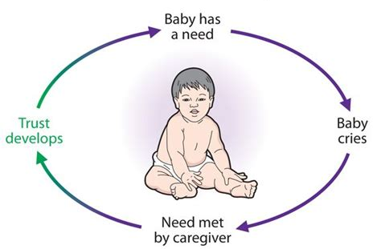
circle of security

Slide 33
Psalm 23

Slide 34
3
Go to God Instantly

Slide 35
Keep me safe, O God,
for I have come to you for refuge.
I said to the Lord, “You are my Master!
Every good thing I have comes from you.” psalm 16:1-2

Slide 36
Psalm 23

Slide 37
4
Anticipate God’s Goodness

Slide 38
Yet I am confident I will see the Lord’s goodness
while I am here in the land of the living. Psalm 27:13

Slide 39
Psalm 23

