Slide 2
OUR TURN NOW

Slide 4
I left you on the island of Crete so you could complete our work there and appoint elders in each town as I instructed you.
I am planning to send either Artemas or Tychicus to you. As soon as one of them arrives, do your best to meet me at Nicopolis, for I have decided to stay there for the winter.
Titus 1:5
Titus 3:12 new living translation

Slide 5
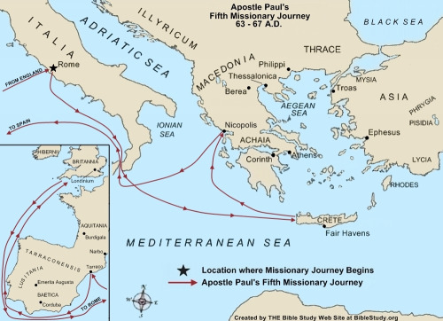

Slide 6
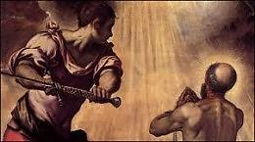

Slide 8
1
BE
EXAMPLES

Slide 9
As Paul gathered an armful of sticks and was laying them on the fire, a poisonous snake, driven out by the heat, bit him on the hand. The people of the island saw it hanging from his hand and said to each other, “A murderer, no doubt! Though he escaped the sea, justice will not permit him to live.” But Paul shook off the snake into the fire and was unharmed. The people waited for him to swell up or suddenly drop dead. But when they had waited a long time and saw that he wasn’t harmed, they changed their minds and decided he was a god.
Acts 28:3-6 new living translation

Slide 10
Paul went in and prayed for him, and laying his hands on him, he healed him. Then all the other sick people on the island came and were healed. As a result we were showered with honors….
Acts 28:8-10 new living translation

Slide 11
Still later he appeared to the eleven disciples as they were eating together. He rebuked them for their stubborn unbelief because they refused to believe those who had seen him after he had been raised from the dead. And then he told them, “Go into all the world and preach the Good News to everyone. Anyone who believes and is baptized will be saved. But anyone who refuses to believe will be condemned. These miraculous signs will accompany those who believe: They will cast out demons in my name, and they will speak in new languages. They will be able to handle snakes with safety, and if they drink anything poisonous, it won’t hurt them. They will be able to place their hands on the sick, and they will be healed.”
Mark 16:14-18 new living translation

Slide 12
Let your good deeds shine out for all to see, so that everyone will praise your heavenly Father.
Matthew 5:16 new living translation

Slide 14
2
SHOW YOUR
WEAKNESSES

Slide 15
“I was arrested in Jerusalem and handed over to the Roman government, even though I had done nothing against our people or the customs of our ancestors. The Romans tried me and wanted to release me, because they found no cause for the death sentence. But when the Jewish leaders protested the decision, I felt it necessary to appeal to Caesar, even though I had no desire to press charges against my own people.”
Acts 28:17-19 new living translation

Slide 16
Three different times I begged the Lord to take it away. Each time he said, “My grace is all you need. My power works best in weakness.” So now I am glad to boast about my weaknesses, so that the power of Christ can work through me. That’s why I take pleasure in my weaknesses, and in the insults, hardships, persecutions, and troubles that I suffer for Christ. For when I am weak, then I am strong.
2 Corinthians 12:8-10 new living translation

Slide 18
3
MAKE MUCH OF
CHRIST

Slide 19
I asked you to come here today so we could get acquainted and so I could explain to you that I am bound with this chain because I believe that the hope of Israel—the Messiah—has already come.”
Acts 28:20 new living translation

Slide 21
4
BE UNBIASED

Slide 22
So I want you to know that this salvation from God has also been offered to the Gentiles, and they will accept it.”
For the next two years, Paul lived in Rome at his own expense. He welcomed all who visited him, boldly proclaiming the Kingdom of God and teaching about the Lord Jesus Christ. And no one tried to stop him.
Acts 28:29-31 new living translation

Slide 24
IT’S OUR
TURN NOW

