Slide 1
Evangelism
JUST DO IT.

Slide 2
Because
WE ARE SUPPOSED TO

Slide 3
Jesus came and told his disciples, “I have been given all authority in heaven and on earth. Therefore, go and make disciples of all the nations, baptizing them in the name of the Father and the Son and the Holy Spirit. Teach these new disciples to obey all the commands I have given you. And be sure of this: I am with you always, even to the end of the age.”
Matthew 28:18-20
NEW LIVING TRANSLATION

Slide 4
Discipleship is our call
but we make disciples,
this is not a suggestion,
CREATE DISCIPLES
Lecrae
AFTER THE MUSIC STOPS

Slide 5
So never be ashamed to tell others about our Lord. And don’t be ashamed of me, either, even though I’m in prison for him. With the strength God gives you, be ready to suffer with me for the sake of the Good News. For God saved us and called us to live a holy life. He did this, not because we deserved it, but because that was his plan from before the beginning of time—to show us his grace through Christ Jesus. And now he has made all of this plain to us by the appearing of Christ Jesus, our Savior. He broke the power of death and illuminated the way to life and immortality through the Good News.
2 Timothy 1:8-12
NEW LIVING TRANSLATION

Slide 6
Because
WE CAN ONLY DO IT HERE

Slide 7
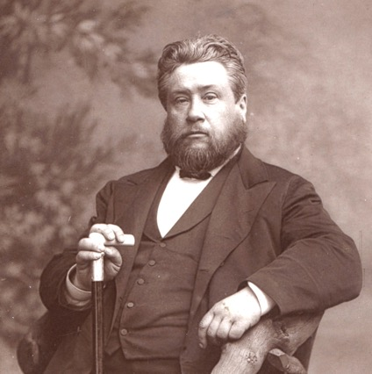
“Every Christian is a missionary or an imposter.”
CHARLES SPURGEON

Slide 8
Preach the word of God. Be prepared,
whether the time is favorable or not.
2 Timothy 4:2
NEW LIVING TRANSLATION

Slide 9
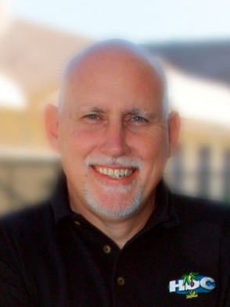
“If you aren’t evangelizing,
you’re better off dead.”
TOM MERCER

Slide 10
Because
YOU ARE MORE READY THAN YOU REALIZE

Slide 11
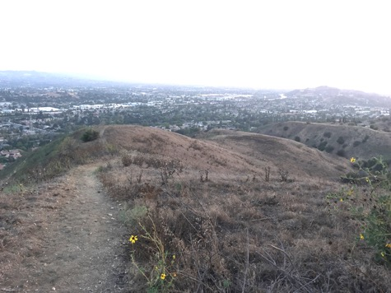
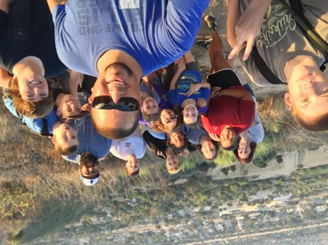

Slide 14
"Brethren, do something; do something, do something! While societies and unions make constitutions, let us win souls. I pray you, be men of action all of you. Get to work and quit yourselves like men. Old Suvarov's idea of war is mine: `Forward and strike! No theory! Attack! Form a column! Charge bayonets! Plunge into the center of the enemy! Our one aim is to win souls; and this we are not to talk about, but do in the power of God!"
CHARLES SPURGEON

