Slide 2
Book of the TWELVE

Slide 3
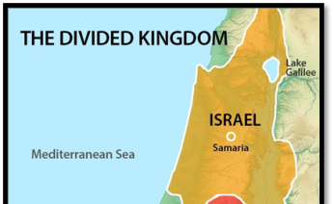

Slide 4
JOEL
Overcoming Complacency

Slide 5
“Then you will know that I am in Israel, that I am the LORD your God, and that there is no other.”
Joel 2:27

Slide 6
Matthew 24:29 (Jesus quotes Joel 2:29) “Your sons and daughters will prophesy. Your young men will see visions, and your old men will dream dreams.”
• Acts 2:16-21 (Apostle Peter Quotes Joel 2:10)
“the sun and the moon [will] grow dark and the stars lose their brightness”
•Romans 10:13 (Apostle Paul Quotes Joel 2:32)
“Whoever will call on the name of the Lord will be saved,” •

Slide 7
Apostle John alludes to Joel when he describes events of the Tribulation
Then locusts came from the smoke and descended on the earth, and they were given power to sting like scorpions. They were told not to harm the grass or plants or trees, but only the people who did not have the seal of God on their foreheads. They were told not to kill them but to torture them for five months with pain like the pain of a scorpion sting. In those days people will seek death but will not find it. They will long to die, but death will flee from them!
Revelation 9:3-6

Slide 8
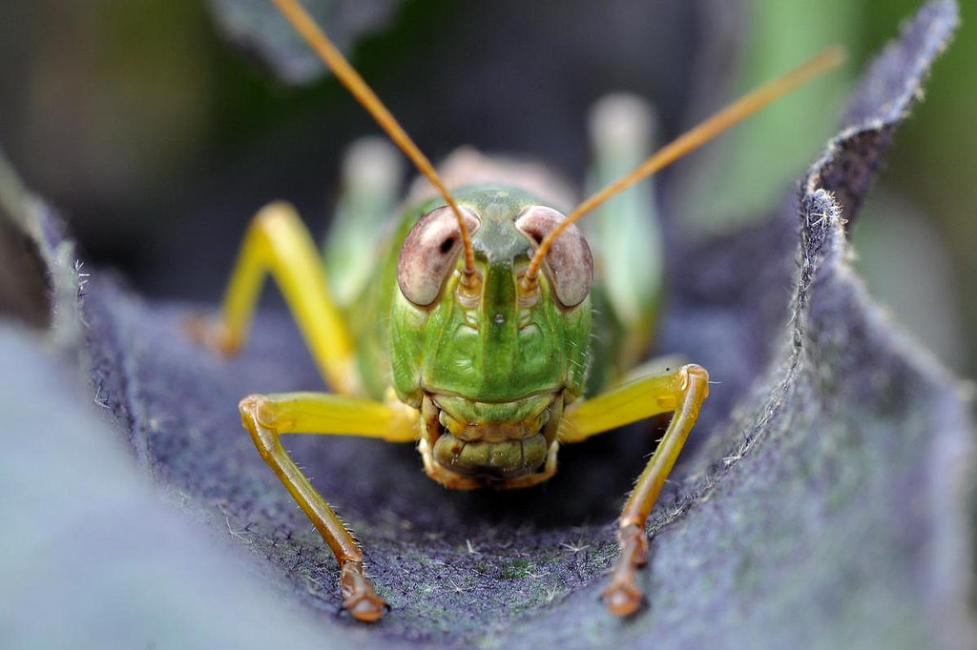

Slide 10
https://www.youtube.com/watch?v=1YNy2R3hg2Q

Slide 12
Wake Up
1
Realize Judgment is Inevitable

Slide 13
Sound the trumpet in Jerusalem!
Raise the alarm on my holy mountain!
Let everyone tremble in fear
because the day of the Lord is upon us.
Joel 2:1

Slide 14
“The Lord is at the head of the column.
He leads them with a shout.
This is his mighty army,
and they follow his orders.
The day of the Lord is an awesome, terrible thing. Who can possibly survive?
Joel 2:11

Slide 15
It is a terrible thing to fall into the hands of the living God. -Hebrews 10:31
"…and you may be sure that your sin will find you out." -Number 32:23
“Don’t be misled—you cannot mock the justice of God. You will always harvest what you plant.” -Galatians 6:7

Slide 17
2
Give God Your
Everything

Slide 18
“Turn to me now, while there is time. Give me your hearts. Come with fasting, weeping, and mourning. Don’t tear your clothing in your grief,
but tear your hearts instead.”
Joel 2:12-13

Slide 20
“Return to the Lord your God, for he is merciful and compassionate, slow to get angry and filled with unfailing love. He is eager to relent and not punish.”
Joel 2:13

Slide 22
3
Look for God’s
Provision

Slide 23
“And in that day the mountains shall drip sweet wine, and the hills shall flow with milk, and all the streambeds of Judah shall flow with water; and a fountain shall come forth from the house of the LORD.”
Joel 3:18

Slide 25
Pay attention now so you’ll be

Slide 26
Pay attention now so you’ll be
Ready for the Great Things yet to come

Slide 27
JOEL
Overcoming Complacency

