Slide 2
Book of the TWELVE

Slide 3
HAGGAI
Get to Work

Slide 4
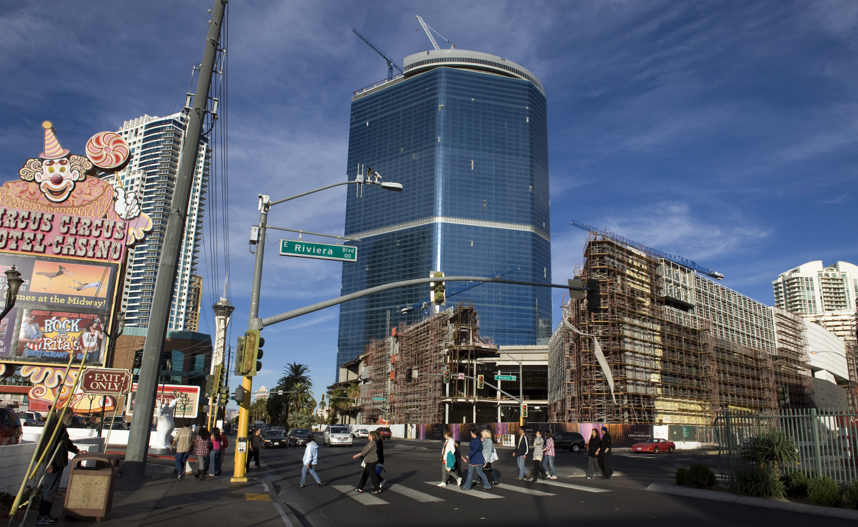
Fontainebleau 68 stories high, vacant since construction started in 2007 at an estimated $3 billion cost.

Slide 6
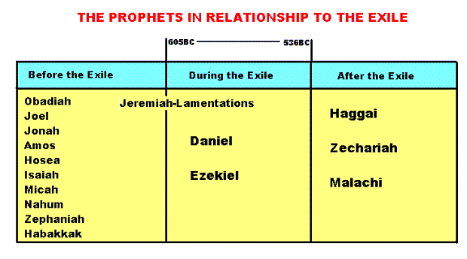

Slide 7
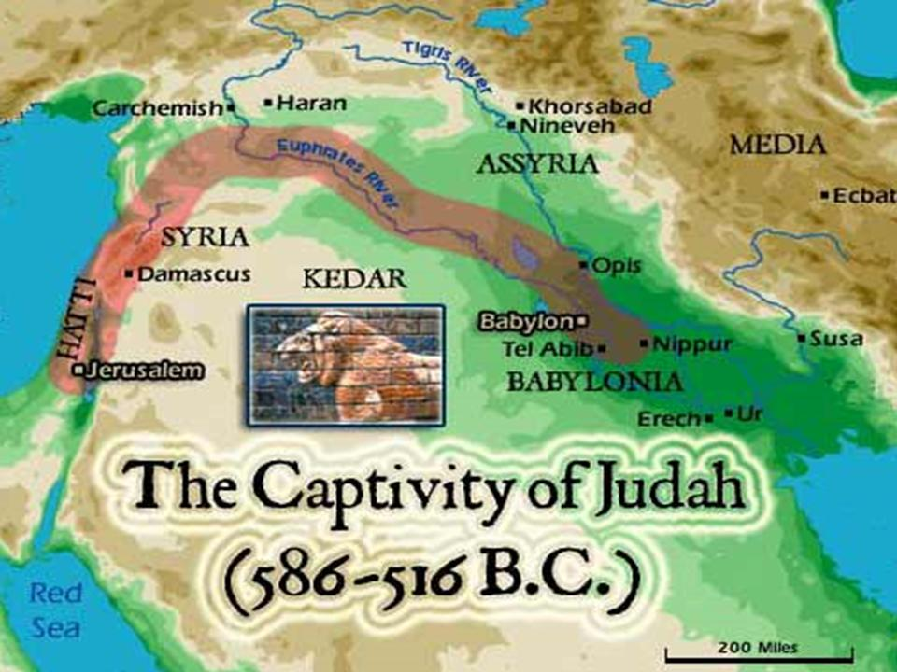

Slide 8
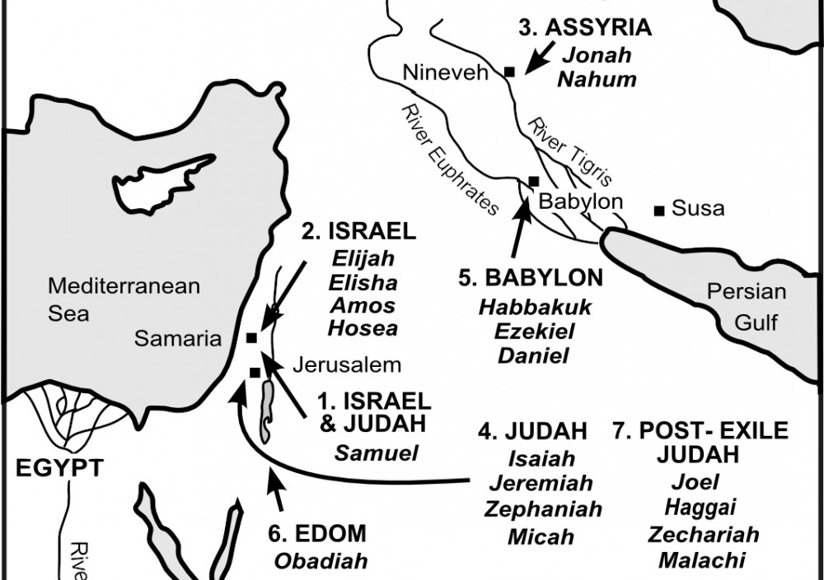

Slide 9
Abraham, Isaac, Jacob
Joshua, Judges, Samuel, Kings, Prophets
Prophets, Jesus, Apostles
1948
Egypt
Babylon
Diaspora

Slide 11
1
QUIT MAKING EXCUSES
“This is what the Lord of Heaven’s Armies says: The people are saying, ‘The time has not yet come to rebuild the house of the Lord.’”
Haggai 1:2

Slide 12
Farmers who wait for perfect weather never plant.
If they watch every cloud, they never harvest.
Ecclesiastes 11:4

Slide 14
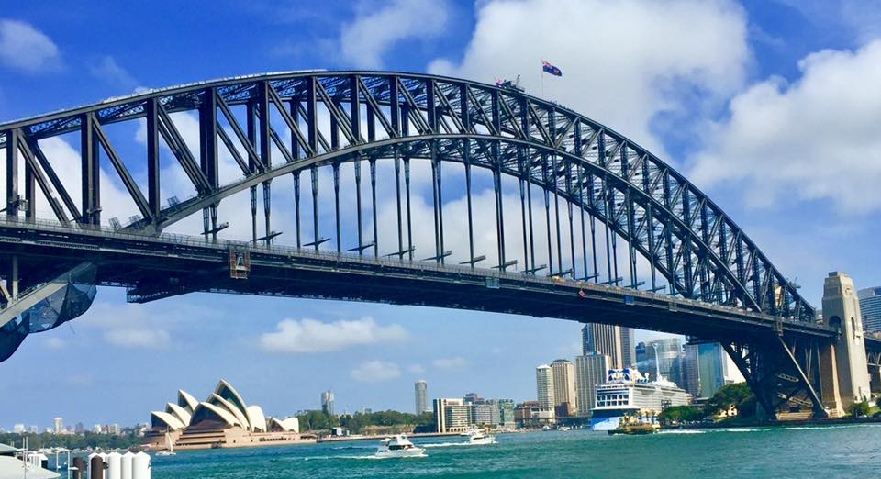

Slide 15
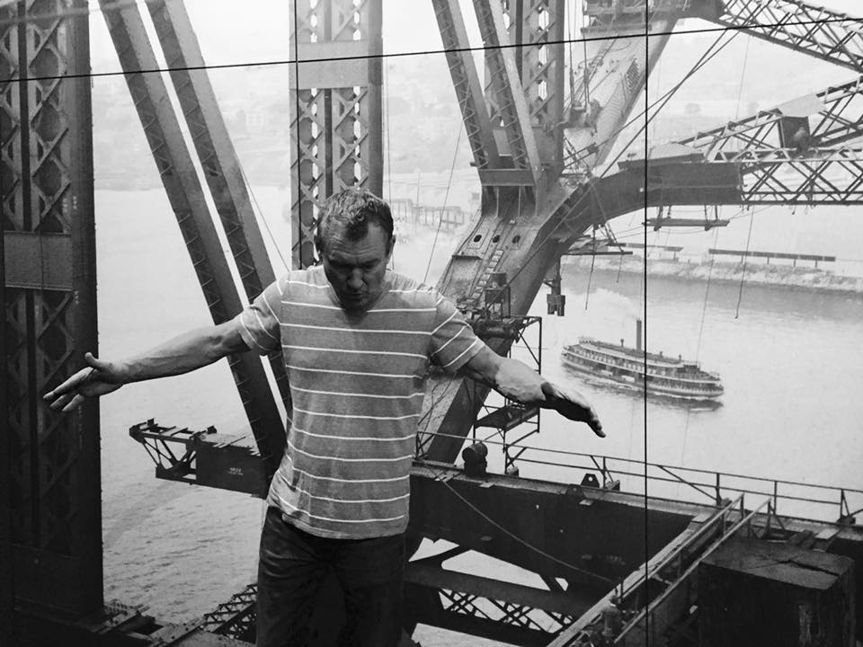

Slide 18
EXAMINE YOURSELF
2
This is what the Lord of Heaven’s Armies says: Look at what’s happening to you!
Haggai 1:5

Slide 19
Now go up into the hills, bring down timber, and rebuild my house. Then I will take pleasure in it and be honored,
says the Lord.
Haggai 1:8

Slide 20
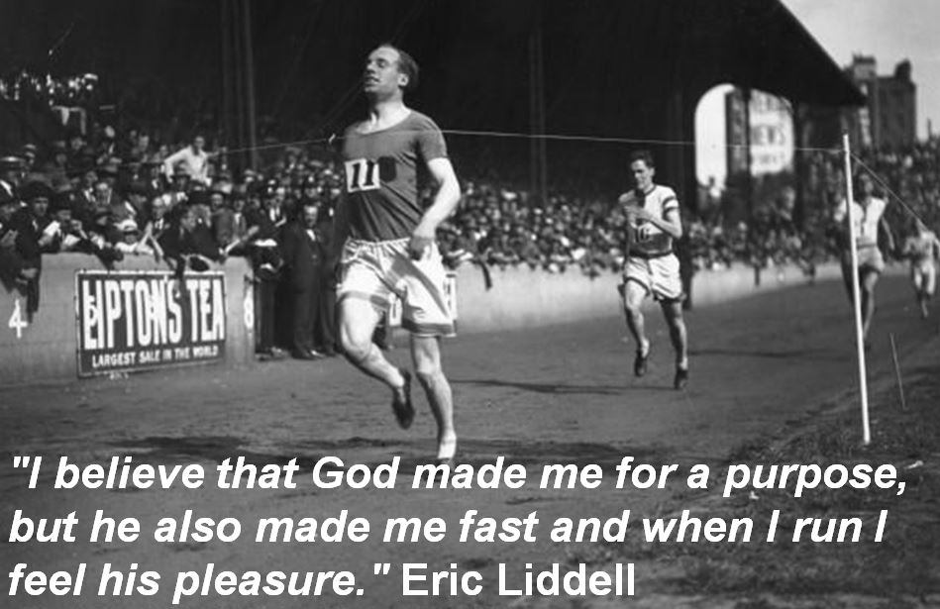

Slide 22
GET TO WORK
3
Be strong, all you people still left in the land. And now get to work, for I am with you, says the Lord of Heaven’s Armies.
Haggai 2:4

Slide 24
DON’T BE AFRAID
4
My Spirit remains among you, just as I promised when you came out of Egypt. So do not be afraid.’
Haggai 2:5

Slide 25
The future glory of this Temple will be greater than its past glory, says the Lord of Heaven’s Armies.
Haggai 2:9

Slide 26
The future glory of this Temple will be greater than its past glory, says the Lord of Heaven’s Armies.
Haggai 2:9

Slide 27
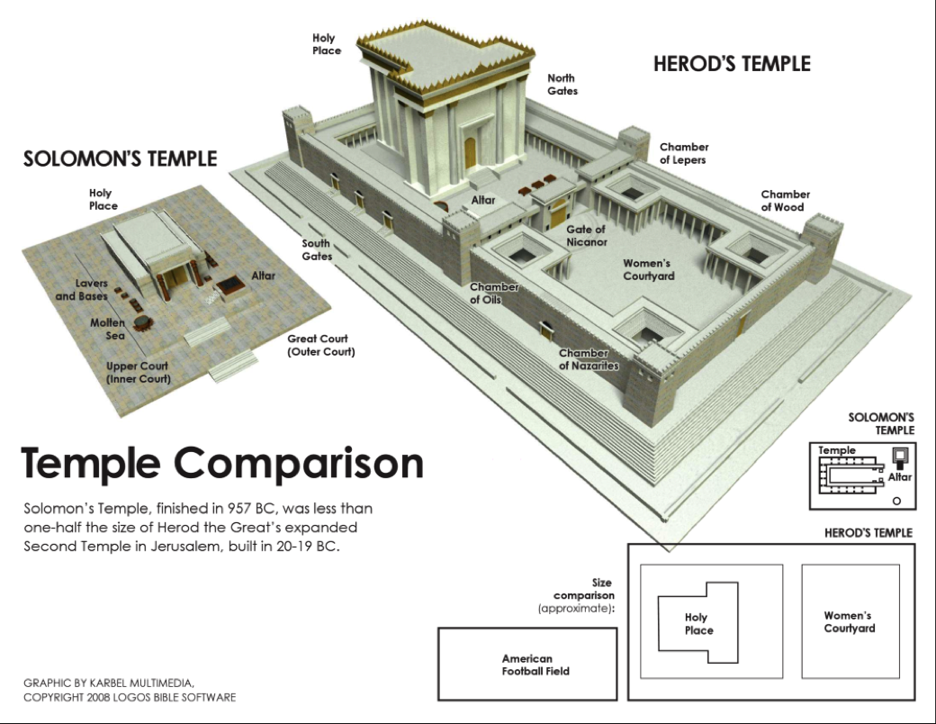

Slide 29
Everything changes when you know the outcome

