Slide 1
People
OF THE
NATIVITY

Slide 3
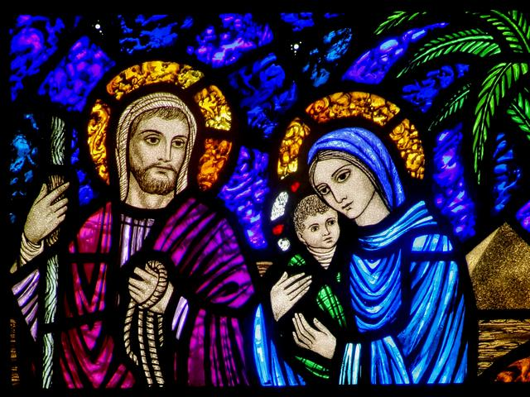

Slide 4
WHY
Mary and joseph

Slide 5
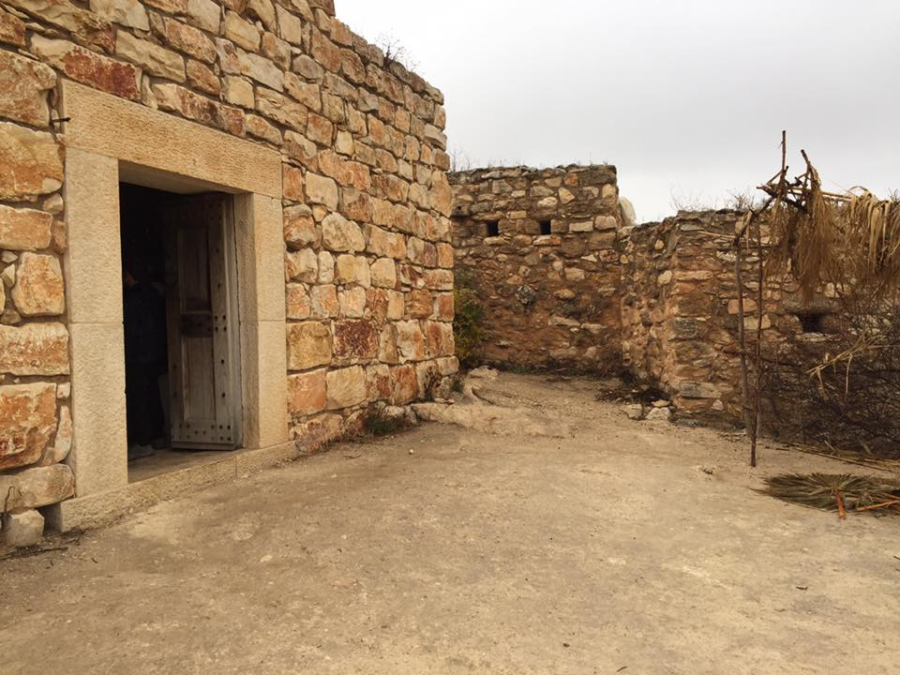
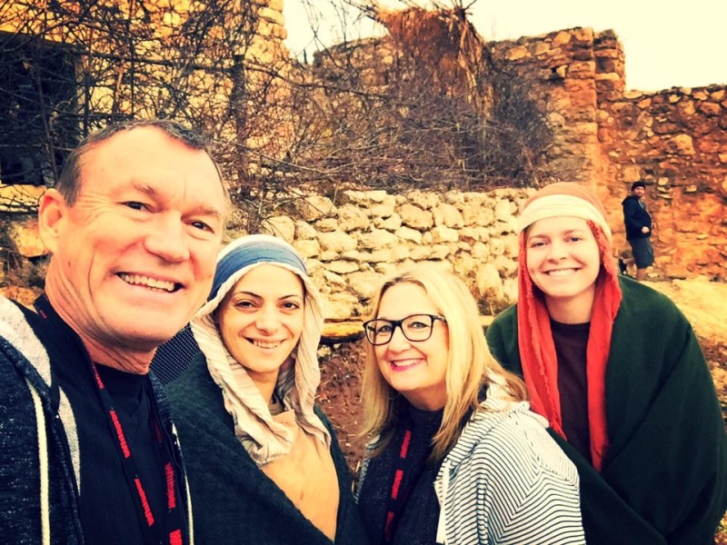

Slide 8
1
God uses people who desire to do his will

Slide 9
“Mary responded “Oh, how my soul praises the Lord. How my spirit rejoices in God my Savior! For he took notice of his lowly servant girl, and from now on all generations will call me blessed.”
Luke 1:46-48 new living translation

Slide 10
When Joseph woke up,
he did as the angel of the Lord commanded
Matthew 1:24 new living translation

Slide 12
“Blessed are those who hunger and thirst after righteousness….” “Seek first the kingdom of God, and all these things will be added to you.”
Matthew 5:6 / Matthew 6:33 new living translation

Slide 14
2
God uses people who Decide to pay the price

Slide 15
Mary responded,
“I am the Lord’s servant.
May everything you have said
about me come true.”
Luke 1:38 new living translation

Slide 16
When Joseph woke up, he did as the angel of the Lord commanded and took Mary as his wife. But he did not have sexual relations with her until her son was born. And Joseph named him Jesus.
Matthew 1:24-25 new living translation

Slide 18
3
God uses people who dare to trust God

Slide 19
You are blessed because you believed that the Lord would do what he said.”
Luke 1:45 new living translation

Slide 20
“…you are to name him Jesus,
for he will save his people from their sins.”
Matthew 1:21 new living translation

Slide 22
People
OF THE
NATIVITY

