Slide 2
LIFE IS ABOUT
NINEVAH
J O N A H 4

Slide 4
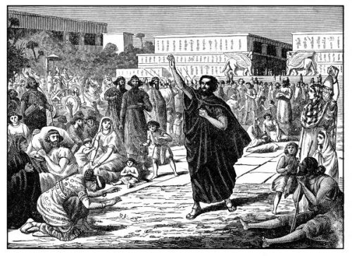

Slide 6
1
DON’T SETTLE FOR A CRISIS-DRIVEN
RELATIONSHIP WITH GOD

Slide 7
JONAH 4:1-2
new living translation
This change of plans greatly upset Jonah, and he became very angry. So he complained to the Lord about it:
“Didn’t I say before I left home that you would do this, Lord?

Slide 9
DEMONSTRATE THE
2
COMPASSION OF GOD

Slide 10
JONAH 4:2
new living translation
I knew that you are a merciful and compassionate God, slow to get angry and filled with unfailing love. You are eager to turn back from destroying people.

Slide 12
ROMANS 8:38-39
new living translation
And I am convinced that nothing can ever separate us from God’s love. Neither death nor life, neither angels nor demons, neither our fears for today nor our worries about tomorrow—not even the powers of hell can separate us from God’s love. No power in the sky above or in the earth below—indeed, nothing in all creation will ever be able to separate us from the love of God that is revealed in Christ Jesus our Lord.

Slide 14
3
LIVE IN THE
FREEDOM OF THE CROSS

Slide 15
JONAH 4:3
new living translation
“Just kill me now, Lord! I’d rather be dead than alive if what I predicted will not happen.”

Slide 16
MARK 11:25
new living translation
But when you are praying, first forgive anyone you are holding a grudge against.

Slide 18
4
LIVE IN THE
FREEDOM OF THE CROSS

Slide 19
JONAH 4:6
new living translation
And the Lord God arranged for a leafy plant to grow there, and soon it spread its broad leaves over Jonah’s head, shading him from the sun. This eased his discomfort, and Jonah was very grateful for the plant.

Slide 20
JONAH 4:7-8
new living translation
But God also arranged for a worm! The next morning at dawn the worm ate through the stem of the plant so that it withered away. And as the sun grew hot, God arranged for a scorching east wind to blow on Jonah.

Slide 22
5
DON’T BE CONCERNED ABOUT
DISTRACTING THINGS

Slide 23
JONAH 4:11 english standard version
And should not I pity Nineveh, that great city, in which there are more than 120,000 persons who do not know their right hand from their left, and also much cattle?”

Slide 24
MATTHEW 28:19-20 new living translation
“Go and make followers of all the nations. Baptize them in the name of the Father and of the Son and of the Holy Spirit. Teach them to do all the things I have told you. And I am with you always, even to the end of the world.”

