Slide 5
Matthew 5:6 (NLT) “God blesses those who work for peace,
for they will be called the children of God.”

Slide 6
Happy are the
peacemakers

Slide 7
James 3:18 (NLT)
“Those who are peacemakers will plant seeds of peace and reap a harvest of goodness.”

Slide 9
1
Make the
first move

Slide 10
Matthew 5:23-24 (new living translation) “If you’re standing before the altar in the Temple, giving an offering to God, and you suddenly remember someone has something against you, leave your offering there beside the altar. Go at once and first be reconciled to that person. Then come and offer your gift to God.”

Slide 11
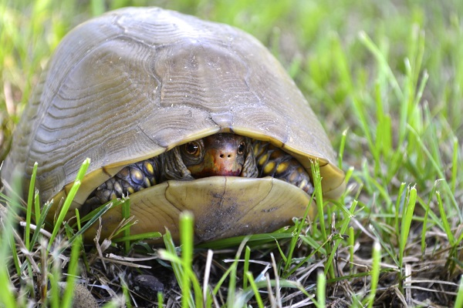

Slide 13
2
Ask God
for what you need

Slide 14
James 1:5 (Living Bible)
“If you want to know what God wants you to do, ask Him, and He will gladly tell you . . .”

Slide 16
3
Take Responsibility
for what’s your fault

Slide 17
S e l f i s h n e s s
James 4:1
“What causes fights and quarrels among you? They are caused by selfish desires that are continually at war inside you.”

Slide 19
P r i d e
Proverbs 13:10 (New Century Version)
“Pride only leads to arguments . . .”

Slide 20
Matthew 7:3-5 (New Living Translation)
And why worry about a speck in your friend’s eye when you have a log in your own? How can you think of saying to your friend, ‘Let me help you get rid of that speck in your eye,’ when you can’t see past the log in your own eye? Hypocrite! First get rid of the log in your own eye; then you will see well enough to deal with the speck in your friend’s eye.

Slide 22
4
Listen to their
perspective

Slide 23
James 1:19 (NLT)
“. . . be quick to listen, slow to speak,
and slow to get angry.”

Slide 24
Philippians 2:4-5 (NIV)
“Each of you should look not only to your own interests, but also to the interests of others. Your attitude should be the same as that of Christ Jesus.”

Slide 26
5
Speak
the truth lovingly

Slide 27
Ephesians 4:15
“Speak the truth in love.”

Slide 29
6
Fix the problem
not the blame

Slide 30
Colossians 3:8 (NIV)
“You must rid yourselves of all such things as these: anger, rage, malice, slander, and filthy language from your lips.”

Slide 32
7
Focus on
strengthening the relationship

Slide 33
2 Corinthians 5:18-20 NLT And God has given us this task of reconciling people to him. For God was in Christ, reconciling the world to himself, no longer counting people’s sins against them. And he gave us this wonderful message of reconciliation. So we are Christ’s ambassadors; God is making his appeal through us.

Slide 35
Happy are the
peacemakers

