Slide 2
Worship Christ as Lord of your life. And if someone asks about your hope as a believer, always be ready to explain it.
1 Peter 3:15
NEW LIVING TRANSLATION

Slide 3
What’s in the
SPAGHETTI SAUCE?

Slide 4
Ten Doctrines
CHRISTIANS SHOULD KNOW

Slide 6
I believe in God, the Father Almighty, the Creator of heaven and earth, and in Jesus Christ, His only Son, our Lord: Who was conceived of the Holy Spirit, born of the Virgin Mary, suffered under Pontius Pilate, was crucified, died, and was buried. He descended into hades. The third day He arose again from the dead. He ascended into heaven and sits at the right hand of God the Father Almighty, whence He shall come to judge the living and the dead. I believe in the Holy Spirit, the holy universal church, the communion of saints, the forgiveness of sins, the resurrection of the body, and life everlasting. Amen.
Apostles Creed
390 AD

Slide 8
The
BIBLE

Slide 9
The study of the Bible
BIBLIOLOGY

Slide 10
All Scripture is inspired by God and is useful to teach us what is true and to make us realize what is wrong in our lives. It corrects us when we are wrong and teaches us to do what is right. It is the word of God
2 Timothy 3:16
NEW LIVING TRANSLATION

Slide 11
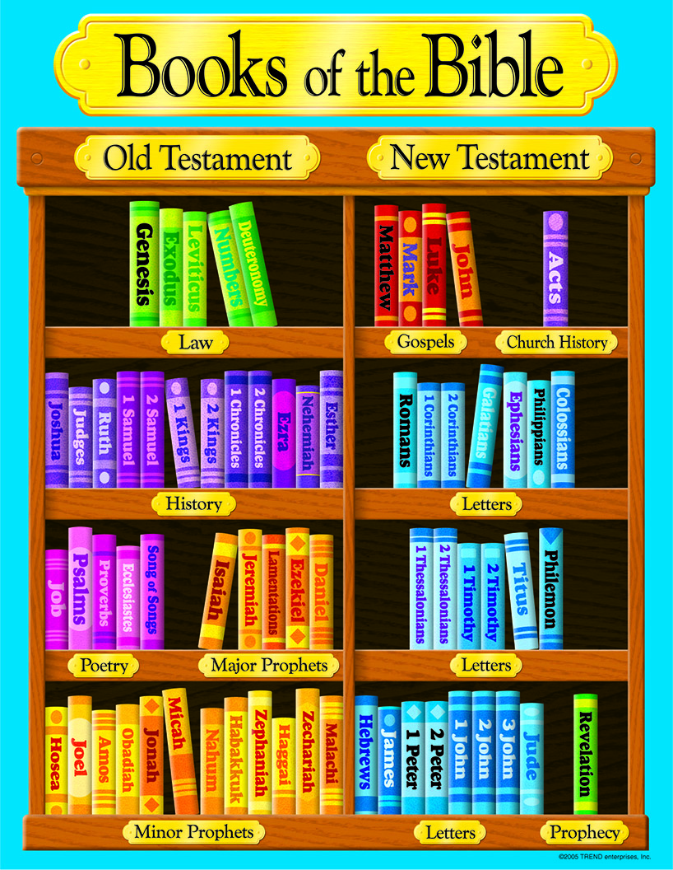
Old Testament - 39 books New Testament - 27 books
Written over 1600 years
Written by 40 Authors

Slide 13
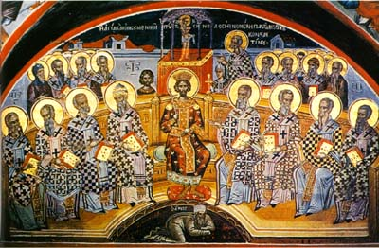

Slide 15
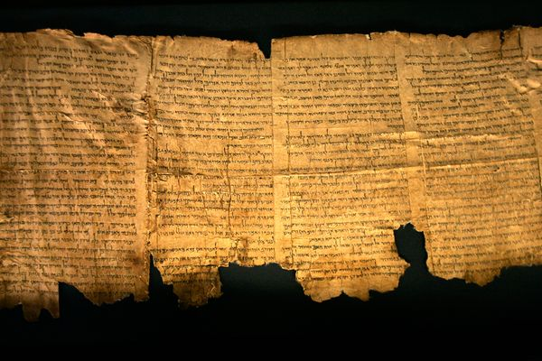
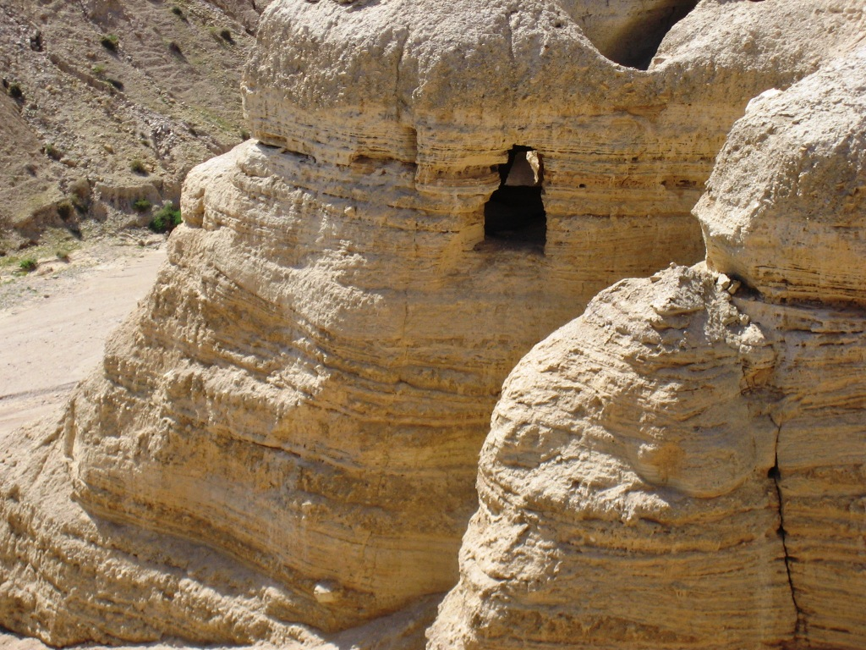
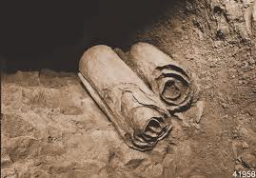
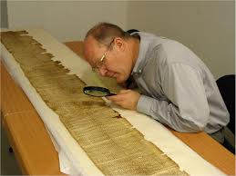

Slide 16
“These proved to be word for word identical with our standard Hebrew Bible
in more than 95% of the text. The 5% variation consisted chiefly of obvious
slips of the pen and variations of spelling.”
Gleason Archer, quoted in Norman Geisler and William Nix, A General Introduction to the Bible (Chicago: Moody, 1986), p. 367

Slide 17
Of the 166 words in Isaiah 53, there are only seventeen letters
(in the Qumran scroll) that differ from the standard Masoretic Text. Ten of those letters are simply a matter of spelling, which does not affect the meaning.

Slide 19
200-300 BC Septuagint
400 AD Latin Vulgate
1519 Textus Receptus 1611 King James Modern Translations
2 Timothy 3:16
NEW LIVING TRANSLATION

Slide 21
The
TRINITY

Slide 22
“Therefore, go and make disciples of all the nations, baptizing them in the name of the Father and the Son and the Holy Spirit.”
Matthew 28:19
NEW LIVING TRANSLATION

Slide 23
After his baptism, as Jesus came up out of the water, the heavens were opened and he saw the Spirit of God descending like a dove and settling on him. And a voice from heaven said, “This is my dearly loved Son, who brings me great joy.”
Matthew 3:16-17
NEW LIVING TRANSLATION

Slide 25
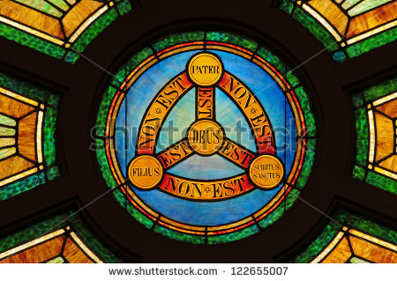

Slide 27
God the
FATHER

Slide 28
The study of God
THEOLOGY

Slide 29
“My Father! If it is possible, let this cup of suffering be taken away from me. Yet I want your will to be done, not mine.”
Matthew 26:39
NEW LIVING TRANSLATION

Slide 31
omnipotent (all powerful) omniscient (all-knowing) omnipresent (everywhere)

Slide 33
God the
SON

Slide 34
The study of Jesus
CHRISTOLOGY

Slide 35
Christ is the visible image of the invisible God.
Colossians 1:15
NEW LIVING TRANSLATION

Slide 37
Theophany: visible manifestation in Old Testament Incarnation: Jesus became human
Colossians 1:15
NEW LIVING TRANSLATION

Slide 39
Messiah Lord Jesus Christ
Colossians 1:15
NEW LIVING TRANSLATION

Slide 41
Our
SALVATION

Slide 42
The study of Salvation
SOTERIOLOGY

Slide 43
For Jesus is the one referred to in the Scriptures, where it says, ‘The stone that you builders rejected has now become the cornerstone.’ There is salvation in no one else! God has given no other name under heaven by which we must be saved.”
Acts 4: 11-12
NEW LIVING TRANSLATION

Slide 45
Atonement, Imputation, Redemption, Justification Reconciliation, Adoption, Glorification

Slide 47
A

Slide 48
ADMIT For everyone has sinned; we all fall short of God’s glorious standard.
Romans 3:23
NEW LIVING TRANSLATION

Slide 49
ADMIT B

Slide 50
ADMIT BELIEVE “For God so loved the world, that he gave his one and only son, that whoever believes, will not perish, but have everlasting life
John 3:16

Slide 51
ADMIT BELIEVE C
John 3:16

Slide 52
ADMIT BELIEVE CONFESS if you confess with your mouth Jesus as Lord, and believe in your heart that God raised Him from the dead, you will be saved
Romans 10:9

Slide 53
ADMIT BELIEVE CONFESS

