Slide 3
Happy
are the gentle

Slide 4
MATTHEW 5:5 NLT
God blesses those who are humble, for they will inherit the whole earth.
Blessed are the meek English Standard Version
Blessed are the gentle New American Standard Version

Slide 5
Matthew 11:29 (New Living Translation) I am humble and gentle at heart, and you will find rest for your souls.

Slide 6
Meek, humble, gentle, lowly…. Strength under control

Slide 8
1
Control
your emotions

Slide 9
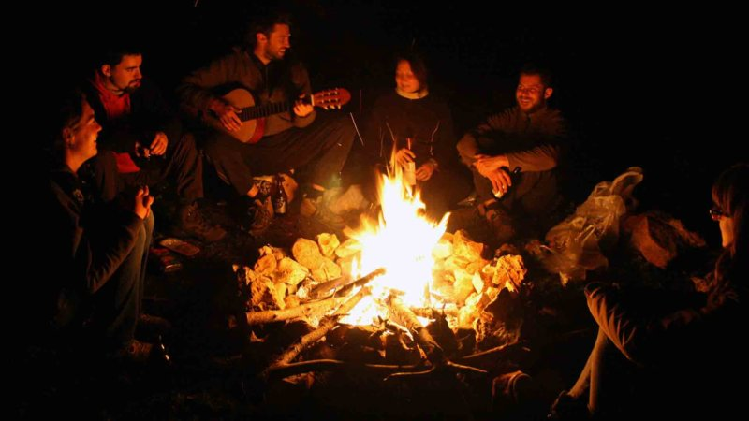

Slide 10
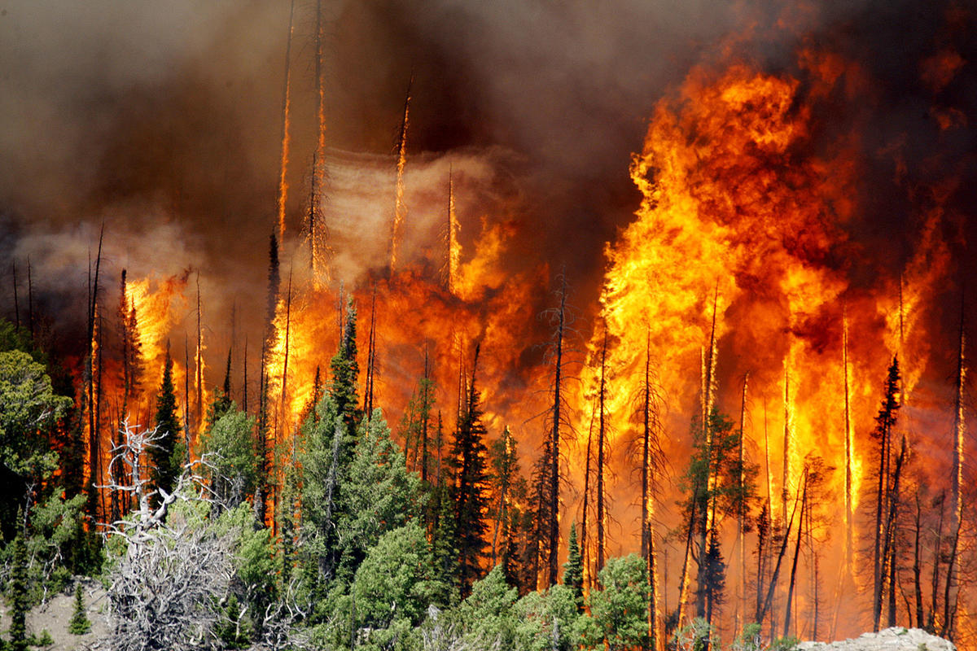

Slide 11
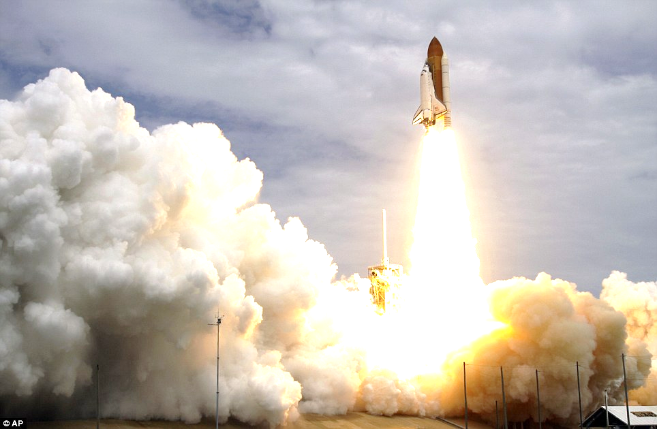
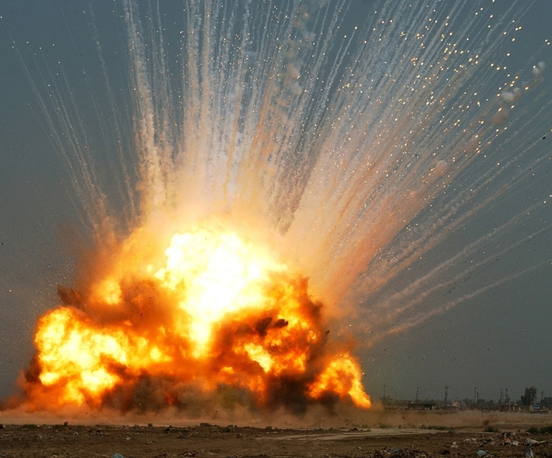

Slide 12
Proverbs 15:1 NIV A gentle answer turns away wrath, but a harsh word stirs up anger.

Slide 13
Ecclesiastes 10:4 NLT If your boss is angry with you, don't quit! A quiet gentle spirit can overcome even great mistakes.

Slide 15
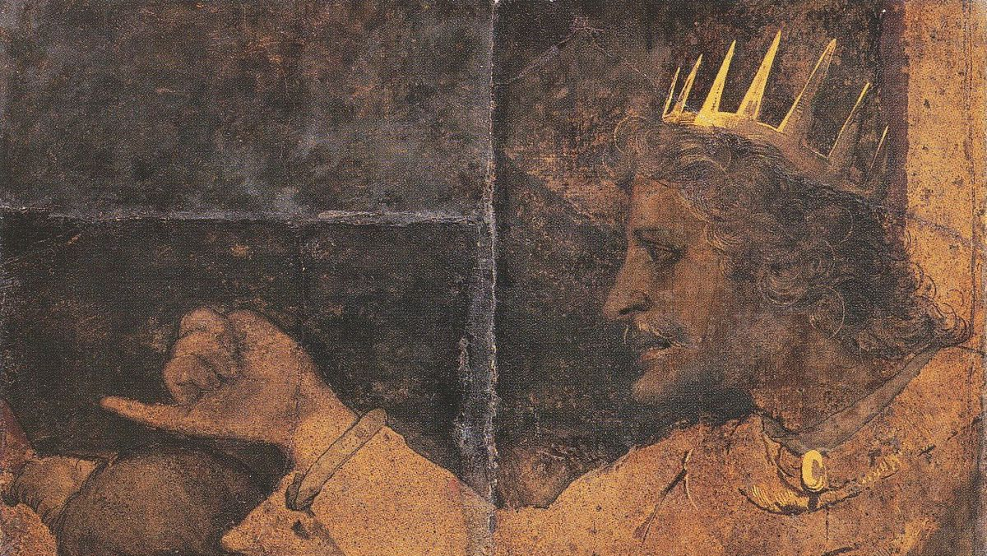
1 Kings 12:4-5 NLT “Your father was a hard master,” they said. “Lighten the harsh labor demands and heavy taxes that your father imposed on us. Then we will be your loyal subjects.”
Rehoboam replied, “Give me three days to think this over. Then come back for my answer.” So the people went away.

Slide 16
1 Kings 12:6-7 NLT Then King Rehoboam discussed the matter with the older men who had counseled his father, Solomon. “What is your advice?” he asked. “How should I answer these people?”
The older counselors replied, “If you are willing to be a servant to these people today and give them a favorable answer, they will always be your loyal subjects.”

Slide 17
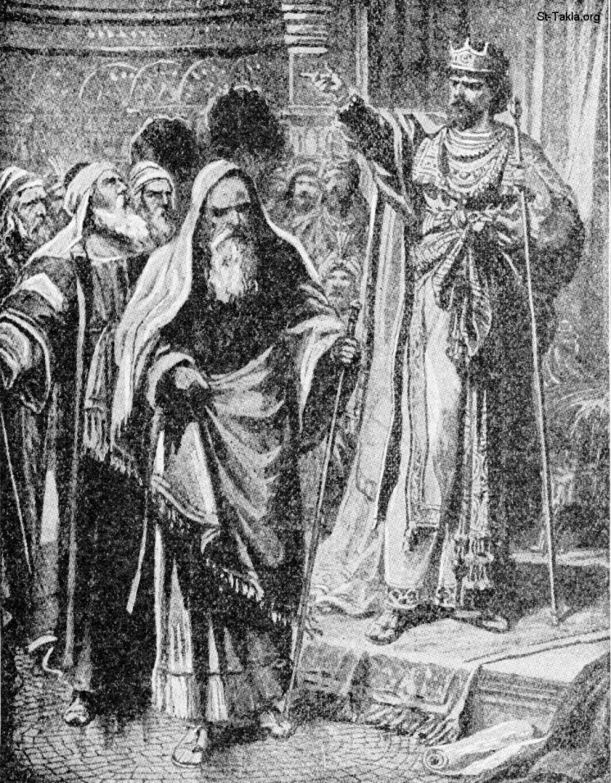
1 Kings 12:8-9 NLT But Rehoboam rejected the advice of the older men and instead asked the opinion of the young men who had grown up with him and were now his advisers. “What is your advice?” he asked them. “How should I answer these people who want me to lighten the burdens imposed by my father?”

Slide 18
1 Kings 12:10-11 NLT The young men replied, “This is what you should tell those complainers who want a lighter burden: ‘My little finger is thicker than my father’s waist! Yes, my father laid heavy burdens on you, but I’m going to make them even heavier! My father beat you with whips, but I will beat you with scorpions!’”

Slide 20
2
Be tender
without surrender

Slide 21
1 Corinthians 4:13 NLT We respond gently when evil things are said about us.

Slide 22
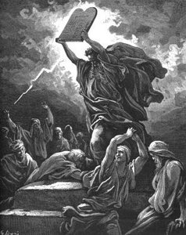
Number 12: 3 NLT (Now Moses was very humble—more humble than any other person on earth.)

Slide 24
3
Commit
acts of kindness

Slide 25
Ruth 2:13-14 NLT “You have comforted me by speaking so kindly to me, even though I am not one of your workers.”
At mealtime Boaz called to her, “Come over here, and help yourself to some food. You can dip your bread in the sour wine.” So she sat with his harvesters, and Boaz gave her some roasted grain to eat. She ate all she wanted and still had some left over.

Slide 28
1 Peter 3:4 NLT You should be known for the beauty that comes from within, the unfading beauty of a gentle and quiet spirit, which is so precious to God.

Slide 29
Colossians 3:19 NCV Husbands, love your wives and be gentle with them.
Ephesians 6:4 Amp
Fathers, do not irritate and provoke your children to anger. Do not exasperate them to resentment, but rear them tenderly in the training and discipline and counsel of the Lord.

Slide 31
4
Mimic
Jesus

Slide 32
Matthew 11:28-29 NIV
Come to me, all you who are weary and burdened, and I will give you rest. Take my yoke upon you and learn from me, FOR I AM GENTLE and humble in heart, and you will find rest for your souls.

Slide 34
5
Be
respectful

Slide 35
1 Peter 3:15-16 NLT And if someone asks about your hope as a believer, always be ready to explain it. But do this in a gentle and respectful way

Slide 36
1 Peter 2:18 NLT You who are slaves must submit to your masters with all respect. Do what they tell you—not only if they are kind and reasonable, but even if they are cruel.

Slide 37
Titus 3:2 ESV
…to speak evil of no one, to avoid quarreling, to be gentle, and to show perfect courtesy toward all people

