Slide 2
Matthew 5:3-6 (NLT)
“God blesses those who are poor and realize their need for him,
for the Kingdom of Heaven is theirs.
God blesses those who mourn, for they will be comforted.
God blesses those who are humble, for they will inherit the whole earth.
God blesses those who hunger and thirst for justice,
for they will be satisfied.”

Slide 3
Matthew 5:7-10 (NLT)
“God blesses those who are merciful,
for they will be shown mercy.
God blesses those whose hearts are pure,
for they will see God.
God blesses those who work for peace,
for they will be called the children of God.
God blesses those who are persecuted for doing right,
for the Kingdom of Heaven is theirs.”

Slide 4
Matthew 5:10 (NLT) “God blesses those who are persecuted for doing right, for the Kingdom of Heaven is theirs.”

Slide 5
How to
handle persecution

Slide 7
1
Refuse to
retaliate

Slide 8
2 Timothy 2:23-26 (new living translation)
“Again I say, don’t get involved in foolish, ignorant arguments that only start fights. A servant of the Lord must not quarrel but must be kind to everyone, be able to teach, and be patient with difficult people. Gently instruct those who oppose the truth. Perhaps God will change those people’s hearts, and they will learn the truth. Then they will come to their senses and escape from the devil’s trap. For they have been held captive by him to do whatever he wants.

Slide 9
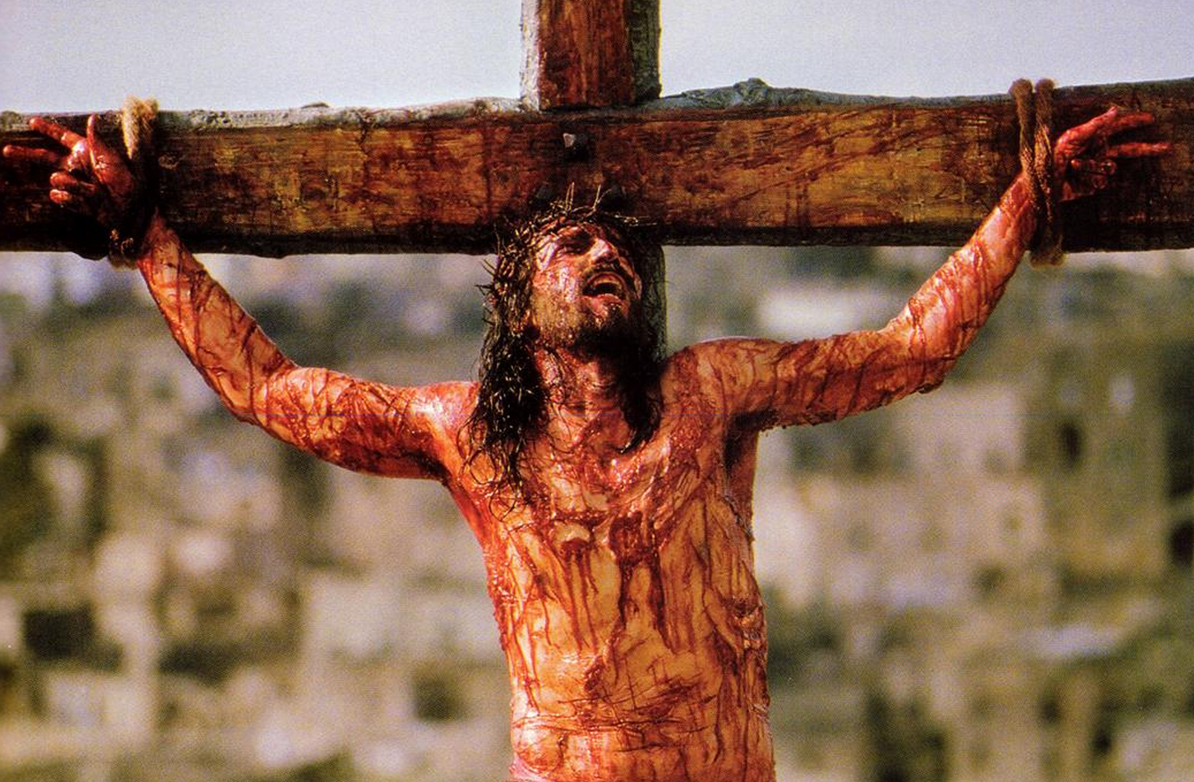
Jesus crucified

Slide 10
John Mark Dragged to death

Slide 11
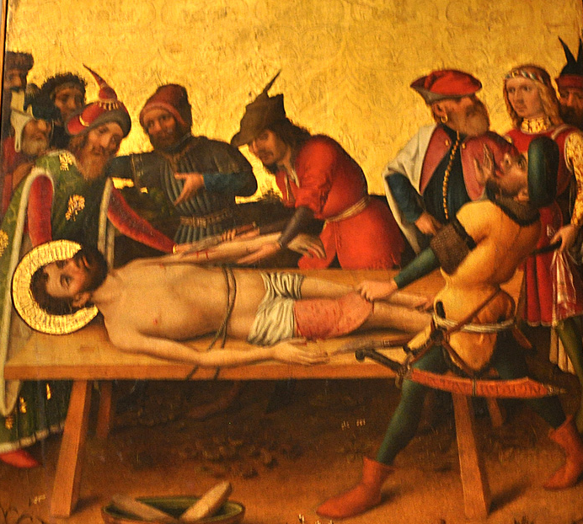
Bartholomew skinned alive

Slide 13
2
Overcome
evil with good

Slide 14
Romans 12:21 (English Standard Version)
“Do not be overcome by evil, but overcome evil with good.”

Slide 15
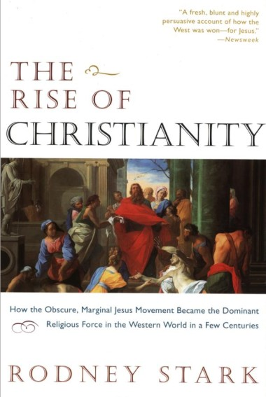
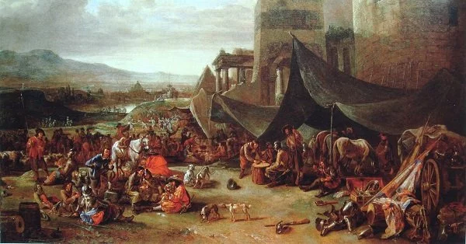

Slide 17
3
Don’t be
surprised

Slide 18
1 Peter 4:12 new living translation
“Beloved, do not be surprised at the fiery trial when it comes upon you to test you, as though something strange were happening to you.”

Slide 19
John 15:18-20 new living translation “If the world hates you, remember that it hated me first. The world would love you as one of its own if you belonged to it, but you are no longer part of the world. I chose you to come out of the world, so it hates you. Do you remember what I told you? ‘A slave is not greater than the master.’ Since they persecuted me, naturally they will persecute you. .”

Slide 21
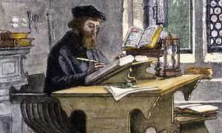

Slide 23
4
Keep your
focus on God

Slide 24
1 Peter 3:13-16 NLT
“Now, who will want to harm you if you are eager to do good? But even if you suffer for doing what is right, God will reward you for it. So don’t worry or be afraid of their threats. Instead, you must worship Christ as Lord of your life. And if someone asks about your hope as a believer, always be ready to explain it. But do this in a gentle and respectful way.”

Slide 25
1 Peter 3:13-16 NLT
“Now, who will want to harm you if you are eager to do good? But even if you suffer for doing what is right, God will reward you for it. So don’t worry or be afraid of their threats. Instead, you must worship Christ as Lord of your life. And if someone asks about your hope as a believer, always be ready to explain it. But do this in a gentle and respectful way.”

Slide 26
John Huss burned at the stake

Slide 28
5
Stand
firm

Slide 29
1 Peter 5:9 (NLT)
“Stand firm against him, and be strong in your faith. Remember that your family of believers all over the world is going through the same kind of suffering you are.”

Slide 30
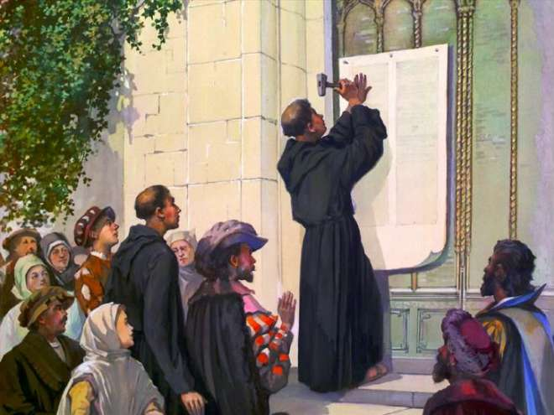
Martin Luther 95 theses October 31, 1517

Slide 31
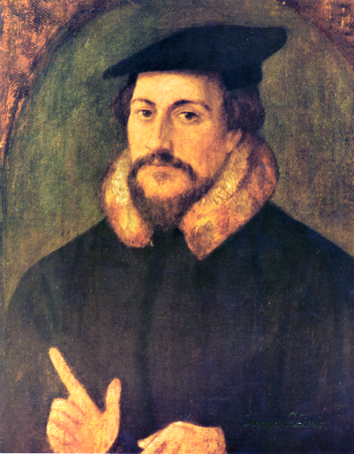
Ulrich Zwingli 1525 Switzerland
John Calvin 1534 Switzerland

Slide 33
6
Recognize the opposition
is from Satan

Slide 34
Revelation 12:9-10 (NLT)
“This great dragon—the ancient serpent called the devil, or Satan, the one deceiving the whole world…the accuser of our brothers and sisters has been thrown down to earth—the one who accuses them before our God day and night.”

