Slide 3
Living in the goodness of God
DON’T FEAR THE REAPER
OR
WHY YOU DON’T NEED TO FEAR YOUR FUTURE

Slide 4
DON’T FEAR THE REAPER
Blue Oyster Cult, 1976

Slide 5
THANATOPHOBIA:
The fear of death

Slide 6
Psalm 23

Slide 7
"The Lord is my Shepherd. I have everything I need. He makes me lie down in green pastures. He leads me beside still waters. He restores my soul. He leads me in the right path for His name's sake. Even when I walk through the valley of the shadow of death, I will fear no evil, for You are with me. Your rod and Your staff comfort me. You prepare a banquet for me in front of my enemies. You anoint my head with oil, and my cup overflows. Surely, goodness and mercy will follow me all the days of my life, and I will dwell in the house of the Lord forever."

Slide 8
Psalm 23

Slide 9
BECAUSE GOD’S GOODNESS
IS WATCHING OVER ME
1

Slide 10
Roz
Monsters Inc.

Slide 11
The Lord watches over all who love Him.
PSALM 145:20

Slide 12
Psalm 23

Slide 13
Don’t forget to show hospitality to strangers, for some who have done this have entertained angels without realizing it!
HEBREWS 13:2

Slide 14
Psalm 23

Slide 15
BECAUSE GOD’S GRACE
IS WORKING IN ME
2

Slide 16
I will have mercy on you through my grace.
ISAIAH 60:10

Slide 17
Psalm 23

Slide 18
Kyoot video

Slide 19
Psalm 23

Slide 20
So, let us come boldly to the throne of our gracious God. There we will receive his mercy, and we will find grace to help us when we need it most.
HEBREWS 4:16

Slide 21
Psalm 23

Slide 22
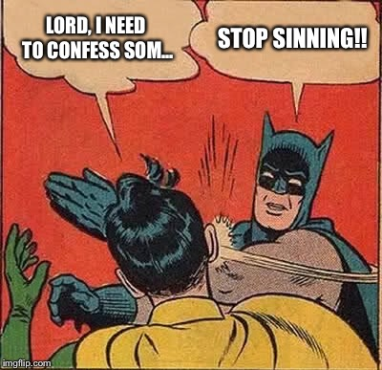

Slide 23
Psalm 23

Slide 24
BECAUSE GOD’S GLORY
IS WAITING FOR ME
3

Slide 25
The heavens declare the glory of God.
PSALM 19:1

Slide 26
Lord, look upon us from heaven, where you live in your holiness and glory.
Isaiah 63:15

Slide 27
How should I live?

Slide 28
I must stay grateful and generous
because God is so good to me
1

Slide 29
Give thanks continually to our Lord because he is so good, and because his mercy will never run out.
Psalm 118:29

Slide 30
Psalm 23

Slide 31
You have been treated generously so live generously. Give as freely as you have received.
Matthew 10:8

Slide 32
Psalm 23

Slide 33
Be gracious to everyone,
because God is so gracious with me
2

Slide 34
Instead, be kind to each other, tenderhearted, forgiving one another, just as God through Christ has forgiven you.
Ephesians 4:32

Slide 35
Such love has no fear, because perfect love expels all fear. If we are afraid, it is for fear of punishment, and this shows that we have not fully experienced his perfect love.
1 John 4:18

Slide 36
Live my life for God’s glory
because he’s going to share his glory with me
3

Slide 37
Let your good deeds shine for all to see, so that everyone will praise your heavenly Father.
Matthew 5:16

Slide 38
Psalm 23

