Slide 1
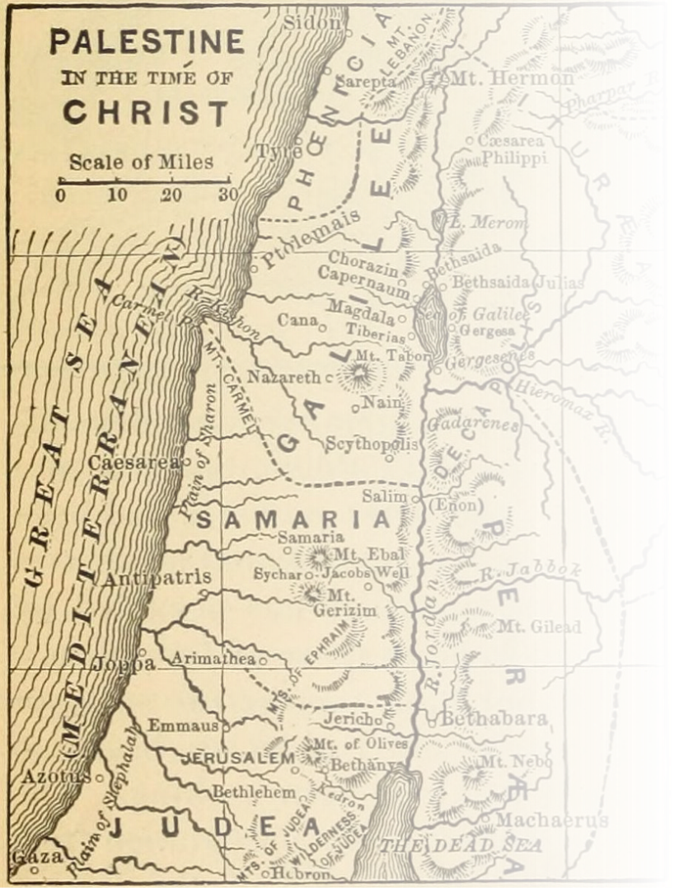
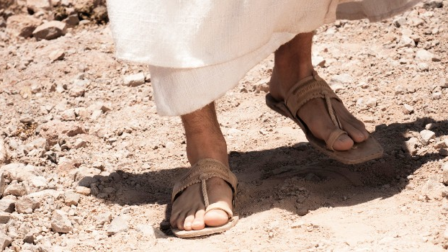
Where Jesus Walked
40 days in the footsteps of Christ

Slide 2
Barriers
Where Jesus Walked

Slide 3
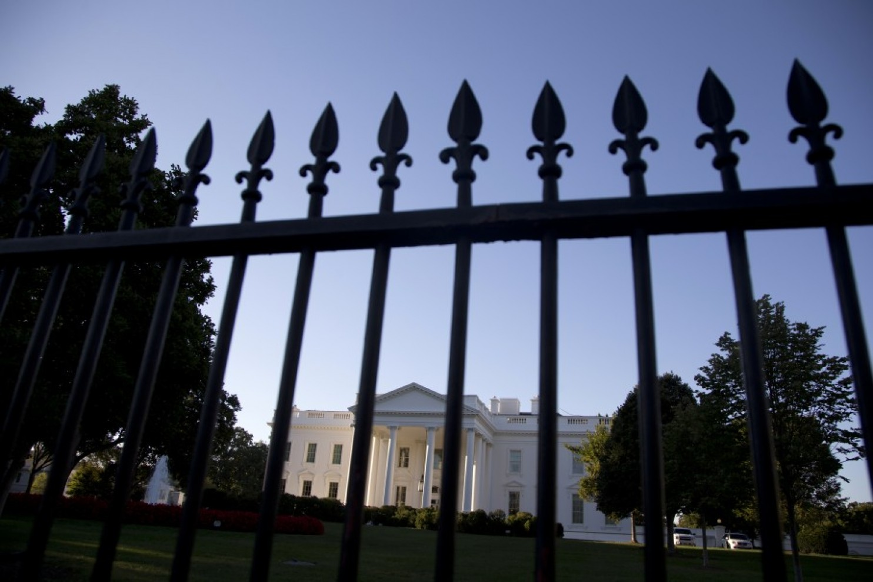

Slide 4
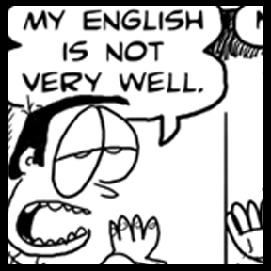

Slide 5
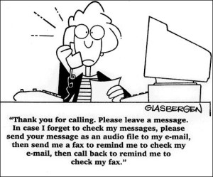

Slide 6
The Setting
As Jesus was leaving the Temple that day, one of his disciples said, “Teacher, look at these magnificent buildings! Look at the impressive stones in the walls.”
Mark 13:1 New Living Translation

Slide 7
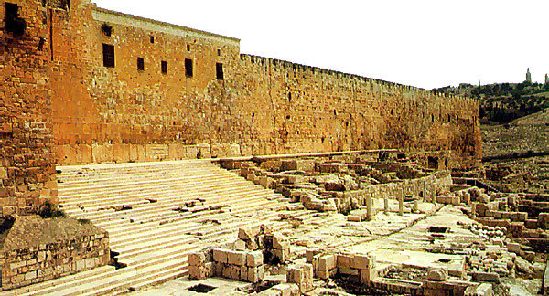

Slide 8
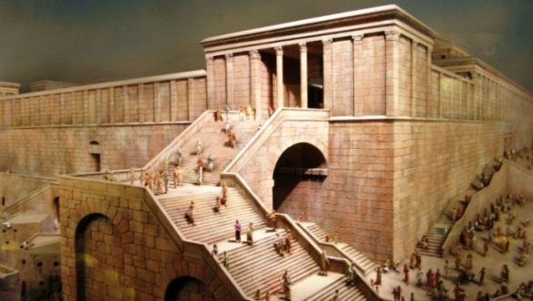

Slide 9
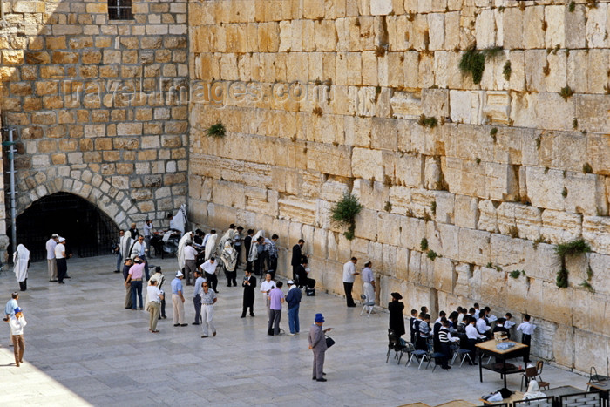

Slide 10
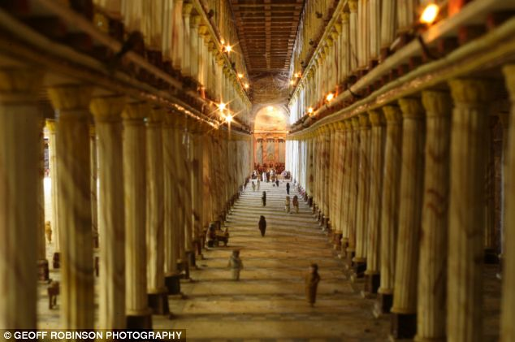

Slide 11
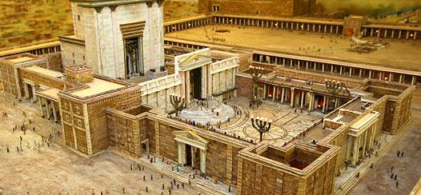

Slide 12
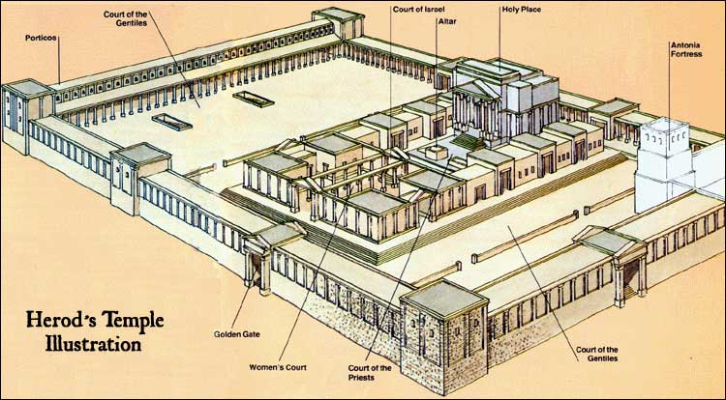

Slide 13
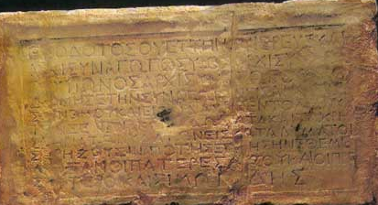
NO FOREIGNER IS TO GO BEYOND THE BALUSTRADE AND THE PLAZA OF THE TEMPLE ZONE WHOEVER IS CAUGHT DOING SO WILL HAVE HIMSELF TO BLAME FOR HIS DEATH WHICH WILL FOLLOW

Slide 14
” Jesus replied, “Yes, look at these great buildings. But they will be completely demolished. Not one stone will be left on top of another!”
Mark 13:2 New Living Translation

Slide 15
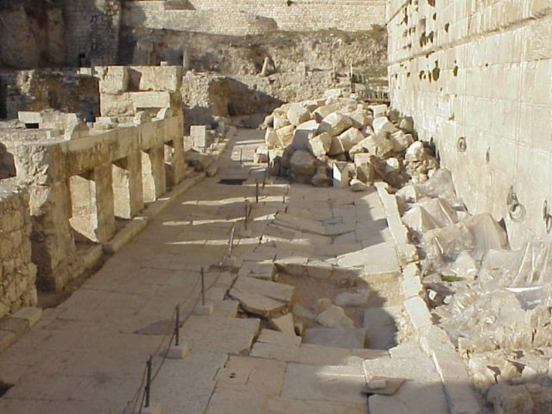
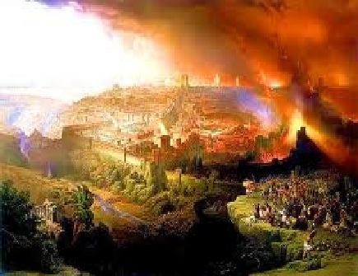
Jerusalem 70 ad

Slide 16
The Temple Represented…
• The place of God’s presence
• The means of atonement
• The center of community
• The promise of better things

Slide 17
“The day is coming,” says the Lord, “when I will make a new covenant with the people of Israel and Judah. ³² This covenant will not be like the one I made with their ancestors when I took them by the hand and brought them out of the land of Egypt. … But this is the new covenant I will make with the people of Israel…I will put my instructions deep within them, and I will write them on their hearts. I will be their God, and they will be my people….and I will forgive their wickedness, and I will never again remember their sins.”
Jeremiah 31:31-34 New Living Translation

Slide 18
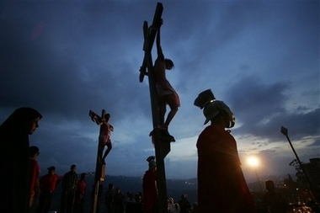
Because of Jesus’ sacrifice on the cross…

Slide 19
1
We have God’s Presence

Slide 20
“Then Jesus shouted out again, and he released his spirit. At that moment the curtain in the sanctuary of the Temple was torn in two, from top to bottom.”
Matthew 27:50-51 New Living Translation

Slide 21
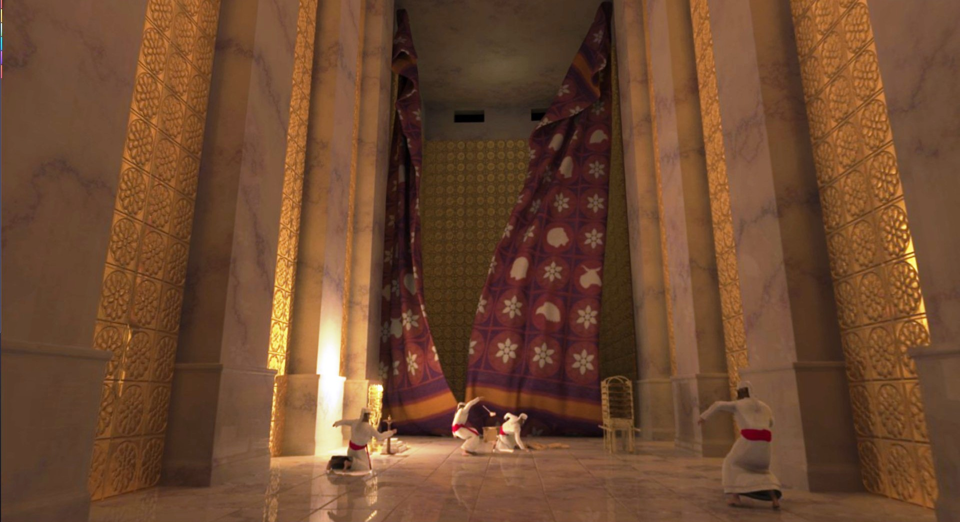
60 feet high, 30 feet wide, 300 priests to hang it, thick as a man’s hand.

Slide 22
“In Christ Jesus you who once were far away have been brought near through the blood of Christ. For he himself is our peace, who has made the two one and has destroyed the barrier, the dividing wall…”
Ephesians 2:13-14 New International Version

Slide 23
2
We have atonement for our sins

Slide 24
He took some bread and gave thanks to God for it. Then he broke it in pieces and gave it to the disciples, saying, “This is my body, which is given for you. Do this to remember me.” After supper he took another cup of wine and said, “This cup is the new covenant between God and his people—an agreement confirmed with my blood, which is poured out as a sacrifice for you.
Luke 22:19-20 New Living Translation

Slide 25
Atonement
…to reestablish the original relationship between God and man by dealing with sin. To atone means to make amends--to repair a wrong done. Biblically, it means to remove guilt of man.

Slide 26
3
We have center for Community life

Slide 27
“This is my body, which is given for you. Do this to remember me.”
Luke 22:19 New Living Translation

Slide 28
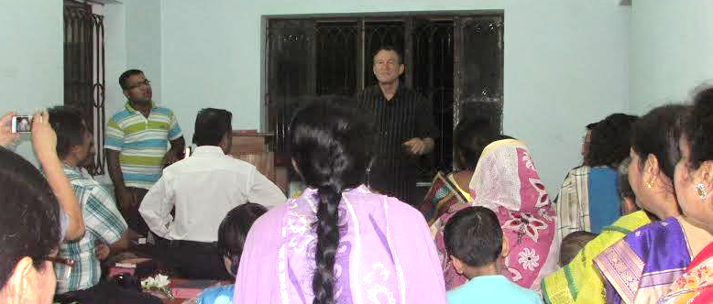

Slide 29
4
We have the promise of better things

Slide 30
“I tell you the truth, I will not drink wine again until the day I drink it new in the Kingdom of God.”
Mark 14:25 New Living Translation

Slide 31
I am going to prepare a place for you? When everything is ready, I will come and get you, so that you will always be with me where I am.
John 14:2-3 New Living Translation

Slide 32
The twelve gates were made of pearls—each gate from a single pearl! And the main street was pure gold, as clear as glass. I saw no temple in the city, for the Lord God Almighty and the Lamb are its temple.
Revelation 21:21-22 New Living Translation

Slide 33
What are your barriers?
Guilt, past church experiences, pride, not Bible smart, addictions, etc…

Slide 34
So then, since we have a great High Priest who has entered heaven, Jesus the Son of God, let us hold firmly to what we believe. This High Priest of ours understands our weaknesses, for he faced all of the same testings we do, yet he did not sin. So let us come boldly to the throne of our gracious God. There we will receive his mercy, and we will find grace to help us when we need it most.
Hebrews 4:14-16 New Living Translation

Slide 35
For God has not given us a spirit of fear and timidity, but of power, love, and self-discipline.
2 Timothy 1:7
New Living Translation

Slide 36
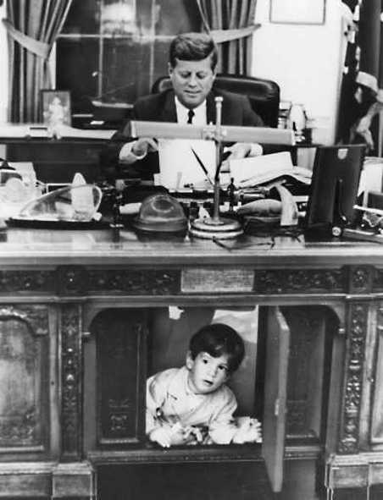
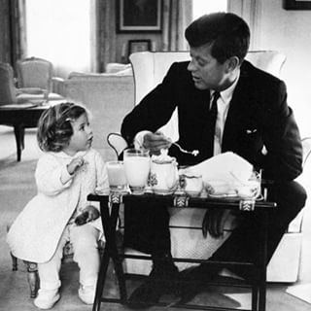

Slide 37
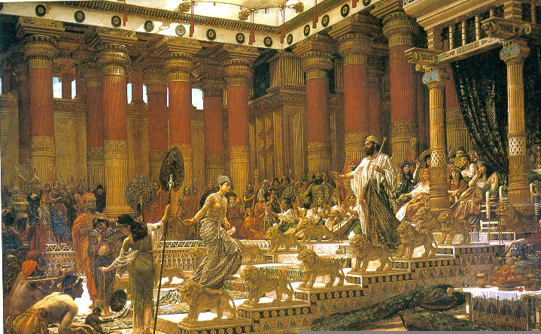

Slide 38
Through Jesus, God has removed all the barriers. Boldly Come to the Throne of God.

Slide 39
Where Jesus Walked
40 days in the footsteps of Christ

