Slide 2
Worship Christ as Lord of your life. And if someone asks about your hope as a believer, always be ready to explain it.
1 Peter 3:15
NEW LIVING TRANSLATION

Slide 3
Proclaiming the Gospel
TO A MUSLIM

Slide 4
“Go into all the world and proclaim the gospel to the whole creation.”
Mark 16:15
ENGLISH STANDARD VERSION

Slide 5
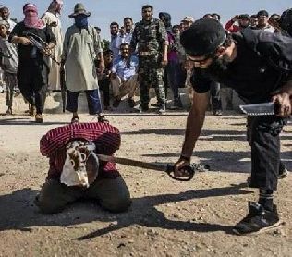
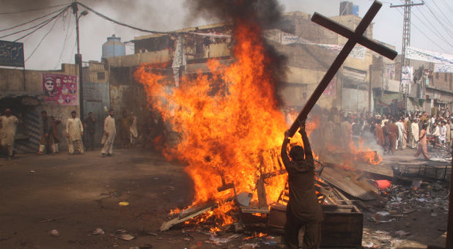

Slide 7
The difference between
CHRISTAINITY AND RELIGION

Slide 8
Every other religion teaches us to earn our way to God. Christianity is the only religion that teaches that God came to us
So the Word became human and made his home among us.
John 1:14
NEW LIVING TRANSLATION

Slide 9
2. Other religions have systems of rules to appease their god. Christianity is a relationship with God.
But to all who believed him and accepted him, he gave the right to become children of God.
John 1:12
NEW LIVING TRANSLATION

Slide 10
3. No other religion has an empty tomb. We’re the only people who follow a leader who died and came back to life.

Slide 11
I passed on to you what was most important and what had also been passed on to me. Christ died for our sins, just as the Scriptures said. He was buried, and he was raised from the dead on the third day, just as the Scriptures said. He was seen by Peter and then by the Twelve.
1 Corinthians 15:3-5
NEW LIVING TRANSLATION

Slide 13
Be
INFORMED

Slide 14
“Men of Athens, I notice that you are very religious in every way, for as I was walking along I saw your many shrines. And one of your altars had this inscription on it: ‘To an Unknown God.’ This God, whom you worship without knowing, is the one I’m telling you about.”
Acts 17:22-23
NEW LIVING TRANSLATION

Slide 16
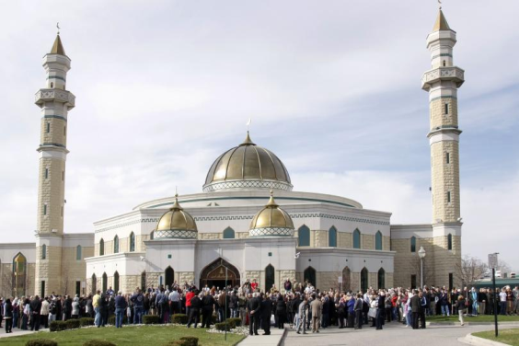
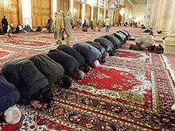
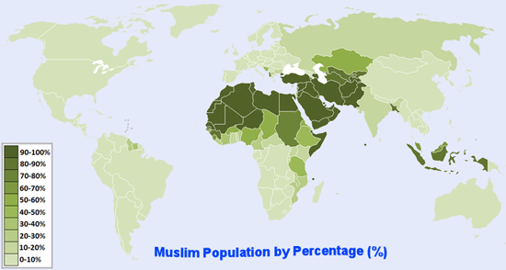

Slide 17
Articles of Belief
1. Allah Alone is God 2. Messengers and Prophets 3. Koran is the holy book 4.Angels 5. Day of Judgment 6. Degrees of Allah

Slide 18
Duties
Reciting the Shahadah Prayer
Alms Fasting Pilgrimage to Mecca

Slide 20
Avoid
ARGUMENTS

Slide 21
Again I say, don’t get involved in foolish, ignorant arguments that only start fights. A servant of the Lord must not quarrel but must be kind to everyone, be able to teach, and be patient with difficult people.
2 Timothy 2:23-24
NEW LIVING TRANSLATION

Slide 23
Be ready to
ANSWER

Slide 24
Worship Christ as Lord of your life. And if someone asks about your hope as a believer, always be ready to explain it.
1 Peter 3:15
NEW LIVING TRANSLATION

Slide 26
Be
RESPECTFUL

Slide 27
“And if someone asks about your hope as a believer, always be ready to explain it. But do this in a gentle and respectful way.”
1 Peter 3:15-16
NEW LIVING TRANSLATION

Slide 29
Be an
EXAMPLE

Slide 30
So we are Christ’s ambassadors; God is making his appeal through us. We speak for Christ when we plead, “Come back to God!”
2 Corinthians 5:20
NEW LIVING TRANSLATION

Slide 32
Proclaim
JESUS

Slide 33
We are here to proclaim that through this man Jesus there is forgiveness for your sins.
Acts 13:38
NEW LIVING TRANSLATION

Slide 34
The ones who follow Jesus of Nazareth.

Slide 36
"There is now no condemnation for those who are in Christ Jesus"
Romans 8:1
NEW INTERNATIONAL VERSION

Slide 38
Invite them to
CHURCH

Slide 39
“Nazareth!” exclaimed Nathanael. “Can anything good come from Nazareth?” “Come and see for yourself,” Philip replied.
John 1:46
NEW LIVING TRANSLATION

Slide 41
PRAY
for them

Slide 42
The earnest prayer of a righteous person has great power and produces wonderful results.
James 5:16
NEW LIVING TRANSLATION

Slide 44
https://www.youtube.com/watch?v=BQ6H_684nsQ Pastor Naeem Fazal

