Slide 2
GET
BACK UP

Slide 4
1
SEIZE
OPPORTUNITIES

Slide 5
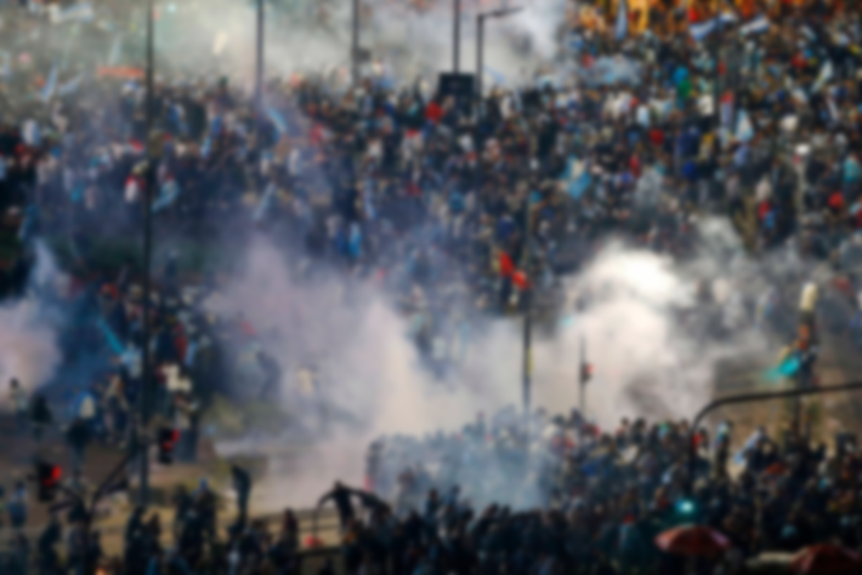
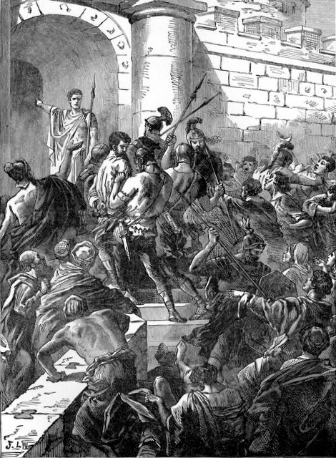
RIOT IN JERUSALEM

Slide 6
“Please, let me talk to these people.” The commander agreed, so Paul stood on the stairs and motioned to the people to be quiet. Soon a deep silence enveloped the crowd, and he addressed them in their own language, Aramaic.
Acts 21:39 new living translation

Slide 7
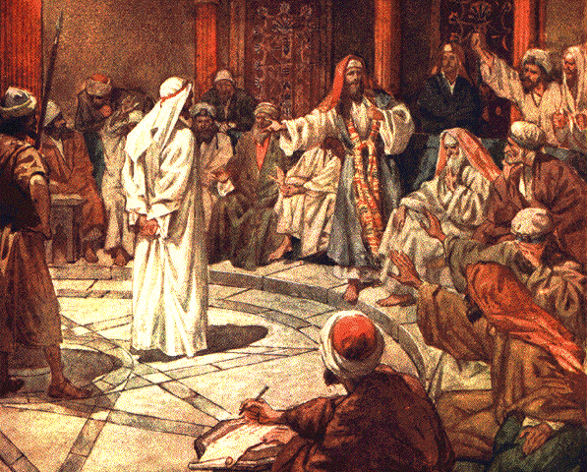
Gazing intently at the high council, Paul began: “Brothers, I have always lived before God with a clear conscience!”
Acts 23:1 new living translation

Slide 8
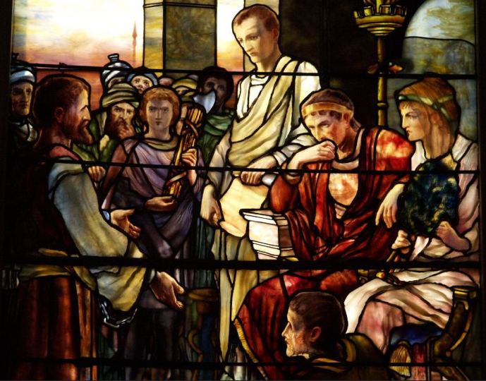
A few days later Felix came back with his wife, Drusilla, who was Jewish. Sending for Paul, they listened as he told them about faith in Christ Jesus. As he reasoned with them about righteousness and self-control and the coming day of judgment, Felix became frightened. “Go away for now,” he replied. “When it is more convenient, I’ll call for you again.” He also hoped that Paul would bribe him, so he sent for him quite often and talked with him.
Acts 24:24-26 new living translation

Slide 9
Then Agrippa said to Paul, “You may speak in your defense.”
So Paul, gesturing with his hand, started his defense: “I am fortunate, King Agrippa, that you are the one hearing my defense today against all these accusations made by the Jewish leaders, for I know you are an expert on all Jewish customs and controversies. Now please listen to me patiently!
Acts 26:1-3 new living translation

Slide 10
http://www.tlc.org/acts/

Slide 11
2
TAKE
COURAGE

Slide 12
That night the Lord appeared to Paul and said, “Be encouraged, Paul. Just as you have been a witness to me here in Jerusalem, you must preach the Good News in Rome as well.”
Acts 23:11 new living translation

Slide 14
“Courage is not the absence of fear but rather the judgment that something is more important than fear.”

Slide 15
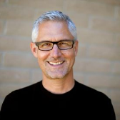
Just because you’ve made decisions that may now seem unwise doesn't mean you are permanently disqualified from service to God.
-Rene Schlaepfer Pastor, Twin Lakes Church, Aptos, CA

Slide 17
3
CONDUCT YOURSELF
NOBLY

Slide 18
Gazing intently at the high council, Paul began: “Brothers, I have always lived before God with a clear conscience!”
Instantly Ananias the high priest commanded those close to Paul to slap him on the mouth. But Paul said to him, “God will slap you, you corrupt hypocrite! What kind of judge are you to break the law yourself by ordering me struck like that?” Those standing near Paul said to him, “Do you dare to insult God’s high priest?”
“I’m sorry, brothers. I didn’t realize he was the high priest,” Paul replied, “for the Scriptures say, ‘You must not speak evil of any of your rulers.’”
Acts 23:1-5 new living translation

Slide 19
Above all, you must live as citizens of heaven, conducting yourselves in a manner worthy of the Good News about Christ.
Philippians 1:27 new living translation

Slide 20
Be careful to live properly among your unbelieving neighbors. Then even if they accuse you of doing wrong, they will see your honorable behavior, and they will give honor to God when he judges the world.
1 Peter 2:12 new living translation

Slide 21
In the same way, you wives must accept the authority of your husbands. Then, even if some refuse to obey the Good News, your godly lives will speak to them without any words. They will be won over by observing your pure and reverent lives.
1 Peter 3:1-2 new living translation

Slide 23
4
TAKE TIME TO
LEARN

Slide 24
"he left Paul in prison."
Acts 24:27 new living translation

Slide 25
We can rejoice, too, when we run into problems and trials, for we know that they help us develop endurance. And endurance develops strength of character, and character strengthens our confident hope of salvation. And this hope will not lead to disappointment.
Romans 5:3-5 new living translation

Slide 27
Determine the Reason

Slide 28
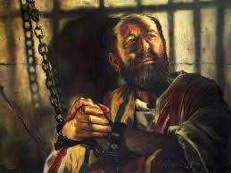
Determine the Reason
Determine the Response

Slide 29
nick

Slide 30
God will never waste an experience.
“He comforts us in all our troubles so that we can comfort others.”
2 Corinthians 1:4 new living translation

