Slide 4
The Lord is my shepherd; I shall not want.
He maketh me to lie down in green pastures: he leadeth me beside the still waters.
He restoreth my soul: he leadeth me in the paths of righteousness for his name's sake.
Yea, though I walk through the valley of the shadow of death, I will fear no evil:
for thou art with me;
thy rod and thy staff they comfort me.
Psalm 23:1-4 (KJV)

Slide 5
Thou preparest a table before me
in the presence of mine enemies:
thou anointest my head with oil;
my cup runneth over.
Surely goodness and mercy shall follow me
all the days of my life:
and I will dwell in the house of the Lord for ever.
Psalm 23:5-6 (KJV)

Slide 6
Psalm 23

Slide 7
Living in the goodness of God
Letting God Meet My Needs

Slide 8
Psalm 23

Slide 9
Three facts About God’s Goodness

Slide 10
Three facts About God’s Goodness
-GOD IS THE SOURCE OF EVERYTHING WE NEED
“The Lord is my shepherd, I have all I need.”
Psalm 23:1

Slide 11
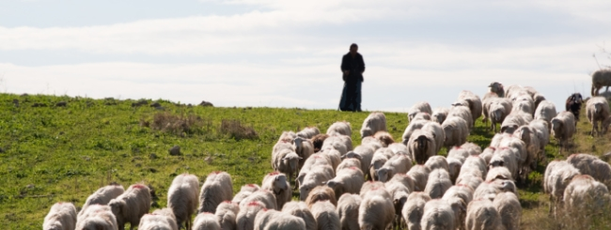

Slide 12
What do shepherds do?

Slide 13
What do shepherds do?
FEED, LEAD, AND MEET NEEDS

Slide 14
Three facts About God’s Goodness
-GOD IS THE SOURCE OF EVERYTHING WE NEED

Slide 15
Three facts About God’s Goodness
-GOD IS THE SOURCE OF EVERYTHING WE NEED -THERE IS NOTHING WE NEED GOD CAN’T SUPPLY
“And this same God who takes care of me will supply all your needs from his glorious riches” Philippians 4:19

Slide 16
Three facts About God’s Goodness
-GOD IS THE SOURCE OF EVERYTHING WE NEED -THERE IS NOTHING WE NEED GOD CAN’T SUPPLY -GOD DOESN’T WANT ME TO WORRY EVER
“Don’t worry about anything!” PHILIPPIANS 4:6

Slide 17
Psalm 23

Slide 18
WHY GOD SAYS NOT TO WORRY

Slide 19
WORRY IS UNIMPORTANT
“That is why I tell you not to worry about everyday life—whether you have enough food and drink, or enough clothes to wear. Isn’t life more than food, and your body more than clothing?
Matthew 6:25

Slide 20
Psalm 23

Slide 21
WORRY IS UNNATURAL
“Look at the birds.
They don’t plant or harvest or store food in barns,
for your heavenly Father feeds them. Matthew 6:26

Slide 23
Look at the lilies of the field and how they grow. They don’t work or make their clothing,
yet Solomon in all his glory was not dressed as beautifully as they are.
Matthew 6:28-29

Slide 25
Psalm 23

Slide 26
WORRY DOESN’T WORK
Can all your worries
add a single moment to your life?
Matthew 6:27

Slide 27
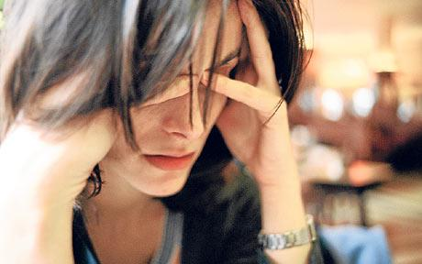
“Worry weighs a person down”
Proverbs 12:25

Slide 28
Psalm 23

Slide 29
WORRY IS UNNECESSARY
And aren’t you far more valuable to him than they are?
Matthew 6:27

Slide 30
Psalm 23

Slide 31
WORRY DOESN’T WORK
Can all your worries
add a single moment to your life?
Matthew 6:27

Slide 32
Psalm 23

Slide 33
WORRY IS UNBELIEF
So don’t worry about these things, saying, ‘What will we eat? What will we drink? What will we wear?’ These things dominate the thoughts of unbelievers…
Matthew 6:31-32

Slide 34
Psalm 23

Slide 35
“Don’t let your hearts be troubled.
Trust in God, and trust also in me.”
John 14:1

Slide 36
Psalm 23

Slide 37
HOW TO TRUST JESUS TO MEET MY NEEDS

Slide 38
EVERYDAY ASK GOD
1
TO BE YOUR SHEPHERD
The Lord is my shepherd….
Psalm 23:1

Slide 39
“I am the good shepherd; I know my own sheep, and they know me, and I lay down my life for my sheep.”
John 10:14-15

Slide 40
Psalm 23

Slide 41
VALUE WHAT GOD VALUES
2
Seek the Kingdom of God above all else, and live righteously, and he will give you everything you need.
Matthew 6:33

Slide 42
Psalm 23

Slide 43
LET WORRY BE A REMINDER
3
TO PRAY AND RELAX
Don’t worry about anything; instead, pray about everything.
PHILIPPIANS 4:6

Slide 44
Hurry creates worry!

Slide 45
Psalm 23

Slide 46
PLAN AHEAD BUT
4
LIVE ONE DAY AT A TIME
So don’t worry about tomorrow, for tomorrow will bring its own worries. Today’s trouble is enough for today.
Matthew 6:34

Slide 47
Psalm 23

