Slide 2
THE CONQUEST BEGINS
HOW TO KNOCK DOWN A WALL

Slide 3
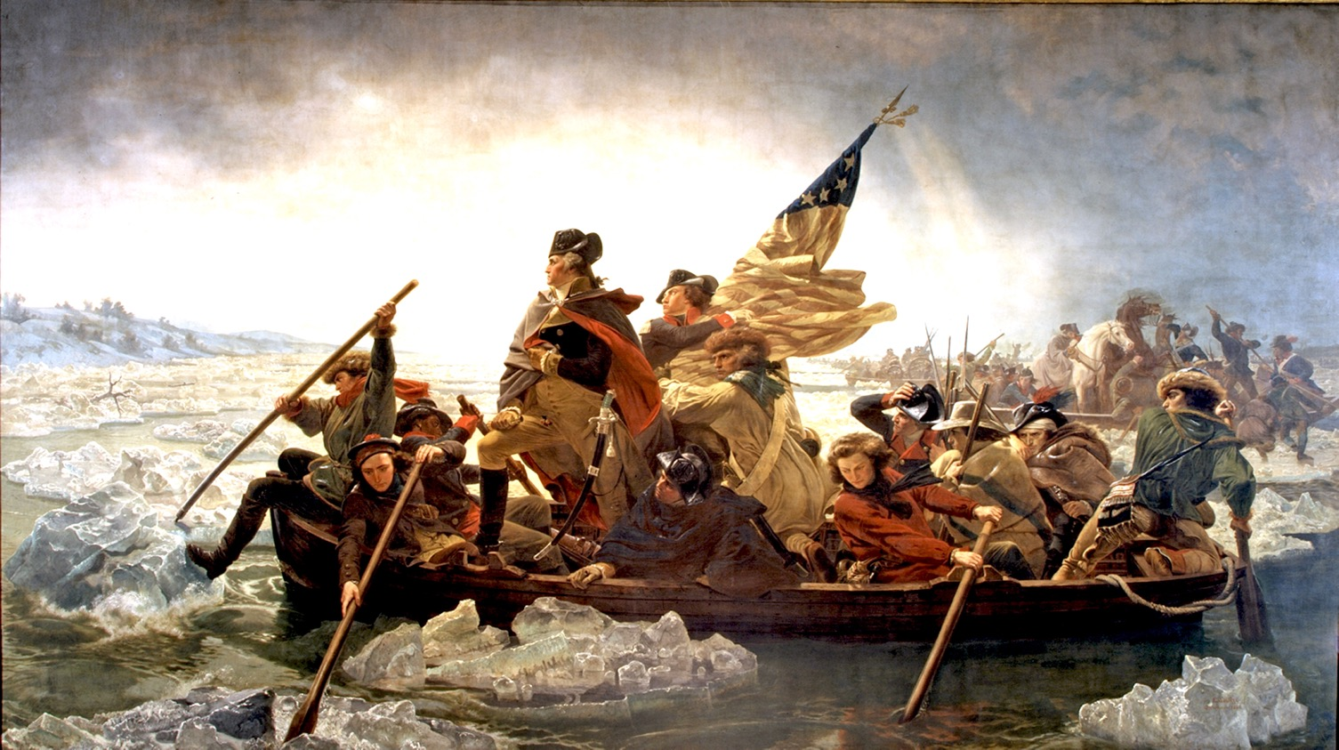

Slide 5
For we are not fighting against flesh-and-blood enemies, but against evil rulers and authorities of the unseen world, against mighty powers in this dark world, and against evil spirits in the heavenly places.
EPHESIANS 6:12
New Living Translation

Slide 6
1
BEFORE THE CHALLENGE
FIGHT FROM VICTORY, NOT JUST FOR VICTORY
Joshua 6:1-5

Slide 7
He defeated Satan in the wilderness (Matthew 4:1-11)
In His earthly ministry (Matthew 12:22-29)
On the cross (Colossians 2:13-15)
And in His resurrection (Ephesians 1:19-23)
And He lets us be on His team (Romans 8:31)

Slide 8
NEW YORK YANKEES
16 PLAYOFF APPEARANCES
5 WORLD SERIES CHAMPIONSHIPS
7 WORLD SERIES APPEARANCES
1995-2012

Slide 9
The fear of the Lord

Slide 10
The fear of the Lord
The promise of the Lord

Slide 11
I have told you all this so that you may have peace in me. Here on earth you will have many trials and sorrows. But take heart, because I have overcome the world.
JOHN 16:33
New Living Translation

Slide 12
The fear of the Lord
The promise of the Lord
The instructions of the Lord

Slide 15
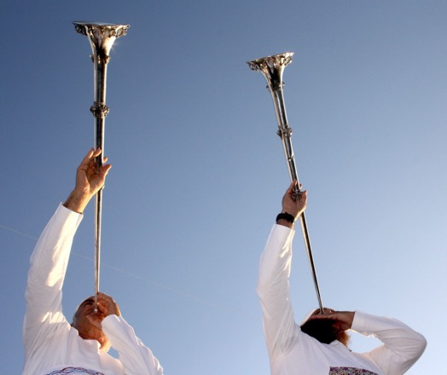
SHOFAR JOBEL

Slide 16
2
DURING THE CHALLENGE
YOU OVERCOME THE ENEMY BY FAITH
Joshua 6:6-16, 20

Slide 17
“Do not pray for easy lives, pray to be better men and women. Do not pray for tasks equal to your powers; pray for power equal to your tasks.”
PHILLIP BROOKS

Slide 18
3
AFTER THE CHALLENGE
OBEY GOD’S COMMANDS AND GIVE HIM THE GLORY
Joshua 6:17-19, 21-27

